Slide 1
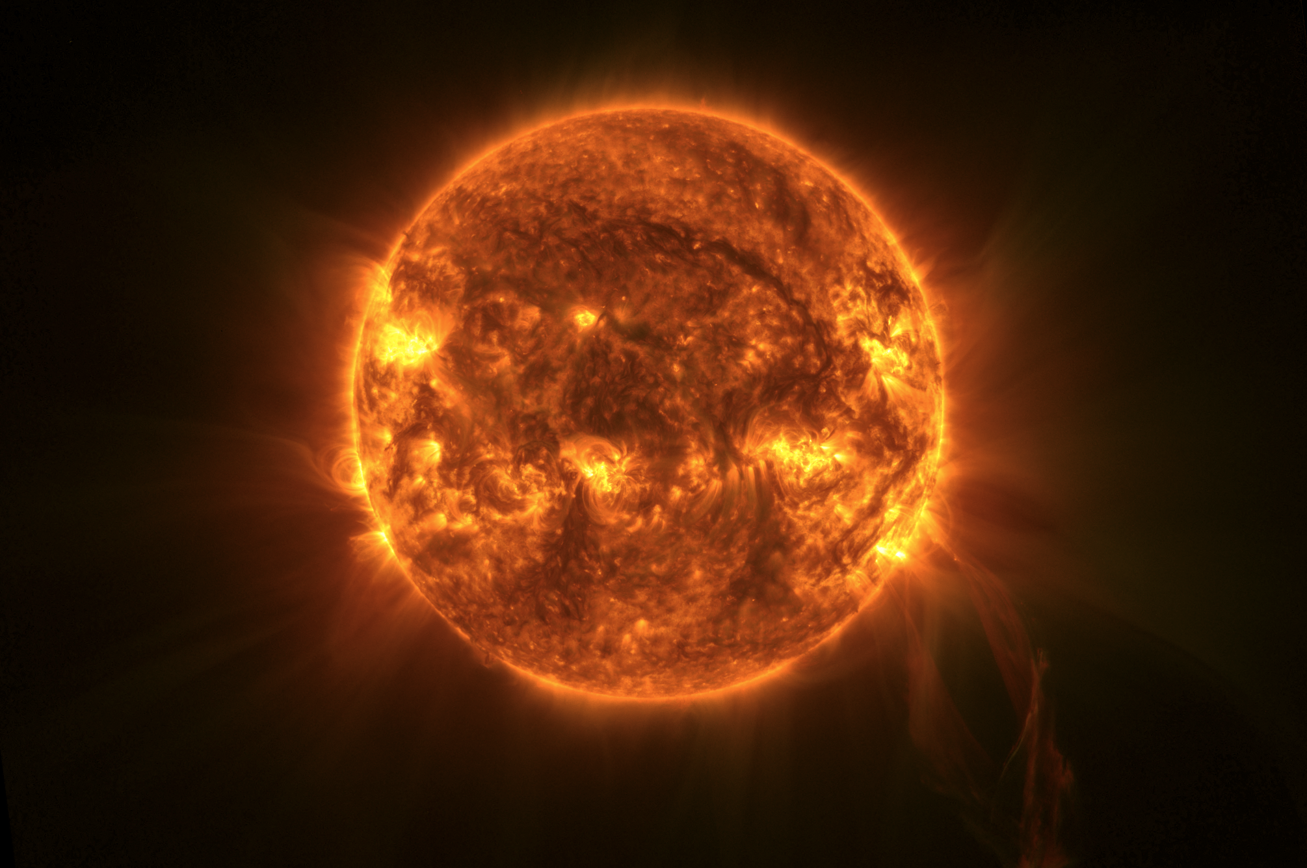
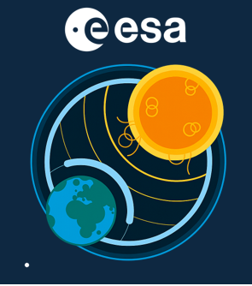



From EUI to JEDI: Why EUV observations away from the Sun–Earth line matter
Brenda D. Dorsch, Luciano Rodriguez, David Berghmans
ESA Space Weather Service Network Workshop 2026,
3-5 February 2026
Notes:
Solar Orbiter has crossed several time the L5 perspective from which Vigil will observe. Moreover the design of the JEDI EUV imager is directly derived from the EUI instrument on Solar Orbiter, in particular the FSI occulter for EUV coronagraphy.
In this presentation we will review relevant EUI observations and make an outlook to what JEDI will bring us.

Slide 2
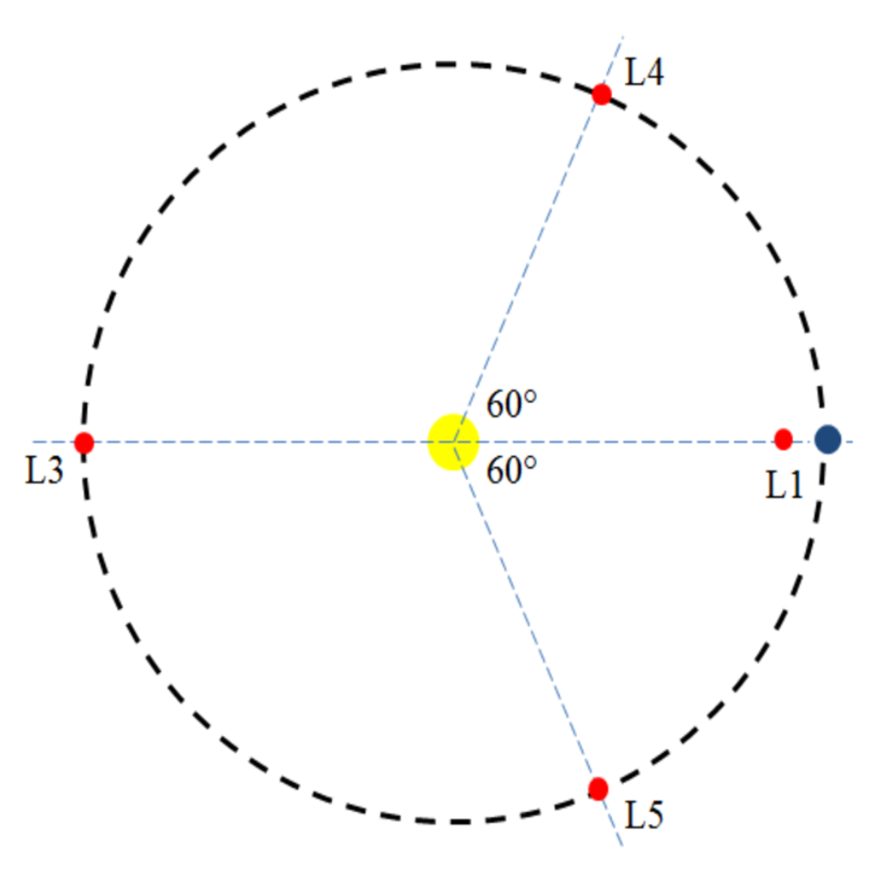
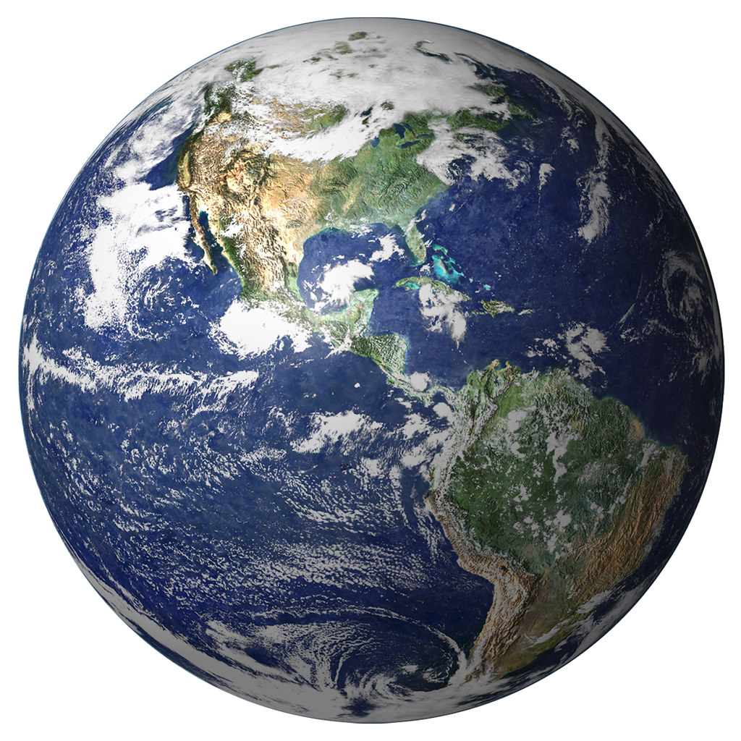
Brenda D. Dorsch – ESA Space Weather Service Network Workshop 2026

Slide 3
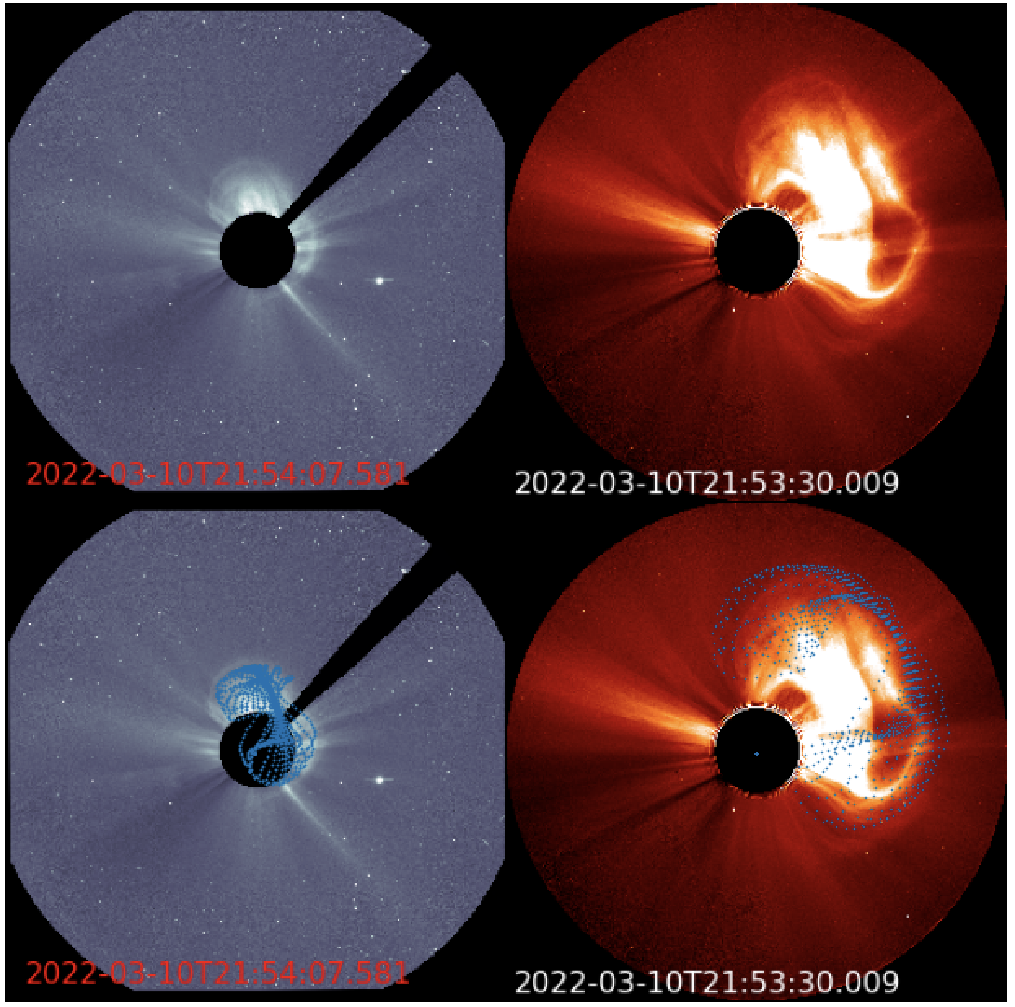
EUV observations for Space Weather
CME modelling
CME source region?
CME direction of propagation?
CME magnetic field orientation?
Coronagraph images are not sufficient.
Brenda D. Dorsch – ESA Space Weather Service Network Workshop 2026
Notes:
We observe a CME eruption with coronagraph images.
How do we know where is the CME originated?
To better asses the CME direction of propagation when performing CME 3D reconstruction for CME speed estimation.
Magnetogram is necessary but not enough to understand magntic field orientation.

Slide 4
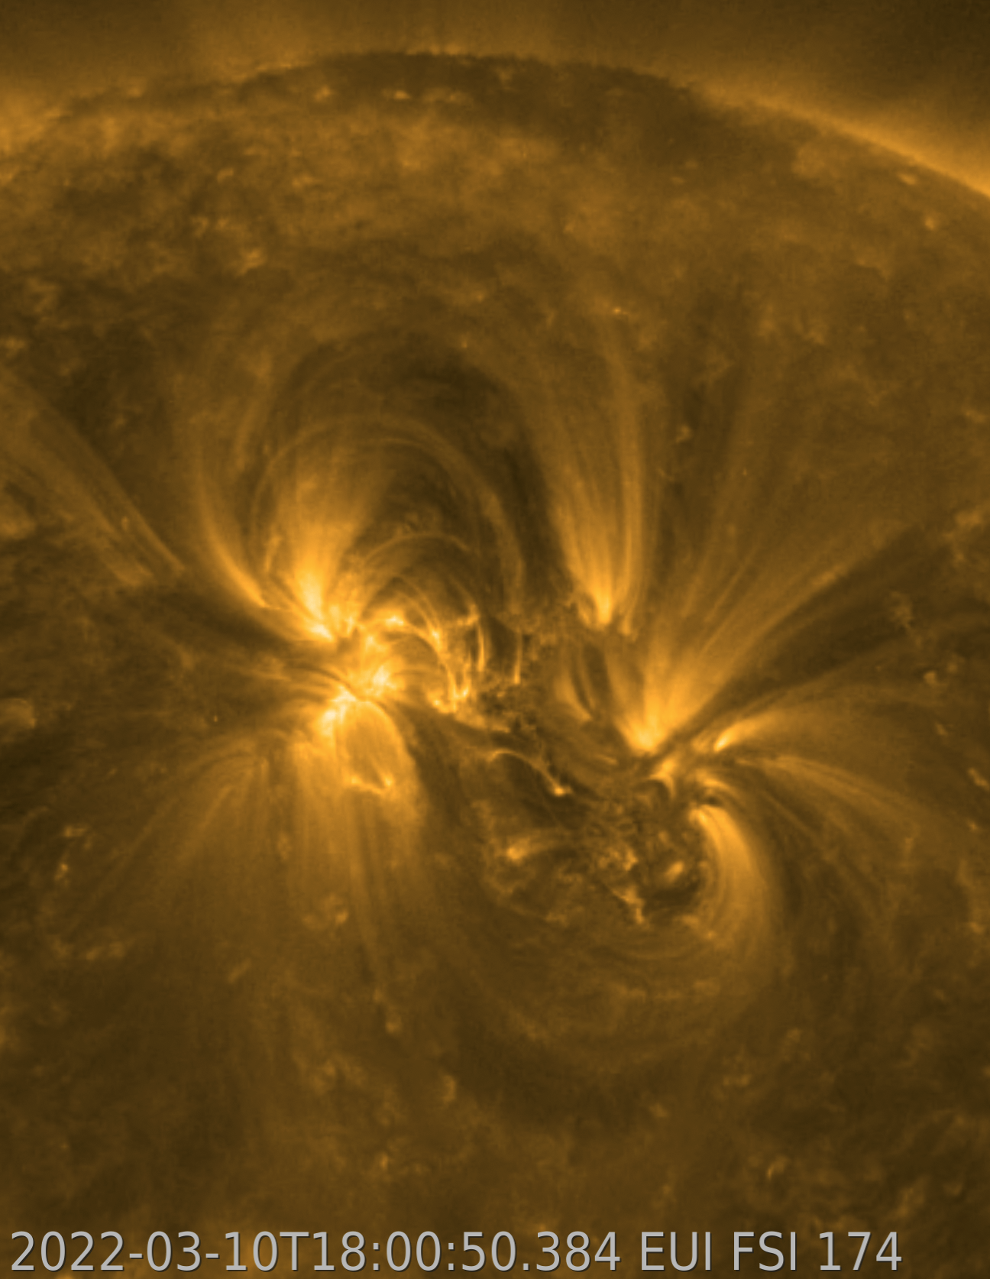
EUV observations for Space Weather
More accurate CME reconstruction for propagation direction and speed.
Brenda D. Dorsch – ESA Space Weather Service Network Workshop 2026

Slide 5
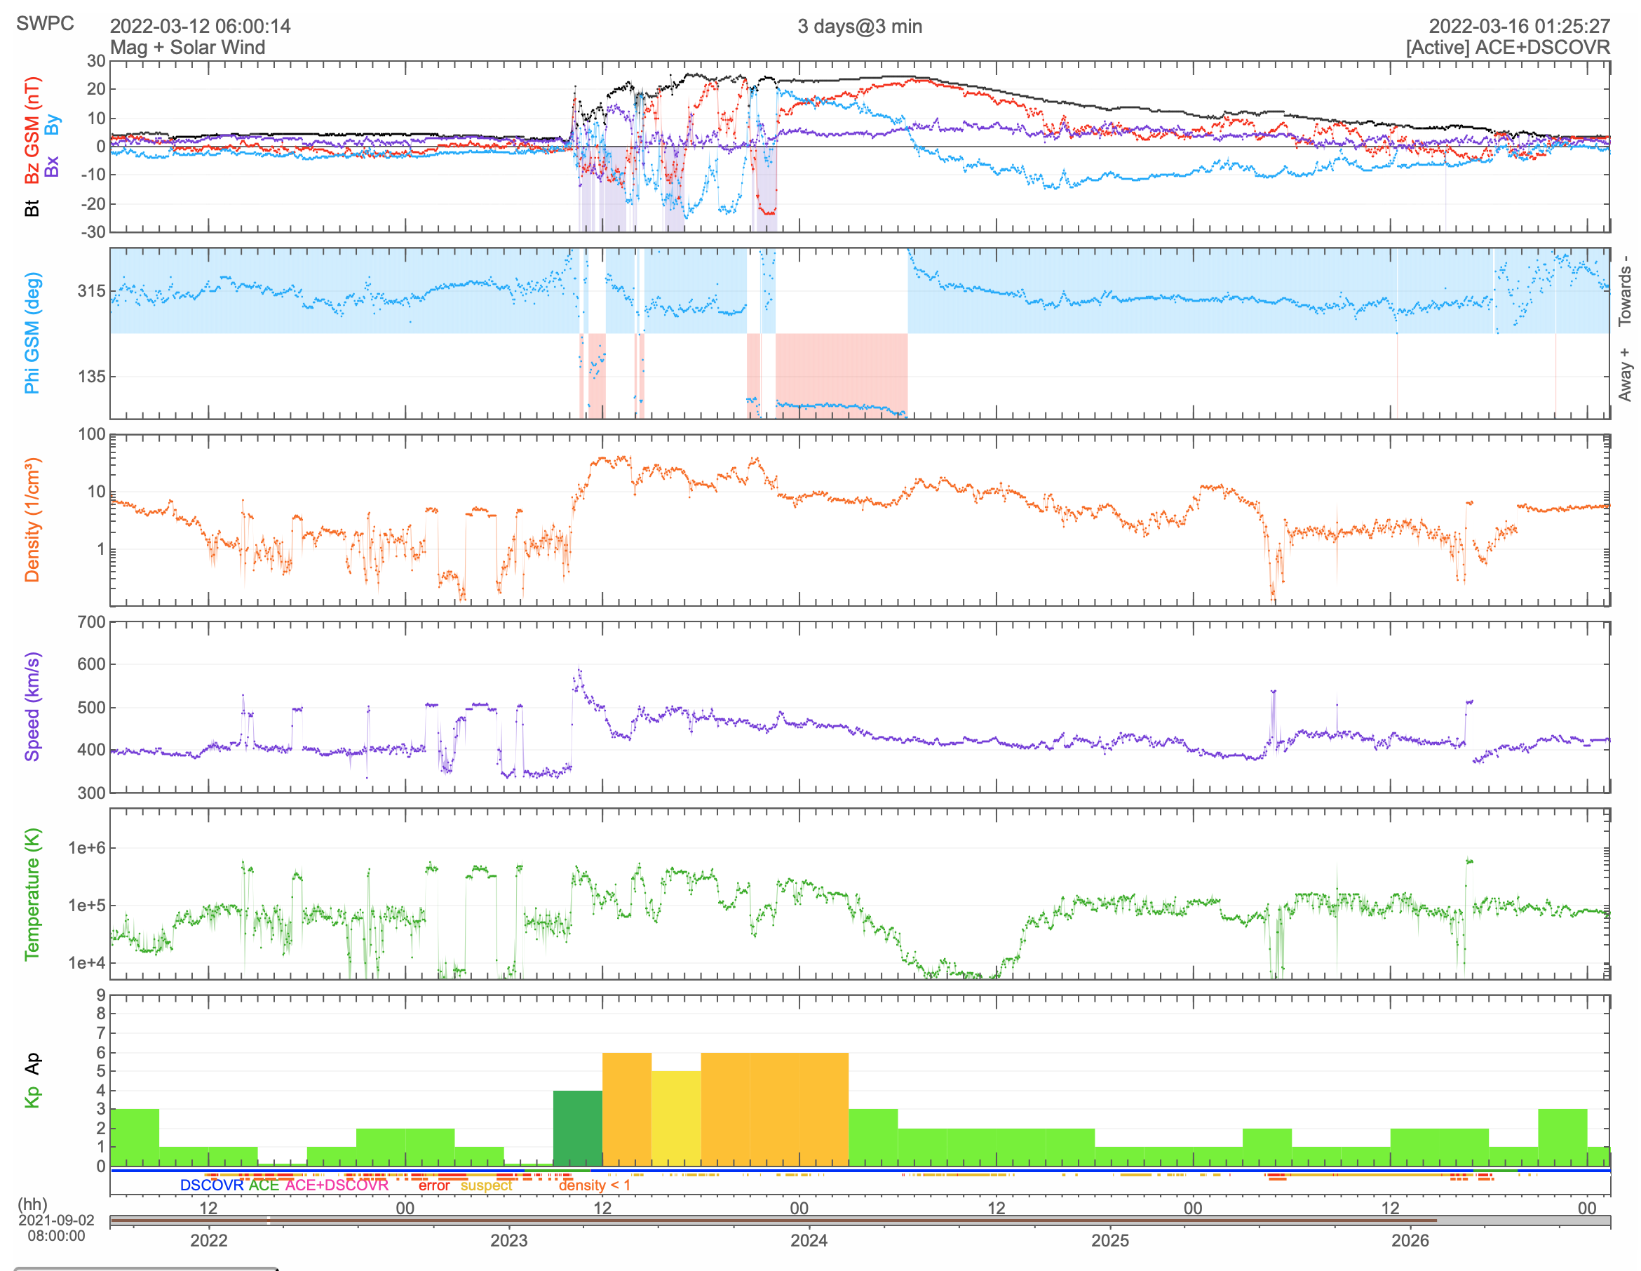
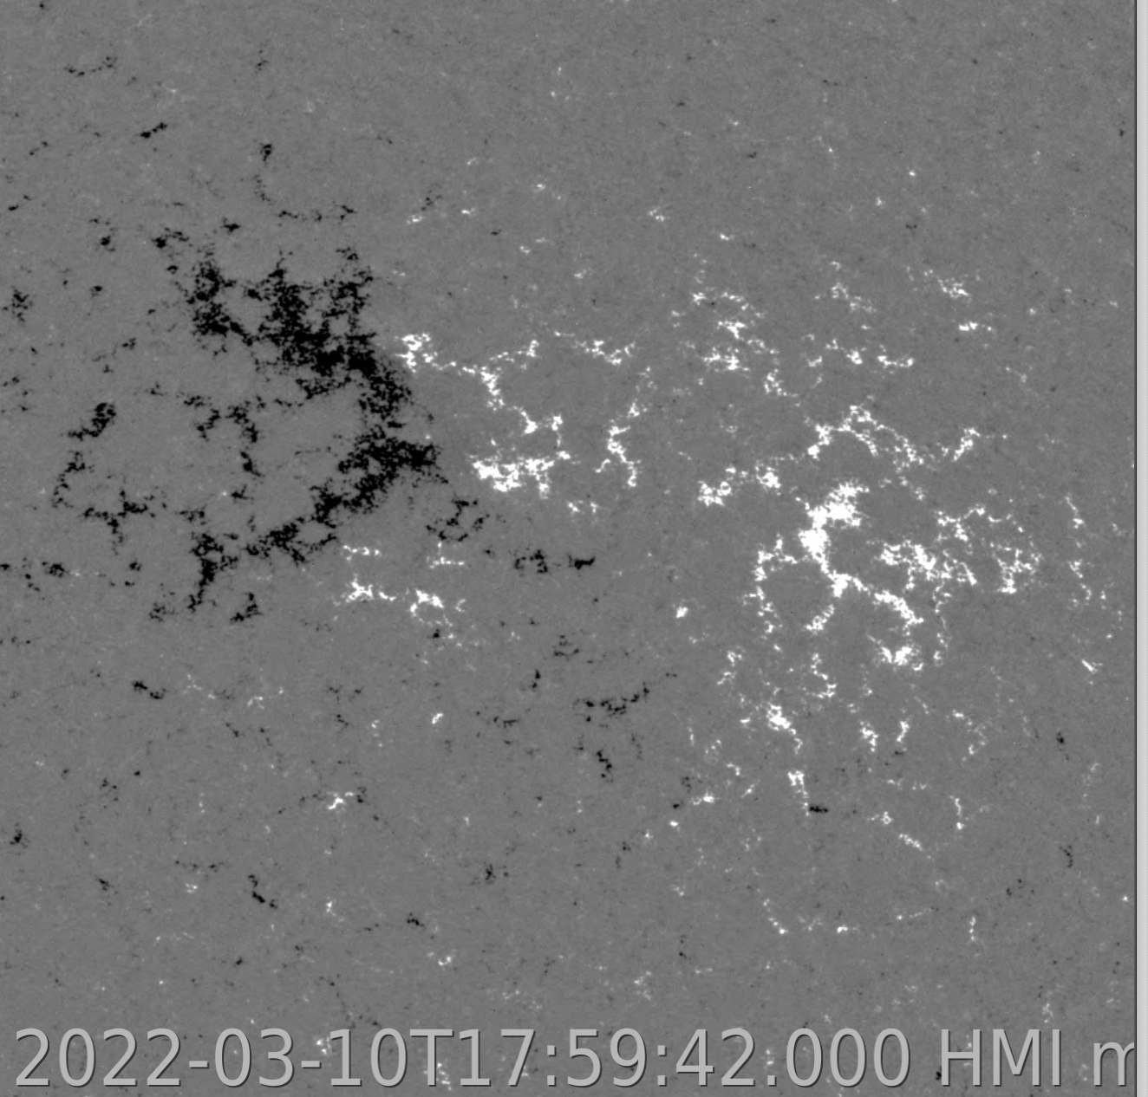
EUV observations for Space Weather
Bz component is predominantly positive.
Bz +
Understanding of magnetic field orientation is important to asses the ICME impact at Earth.
Brenda D. Dorsch – ESA Space Weather Service Network Workshop 2026

Slide 6
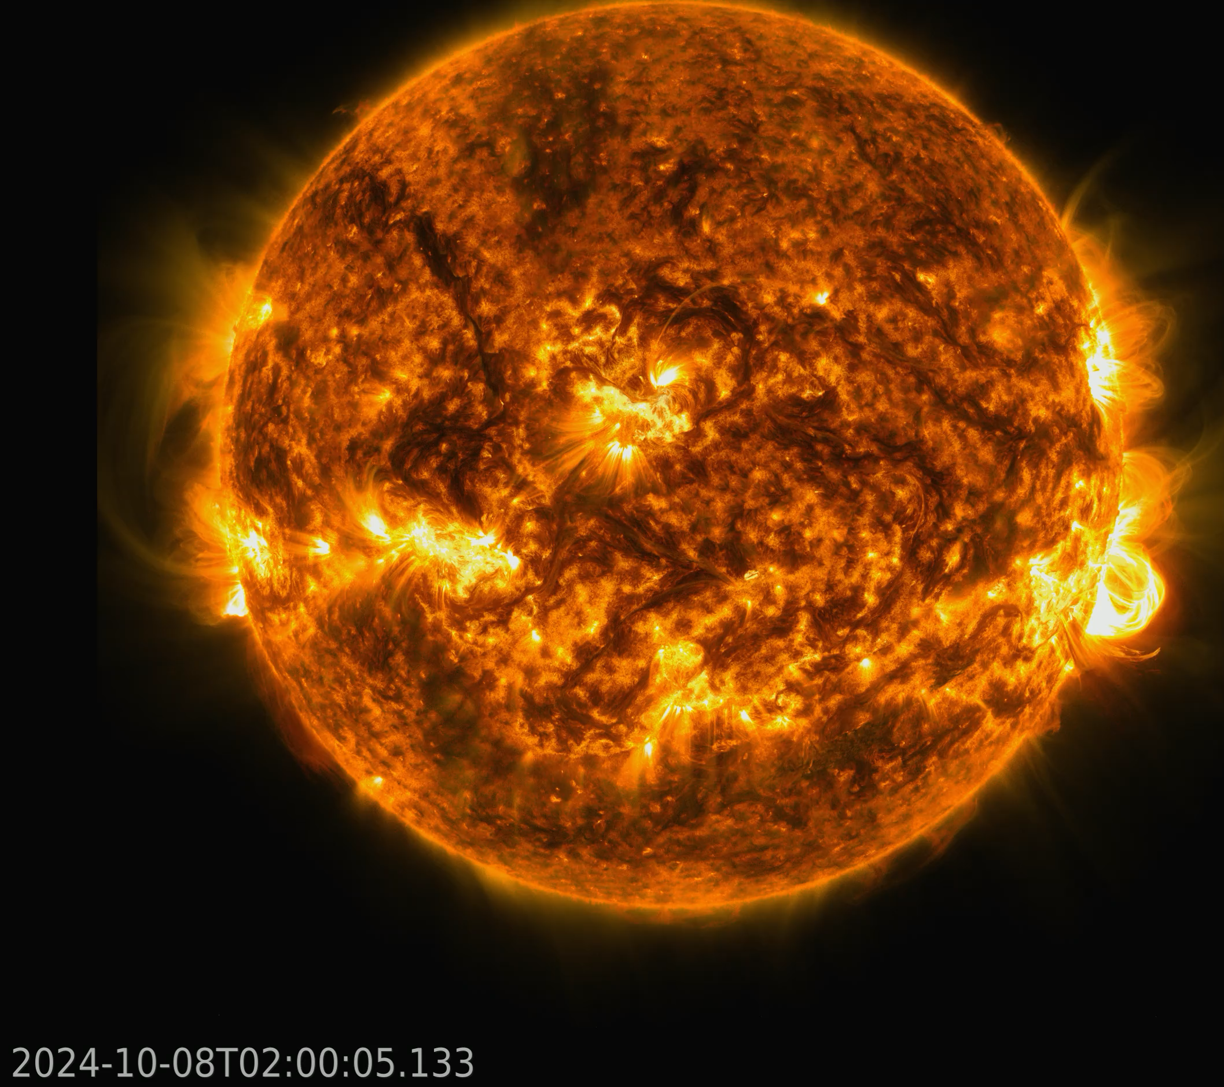
EUV from L5 perspective
AIA 171+304
Case of CME eruptions directed towards Earth.
L1 observations are important for diagnostic but front viewpoint does not allow to follow evolution of eruptions in the low corona.
Brenda D. Dorsch – ESA Space Weather Service Network Workshop 2026

Slide 7
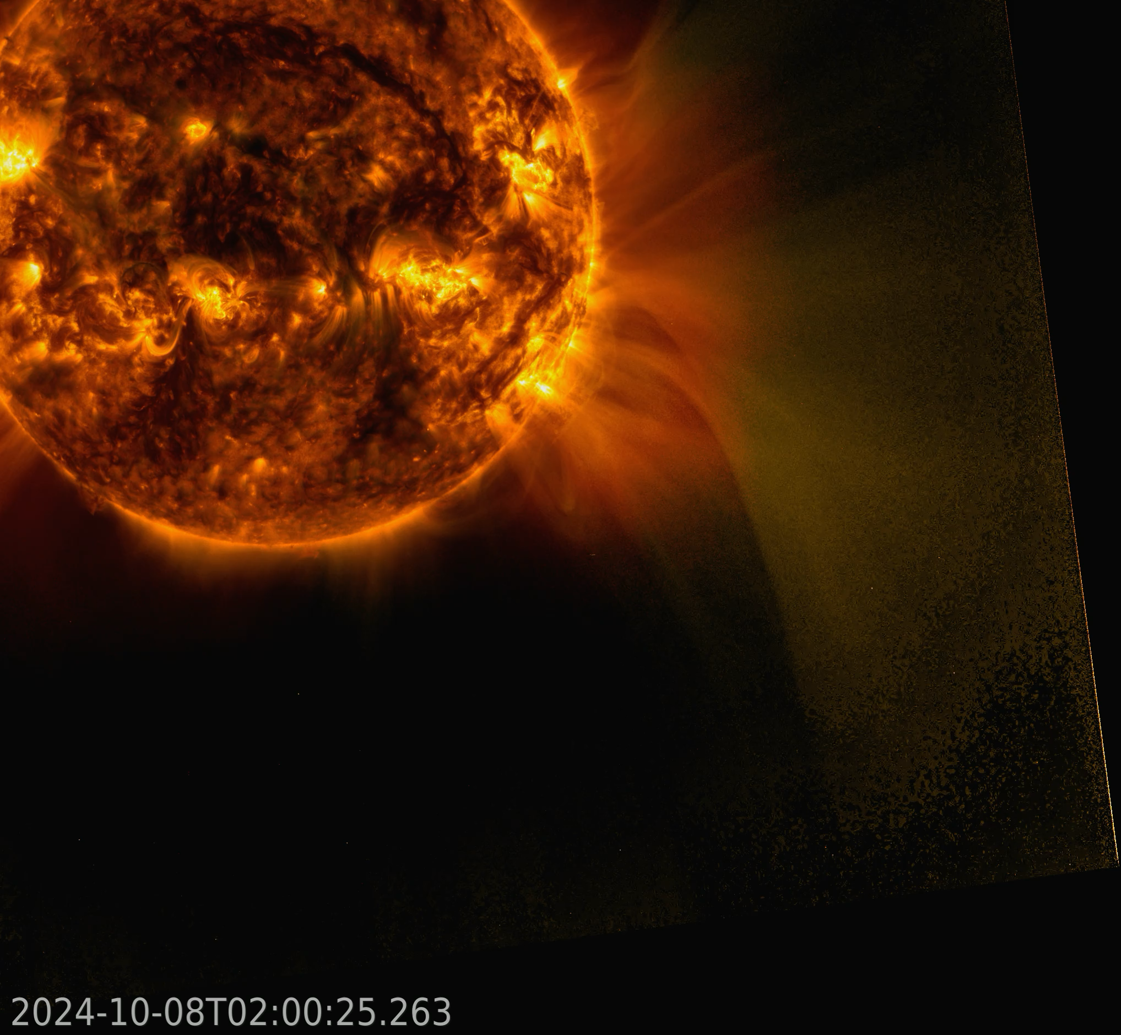
EUV from L5 perspective
EUI FSI 174+304
~ 59 separation angle
Sun-Earth line
Loop-like shape prominence material remains unchanged till ~1.8 Rs then it started to twist.
Magnetic field orientation changes.
Current improvement of magnetized CME models for Space Weather forecasting.
Magnetic field properties are key!
~3Rs
Brenda D. Dorsch – ESA Space Weather Service Network Workshop 2026

Slide 8
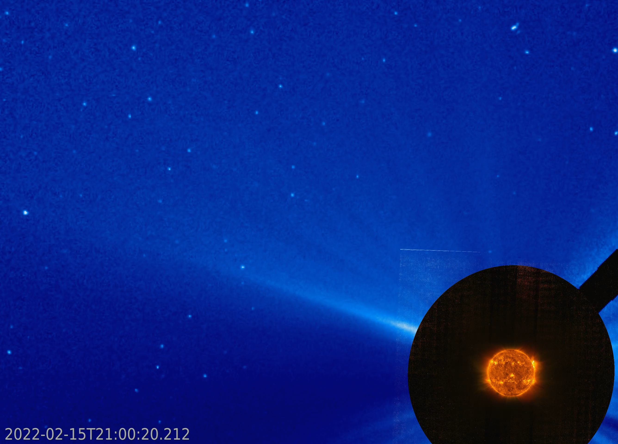
EUV observations of extended corona
LASCO C3
Connecting structures observed in EUV with white light imaging.
EUI FSI 174+304
Brenda D. Dorsch – ESA Space Weather Service Network Workshop 2026

Slide 9
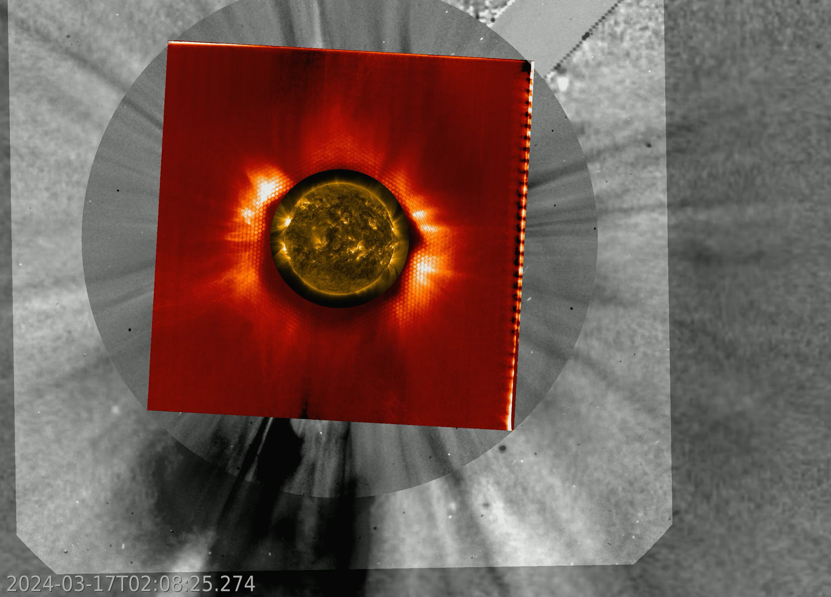
EUV observations of extended corona
LASCO C3
EUI FSI304
LASCO C2
EUI/FSI
EUV observations with “coronagraph mode”.
AIA171
Better definition of solar structures on the edges of the FOV.
Brenda D. Dorsch – ESA Space Weather Service Network Workshop 2026

Slide 10
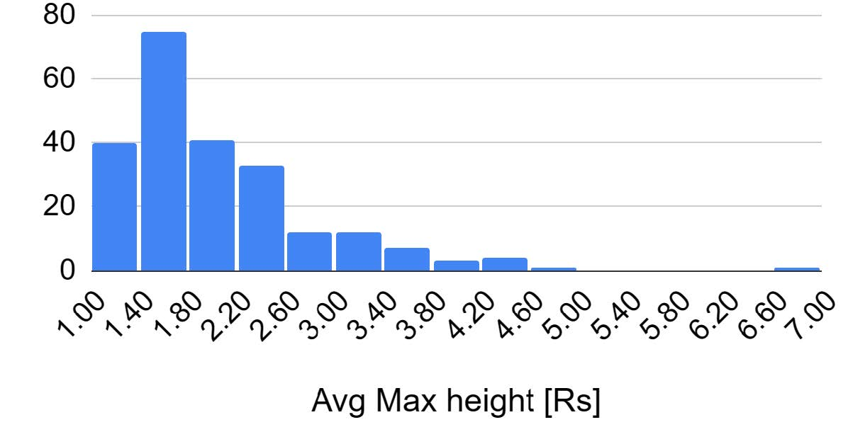
EUV wide FOV
Lesson learned from the EUI wide FOV.
We studied 229 prominence eruptions observed with EUI FSI304.
We took advantage of the wide FOV of EUI to measure the maximum height reached by the eruptions.
Our study shows majority of prominence eruptions are observed below 3 Rs.
Dorsch et al. (in prep)
Brenda D. Dorsch – ESA Space Weather Service Network Workshop 2026

Slide 11
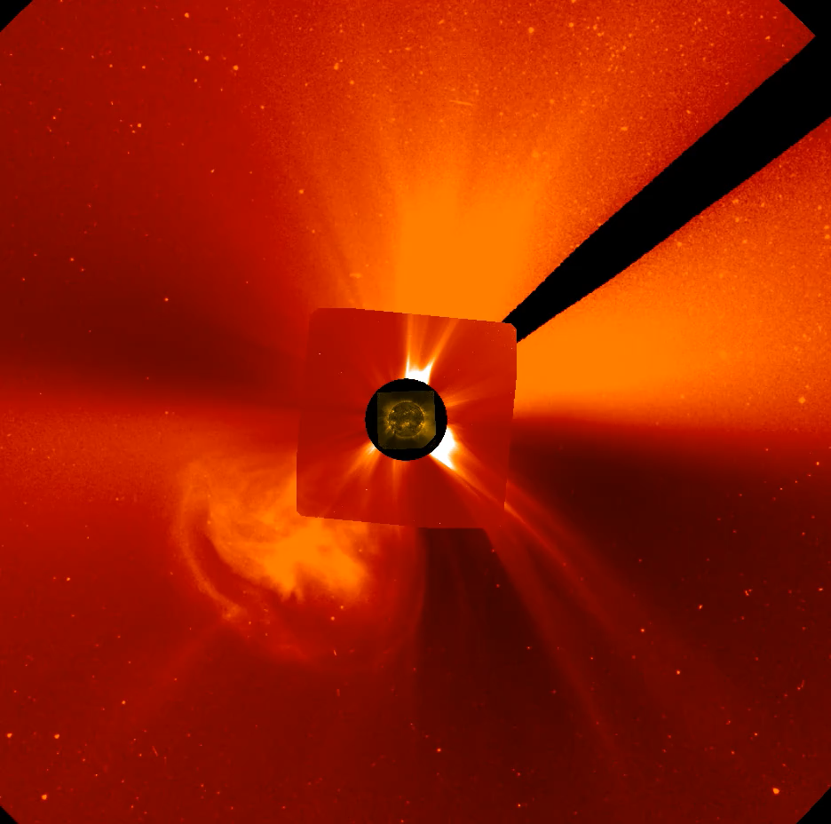
From EUI to JEDI
EUV
Imager
SWOC - (Space Weather Operational Coronal Imager)
3 channels: 133, 195, 304 Å.
4 min cadence.
Full solar disk and extended corona out to 3.2 Rs.
EWOC – (Enhanced Wide-angle Observations of the Corona)
2 channels: 171, 304 Å.
8 min cadence.
Full solar disk & Occulted coronal images out to 6 Rs.
Occulter 10x greater throughput than EUI/FSI.
Coronagraph
Dorsch et al. (in prep)
Brenda D. Dorsch – ESA Space Weather Service Network Workshop 2026

Slide 12
Summary
EUV data are important for both research and operations.
L5 point provides valuable perspective for space weather.
From EUI/FSI data we learned most prominence eruptions are observed < 3 Rs. JEDI extended corona observes up to 3.2 Rs & 6 Rs.
EUI occulter mode allowed for better EUV observations of middle corona. JEDI with 10x higher performance than EUI makes high cadence observations up to 6 Rs.
Brenda D. Dorsch – ESA Space Weather Service Network Workshop 2026
Notes:
EWOC FOV is enable by a moveable occulter, inherit from SolO/EUI, allowing low-scattered light images of the extended corona.

