Slide 1











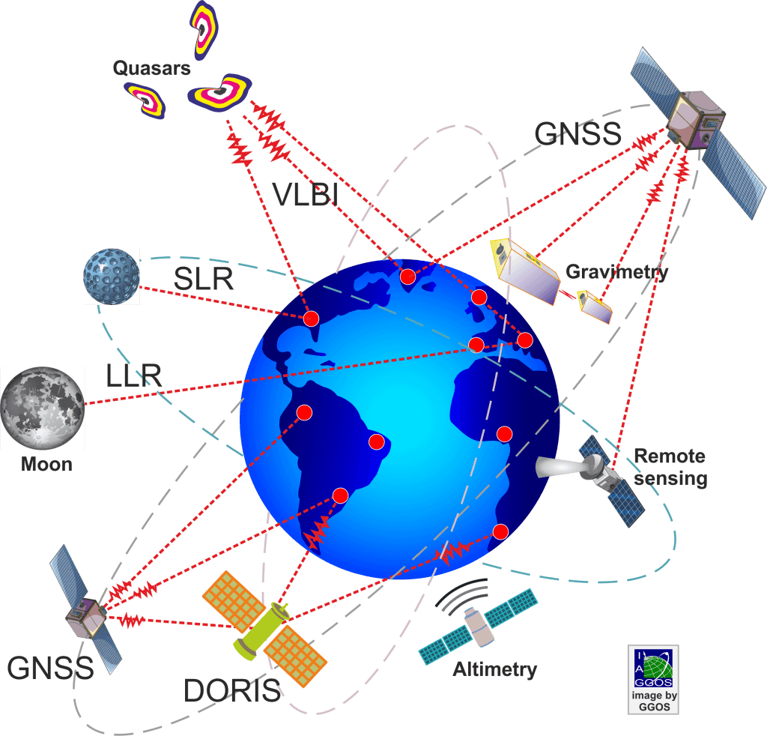

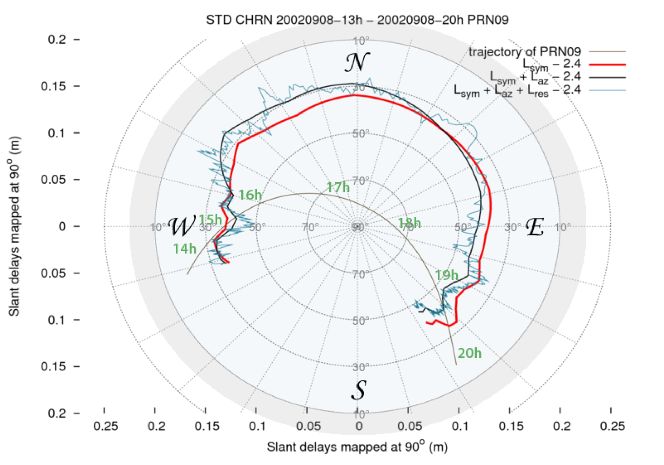

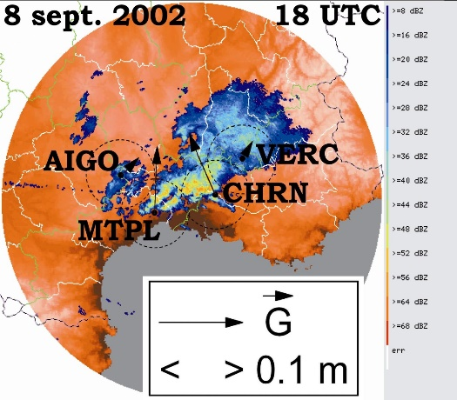
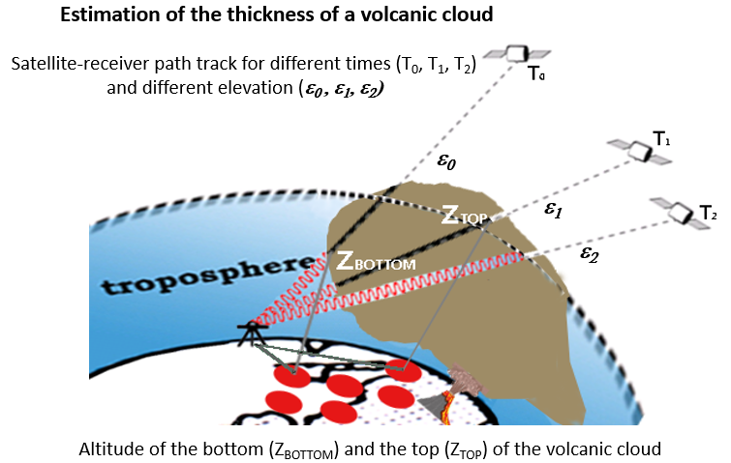

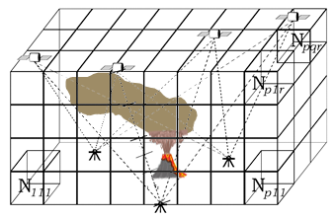
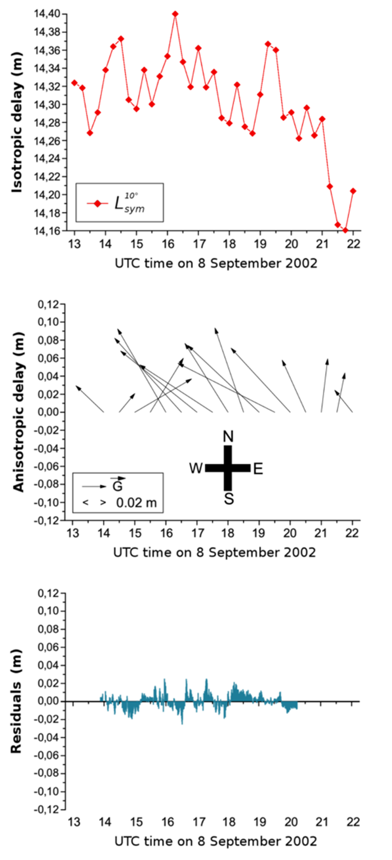
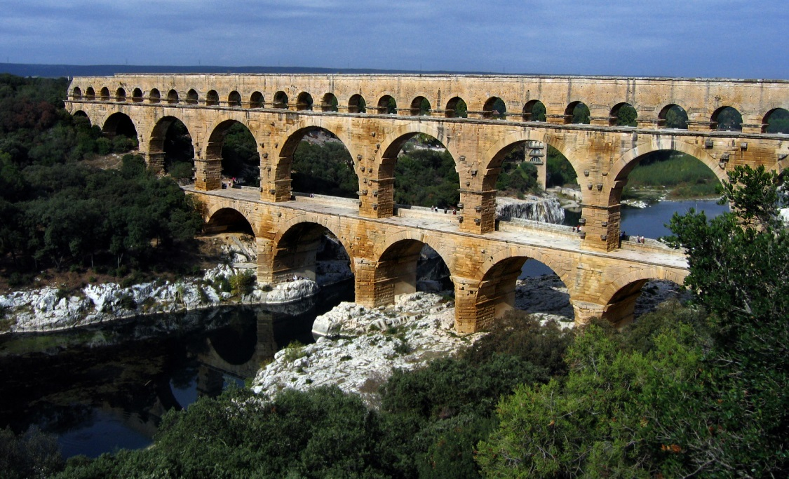
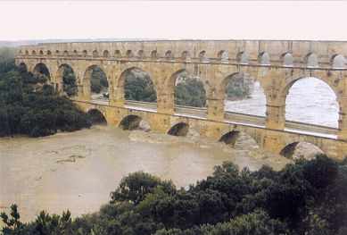
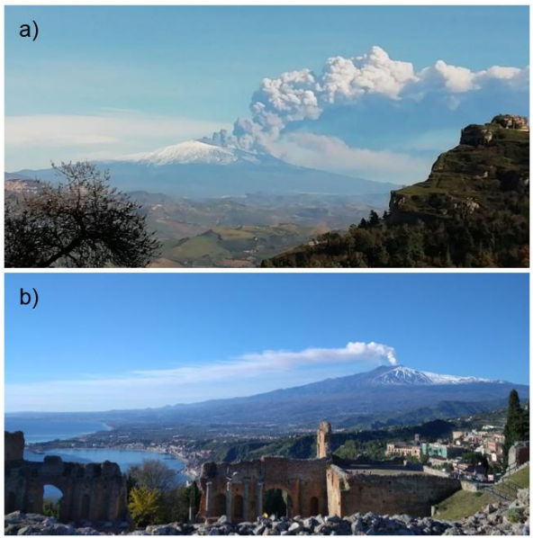
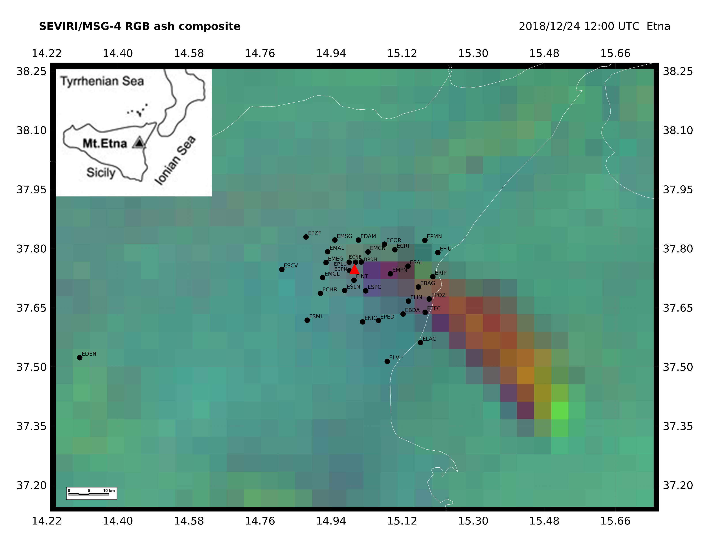
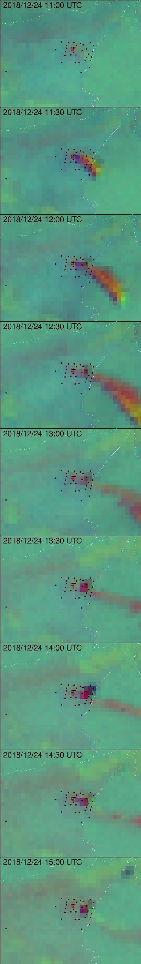
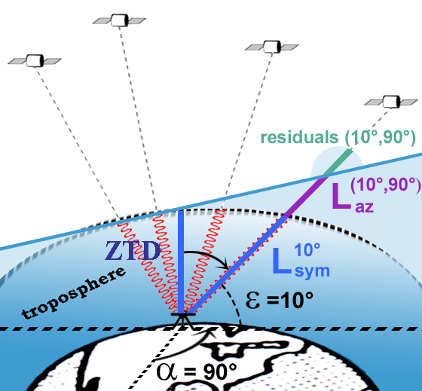
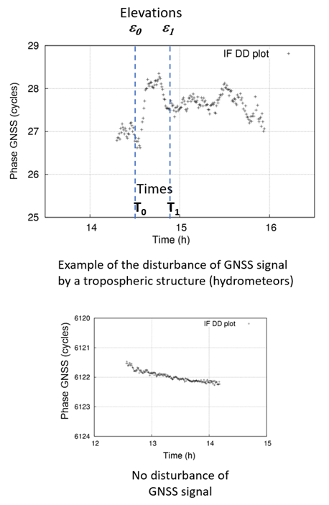
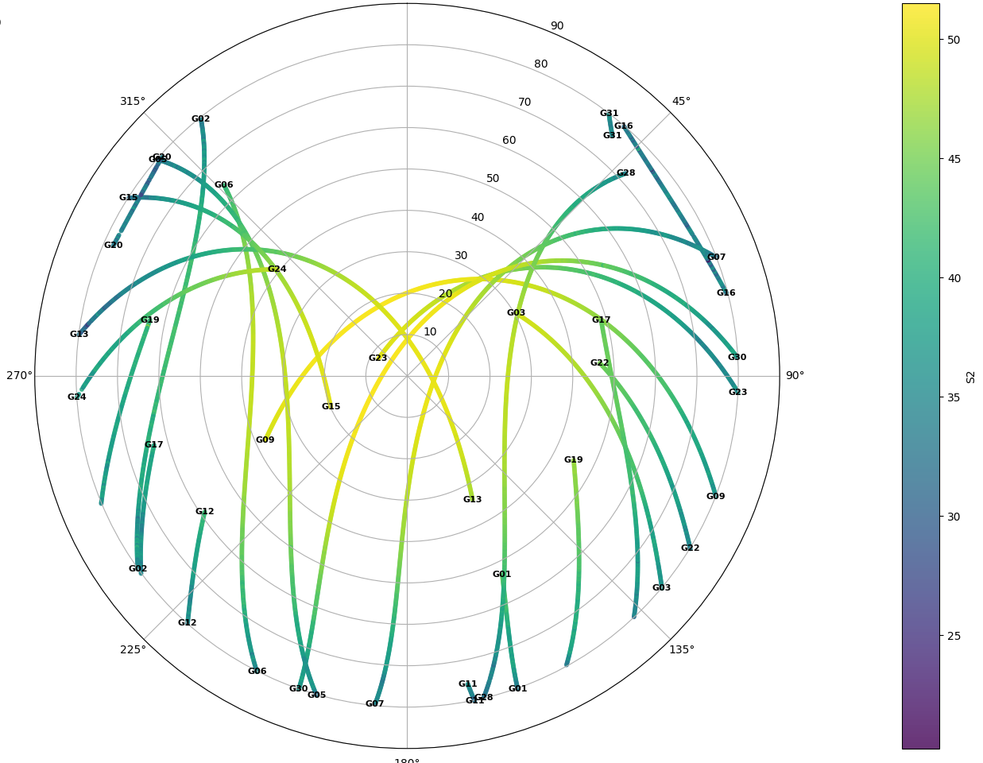
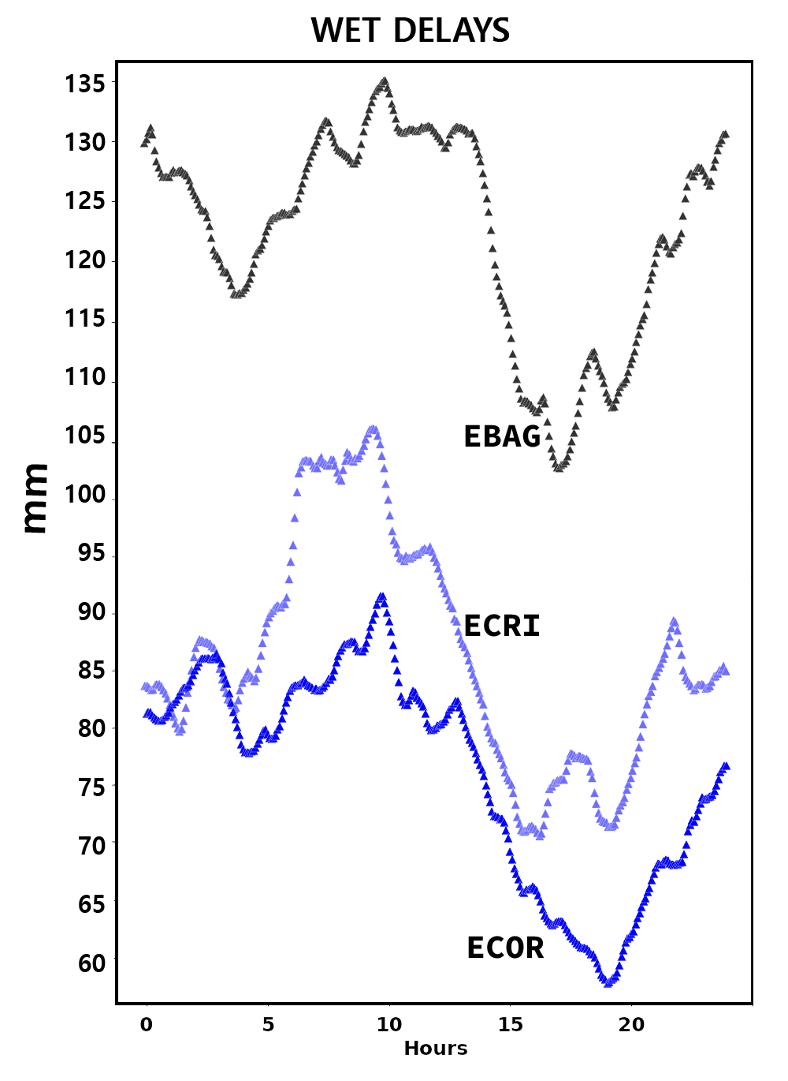
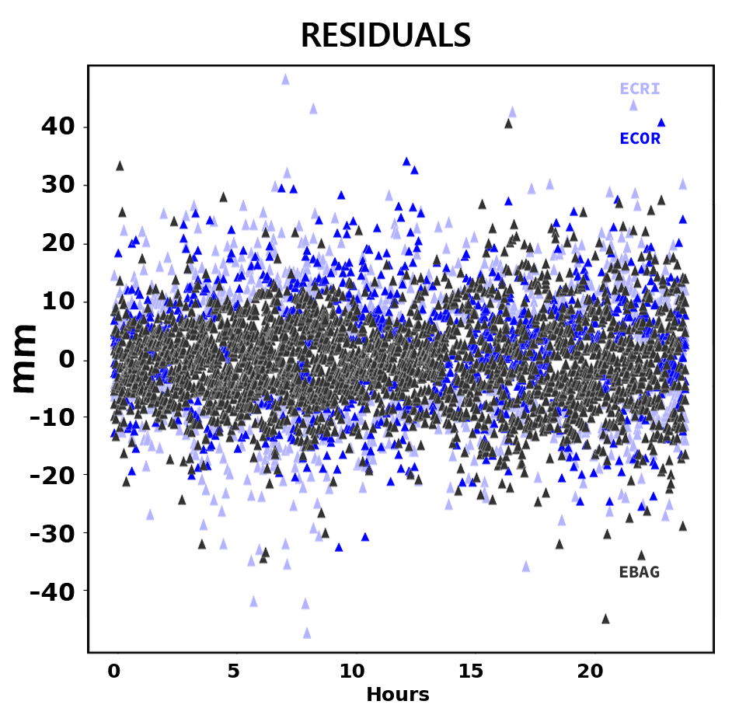
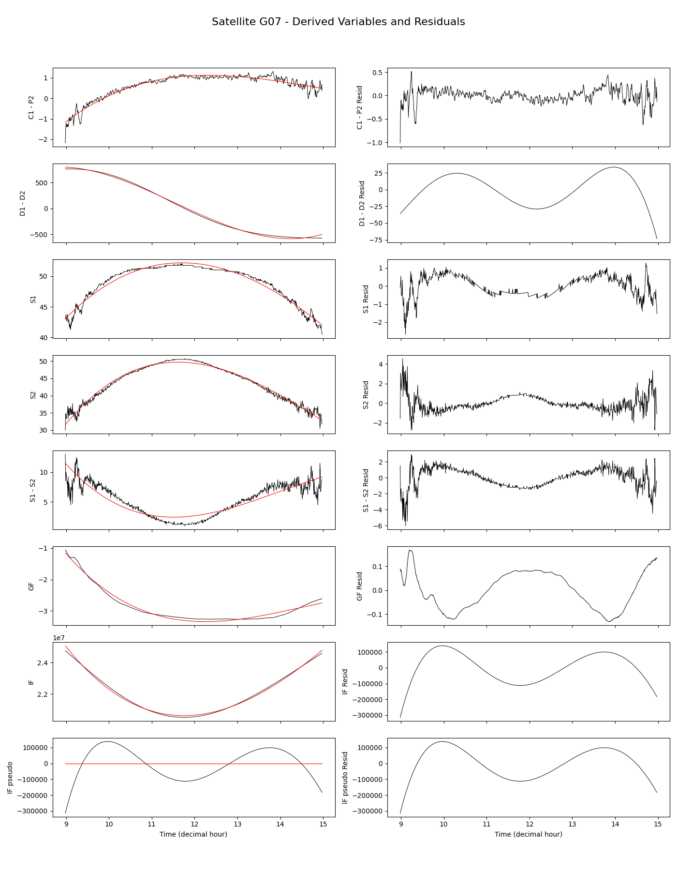
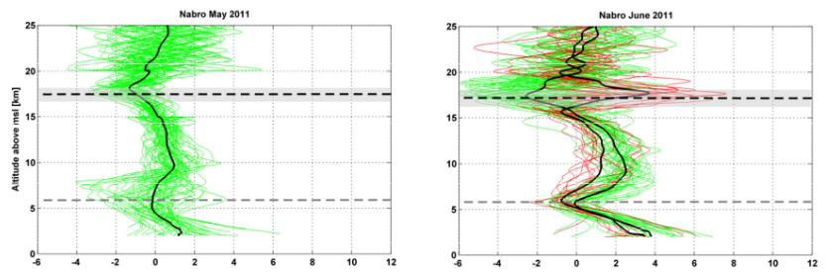
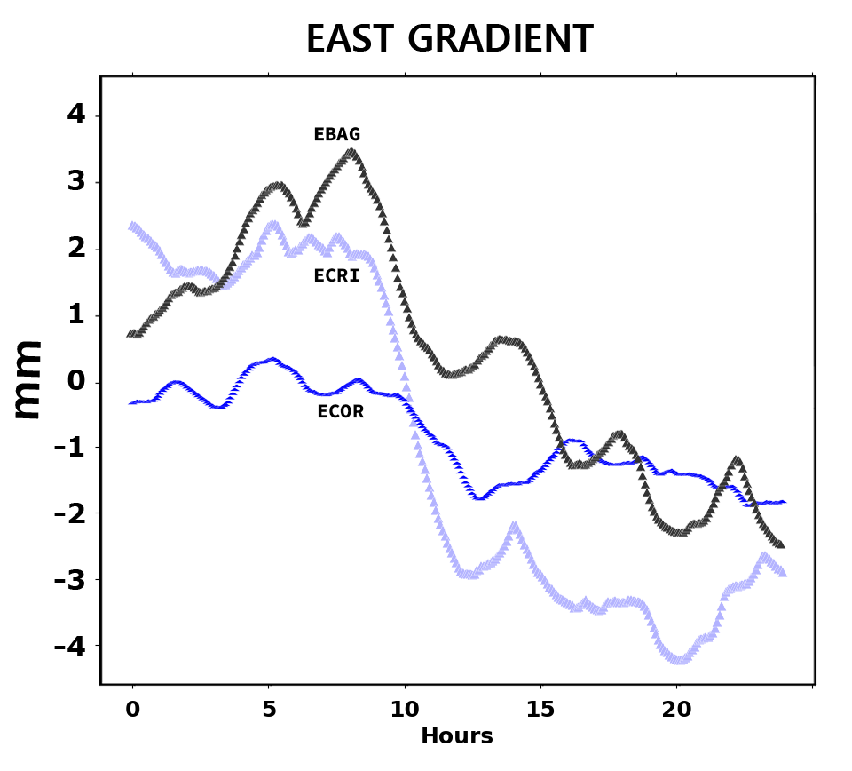
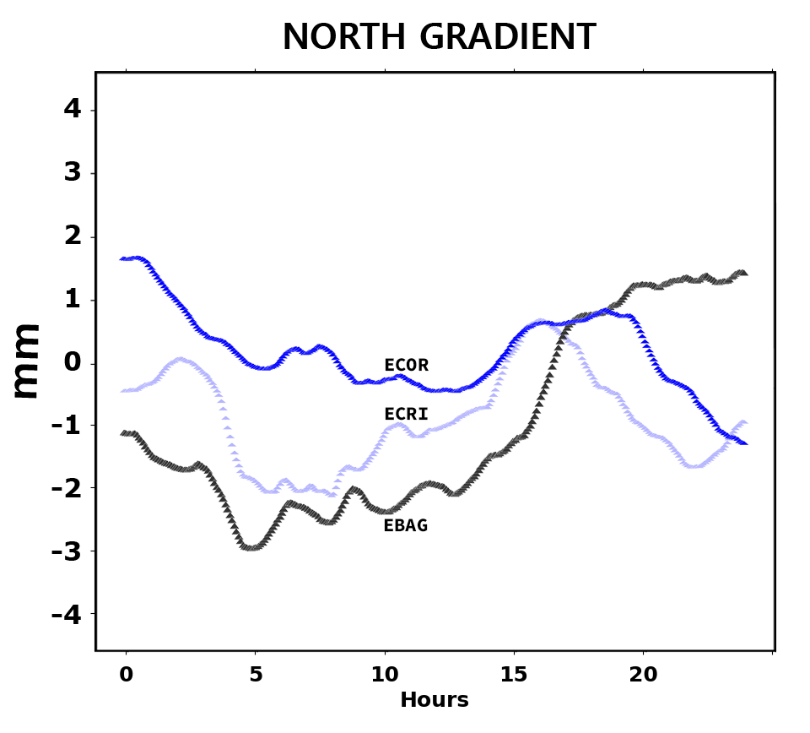
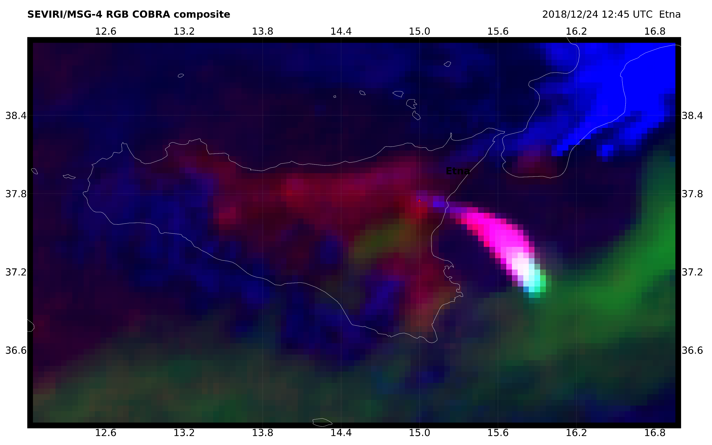

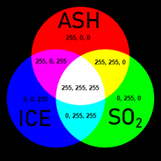
Monitoring ash-laden plumes using geodetic remote sensing techniques
Session 3.12: Dynamics of volcanic eruption plumes: models and observations
IAG WG 4.3.9 Observing convective and volcanic clouds
Hugues Brenot^{1,*}, Riccardo Biondi², Flavio Cannavò³, Mohammed Hammouti⁶ , Samuel Nahmani⁴, Eric Pottiaux⁵, Rohm Witold⁷
http://iag.tomography.igig.upwr.edu.pl
⁽¹⁾ ⁽²⁾ ⁽³⁾ ⁽⁴⁾ ⁽⁵⁾ ⁽⁶⁾ ⁽⁷⁾
Overview of CVC IAG WG 4.3.9
Frame work
Commission 4 – Positioning and Applications 2023-2027
IUGG
Focus on advancing positioning, navigation, and timing (PNT) technologies, with an emphasis on GNSS and alternative systems. It aims to improve positioning integrity, sensor integration, and geodetic applications, addressing challenges such as interference and atmospheric disturbances.
Sub-commission 4 3 – Atmosphere remote sensing
Sensing ionosphere & neutral atmosphere
Nowadays, the ground-based and space-borne geodetic observation techniques — including GNSS, satellite altimetry, VLBI, SLR, DORIS, and radio occultations — provide valuable information about the state and dynamic of the atmosphere.
WG 4.3.9 Observing convective and volcanic clouds with geodetic remote sensing techniques
Motivation: Convective and volcanic clouds (CVC) represent a risk for population aviation safety which requires:
  improved CVC detection using GNSS (GB & RO);
  a better characterisation of the hazardous source (composition, cloud height, thickness, and density).
Ground-based GNSS (GB)
GNSS radio-occultation (RO)
Action plan:
  Setting benchmarks campaigns and synergy of GNSS analysis with:
  - other remote sensing techniques (GEO imagers and LEO sensors for plume geo-location, gas composition and structure of the volcanic plume)
  - ground-deformation and seismicity for understanding the mechanisms of an eruption.
GNSS analysis:
  GNSS RO: generating anomaly detection with respect to reference data
  GNSS tomography to retrieve 3D-structure (slant delay analysis with ZTD, gradients and residuals
  Develop diagnostic tool from slant delays observations (delays disturbance and SNR).
Convective cloud using ground-based GNSS
Volcanic plume using ground-based-GNSS
Flash-flood Gard 2002
Mt Etna 2018 eruption
ECOR
cut-off 30°
Pont du Gard in October 2007.
Flash-flood (8-9th September 2002)
cut-off 10°
ECRI
Extreme event (25 dead mans, 691 mm of precipitations in 24h)
Etna activities on 24 (a) and 27 (b) December 2018 as seen from Enna and Taormina (credits Truscia L. and Ponzo C.). Image from Corradini et al. (2019, IGARSS)
EBAG
ZTD & gradients every 5 min
Daily calculation using GipsyX latest version (2.3)
GPT2 mapping function; cut-off angle of 10°
ZWD constrained to follow a random walk of 5 mm/√h
Tropospheric gradient constrained to 0.5 mm/√h
Reading station metadata from the RINEX file header
Using JPL products by default for PPP processing with GipsyX's gd2e script
No 2nd-order ionospheric correction
cut-off 10°
cut-off 30°
Liquid and solid water (hydrometeors) can disturb GNSS signal and induce delays of propagation.
Consequent quantity of water vapour (wet delays) in the boundary layer above EBAG station (280 m asl.) in comparison to ECOR (1240 m asl.) and ECRI (1480 m asl.). Can this be only the results low layer flux of water vapour combined with the orographic effects?
Brenot, H. (2020). GNSS for Neutral Atmosphere and Severe Weather Monitoring. In Position, Navigation, and Timing Technologies in the 21st Century (eds Y.T.J. Morton, F. Diggelen, J.J. Spilker, B.W. Parkinson, S. Lo and G. Gao). https://doi.org/10.1002/9781119458449.ch30
G7
Volcanic plume using GNSS radio-occultation
One way post-fit residuals shows higher values for ECRI and ECOR stations
→ impact on low elevation signal
Nabro June 2011 eruption
How can the East gradient between the ECRI and ECOR stations (only 500 m apart) be so different?
C1 Pseudorange on L1 (C/A code) Code-based range using civilian signal on L1 (1575.42 MHz).
P2 Pseudorange on L2 (P(Y)-code) Code-based range using encrypted P-code on L2.
D1 Doppler on L1 Doppler shift of the L1 carrier; used to estimate relative velocity.
D2 Doppler on L2 Doppler shift of the L2 carrier (1227.60 MHz).
S1 Signal-to-noise ratio on L1 SNR on L1 signal, typically in dB-Hz.
S2 Signal-to-noise ratio on L2 SNR on L2 signal.
Temperature anomaly (K) Temperature anomaly (K)
Link to animation
Biondi, R., Steiner, A. K., Kirchengast, G., Brenot, H., and Rieckh, T.: Supporting the detection and monitoring of volcanic clouds: A promising new application of Global Navigation Satellite System radio occultation, Advances in Space Research, Volume 60, Issue 12, 2017, p. 2707-2722, ISSN 0273-1177, https://doi.org/10.1016/j.asr.2017.06.039.
Ice particles is observed by SEVIRI in the ash-laden plume using RGB cobra composite.
For COBRA algorithm on SO2 / ash / ice see Poster Board Number: 72
Presentation time: Friday 16:30 - 18:00, Room Poster Hall
Commission 4 - Positioning and Applications
SC 4.3: Atmosphere Remote Sensing
* Contact Author: brenot@aeronomie.be
https://geodesy.science/com4

