Slide 1
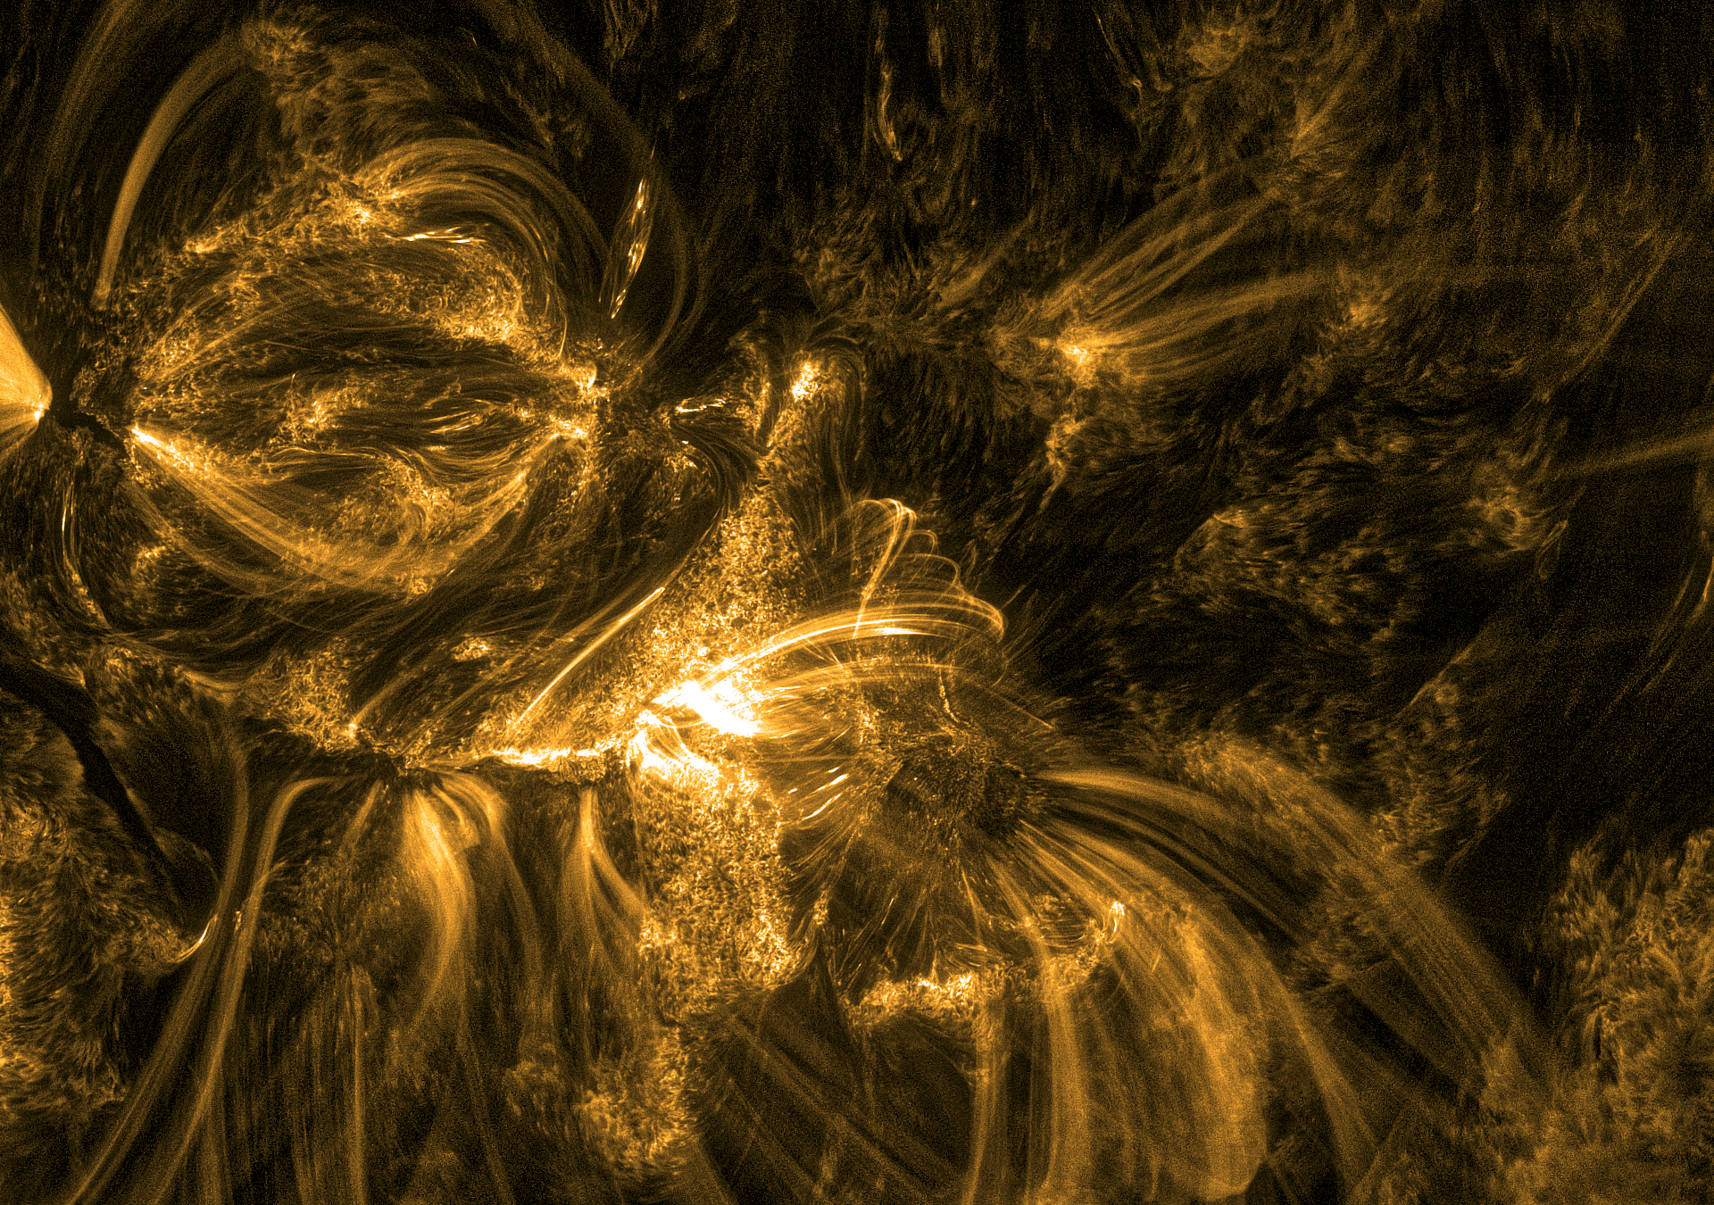




EUI-HRI/SolO
Estimation of the twist in a solar magnetic flux rope
Brenda D. Dorsch
Luciano Rodriguez
Jasmina Magdalenić
Royal Observatory of Belgium
European Space Weather Week
27-31 October 2025, Umeå, Sweden.

Slide 2
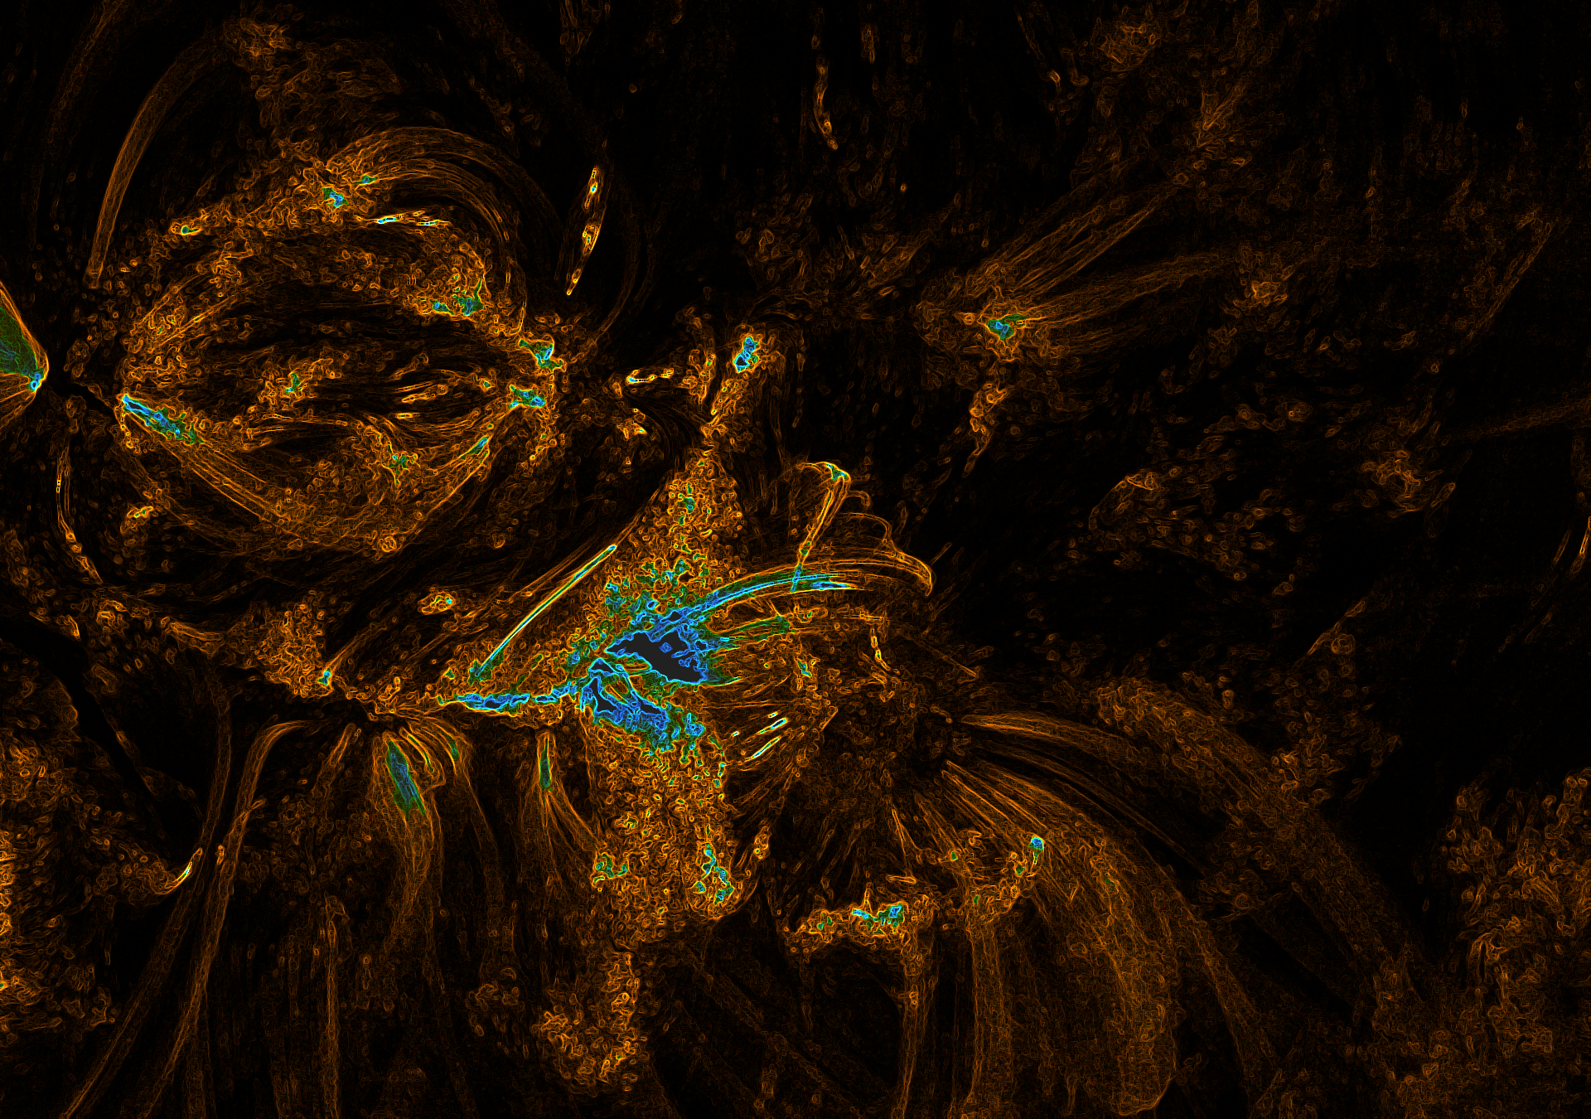
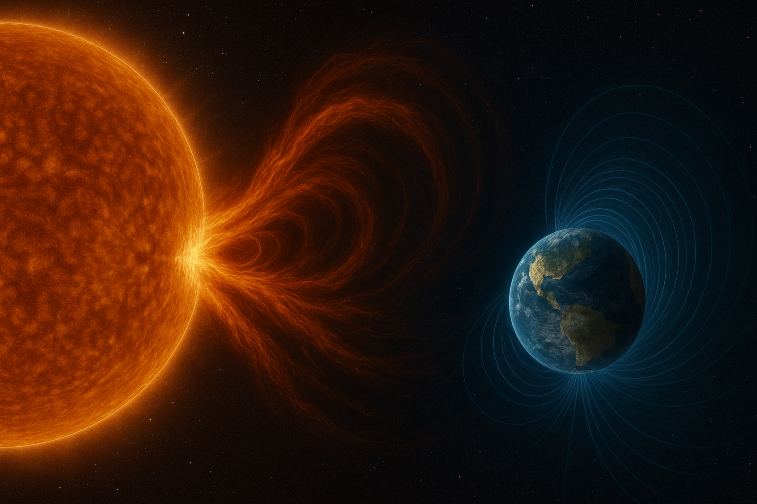
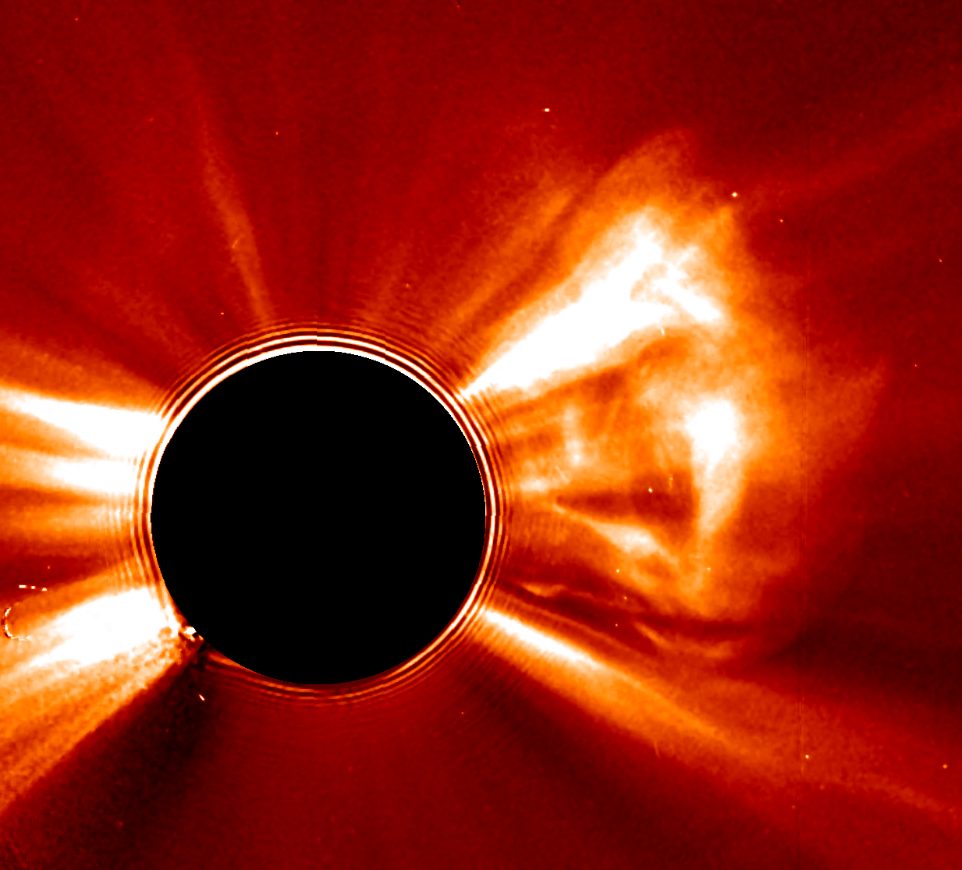
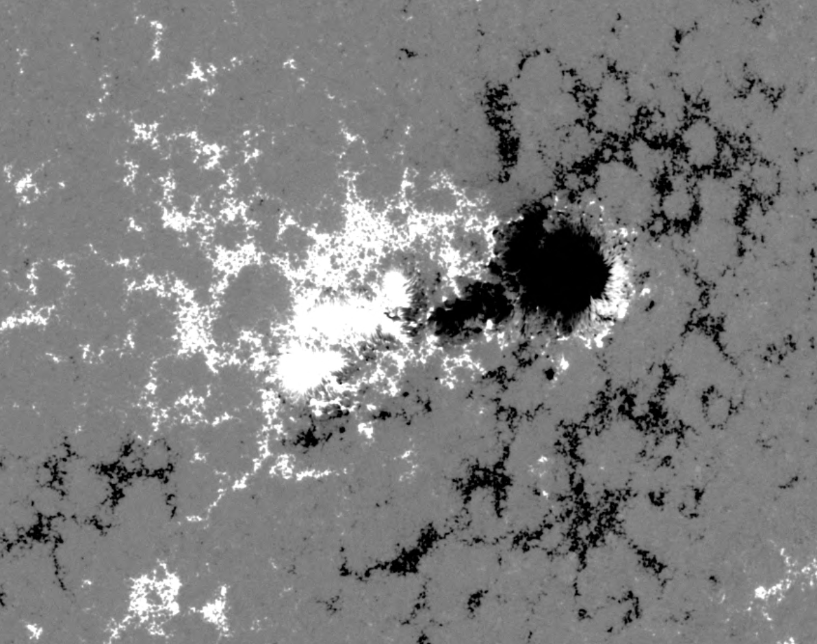
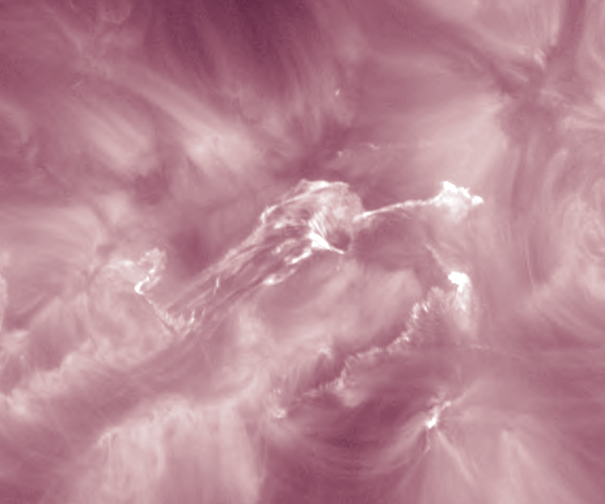
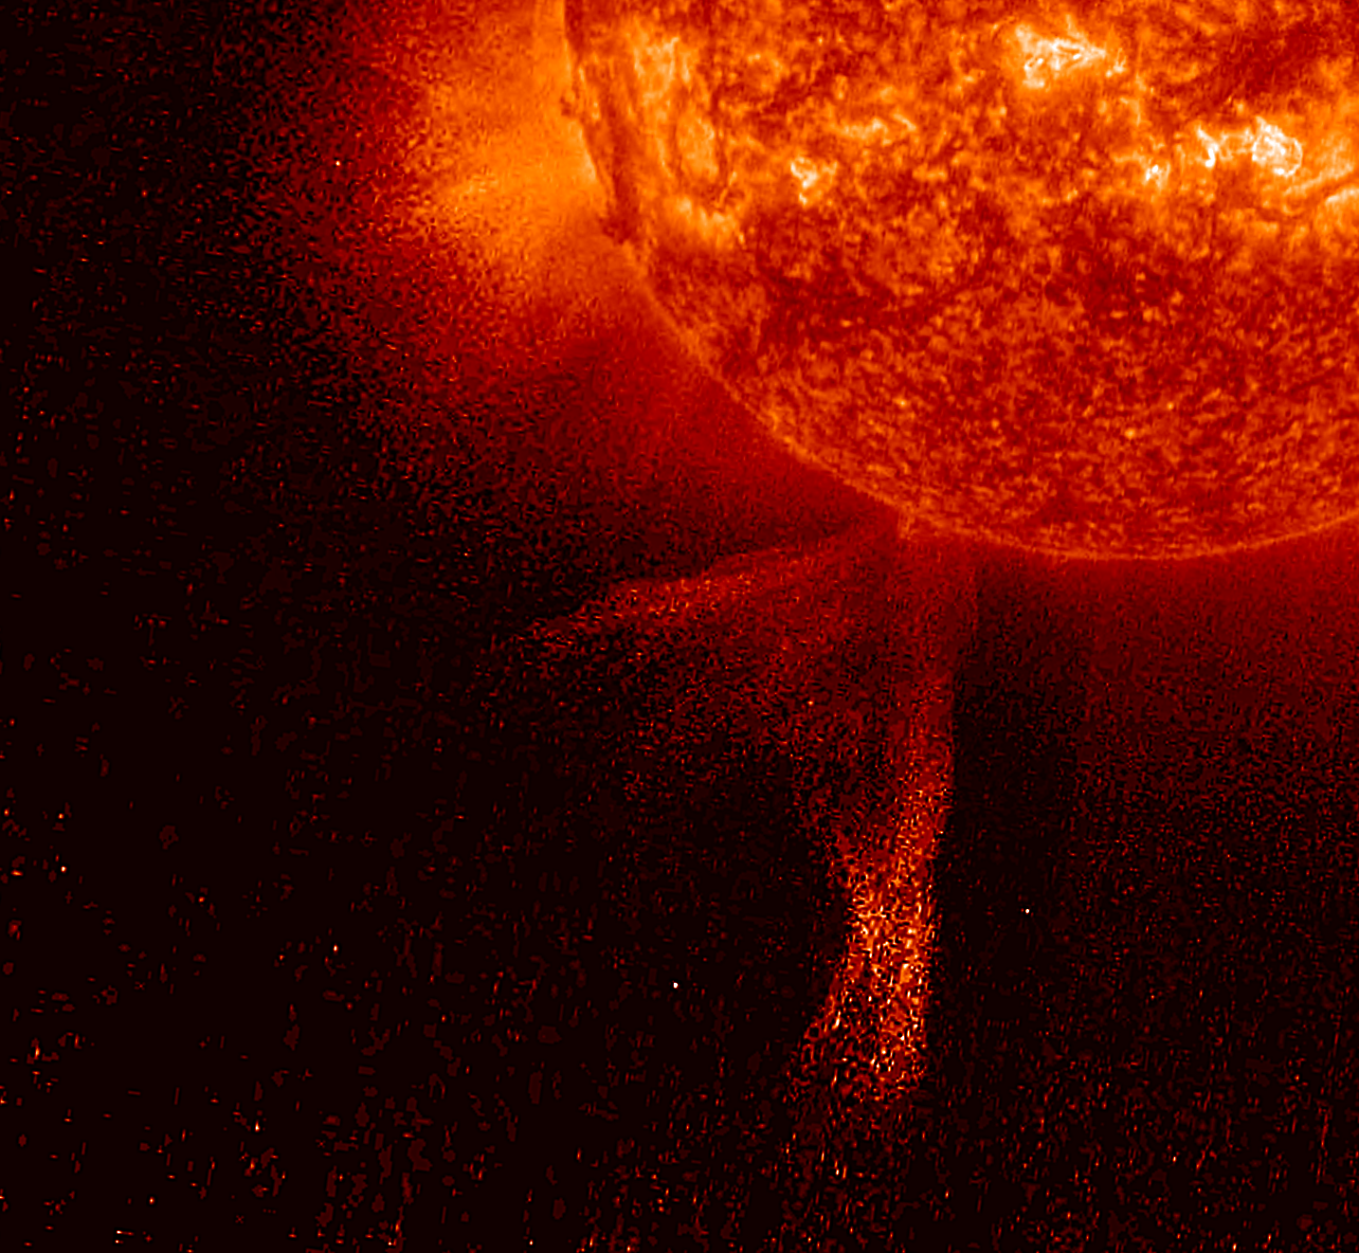
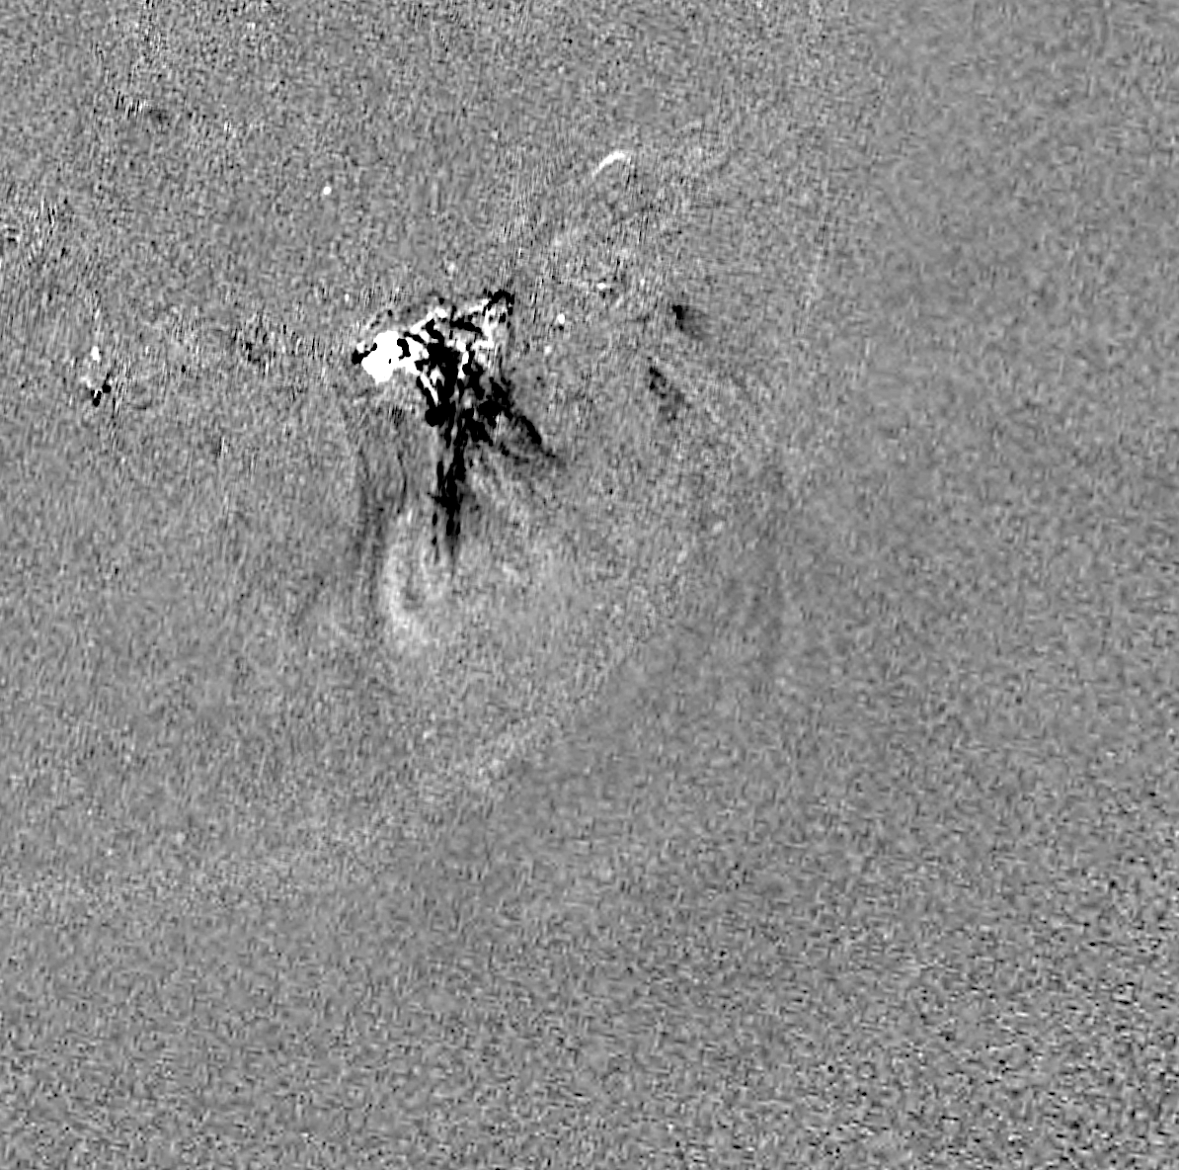
Introduction
European Space Weather Week, 2025 – brenda.dorsch@oma.be
Notes:
Explosive eruptions of plasma and magnetic field from the Sun’s corona (250 to 3000 km/s).
Key CME parameters for analysis: size, speed, direction, and magnetic field (inferred from spacecraft data).
The arrival at Earth is first observed in situ at L1: marked by an increase in total magnetic field strength, and changes in plasma speed, temperature and density.
Main drivers of the most intense geomagnetic storms.

Slide 3
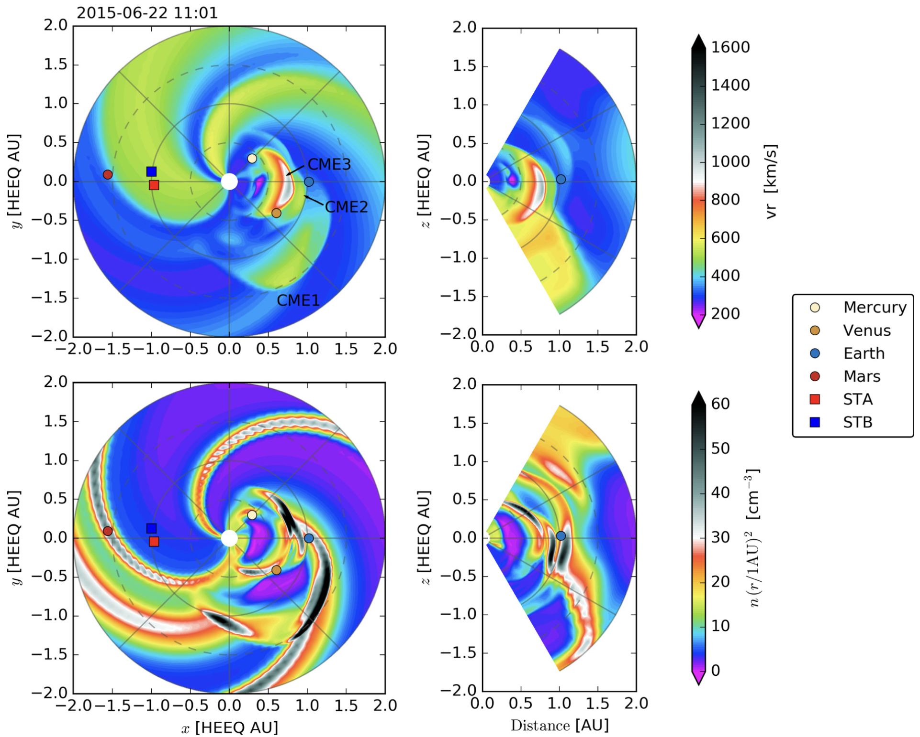
Introduction
3
EUHFORIA
European Heliospheric FORecasting Information Asset.
Pomoell & Poedts 2018.
Space weather forecasting-targeted inner heliosphere model.
Two major components
Coronal model
Heliospheric model
CMEs are injected at the inner boundary.
Different CME models can be implemented.
European Space Weather Week, 2025 – brenda.dorsch@oma.be
Notes:
Coronal model:
Provides data-driven solar wind plasma parameters at 0.1 AU.
Heliospheric model:
Use boundary conditions to drive a 3D time-dependent MHD model of the inner heliosphere up to 2 AU.
CMEs are injected at the inner boundary of EUHFORIA.
Different CME models can be implemented.

Slide 4
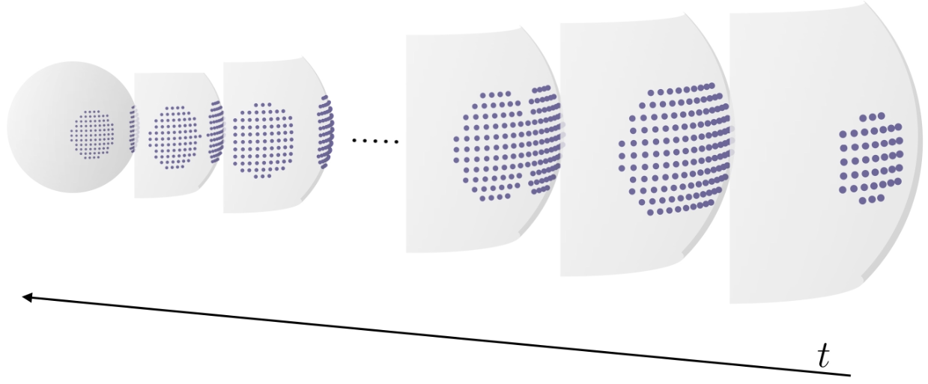
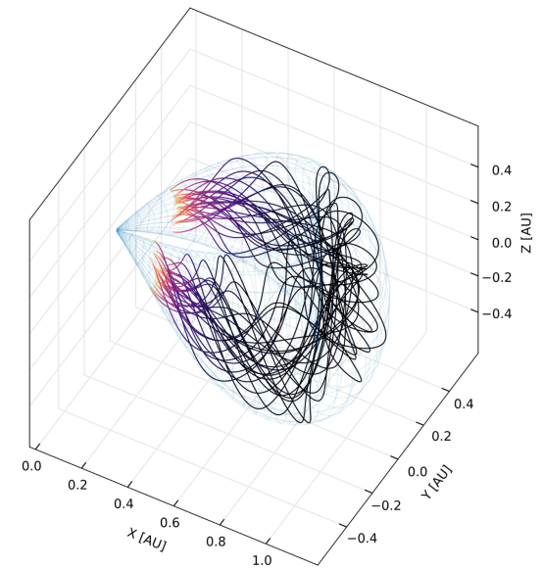
Introduction
4
FRi3D - Flux rope in 3D
Recent FRi3D improvements.
Flossie et al. 2025
17 input parameters:
Chirality.
Polarity.
Tilt.
Total magnetic flux.
Twist
Datacube file generation at the inner boundary of EUHFORIA.
Plasma.
Geometrical.
Computational time reduction of up to 95%.
Deformation.
Magnetic field.
Twist.
Poster session
→ CD1: 58, Thursday
Isavnin 2016.
Complex.
An average value is used.
European Space Weather Week, 2025 – brenda.dorsch@oma.be
Notes:
CD1:58 Computational optimisation of the FRi3D CME model in EUHFORIA used for SEP simulations, on Thursday

Slide 5
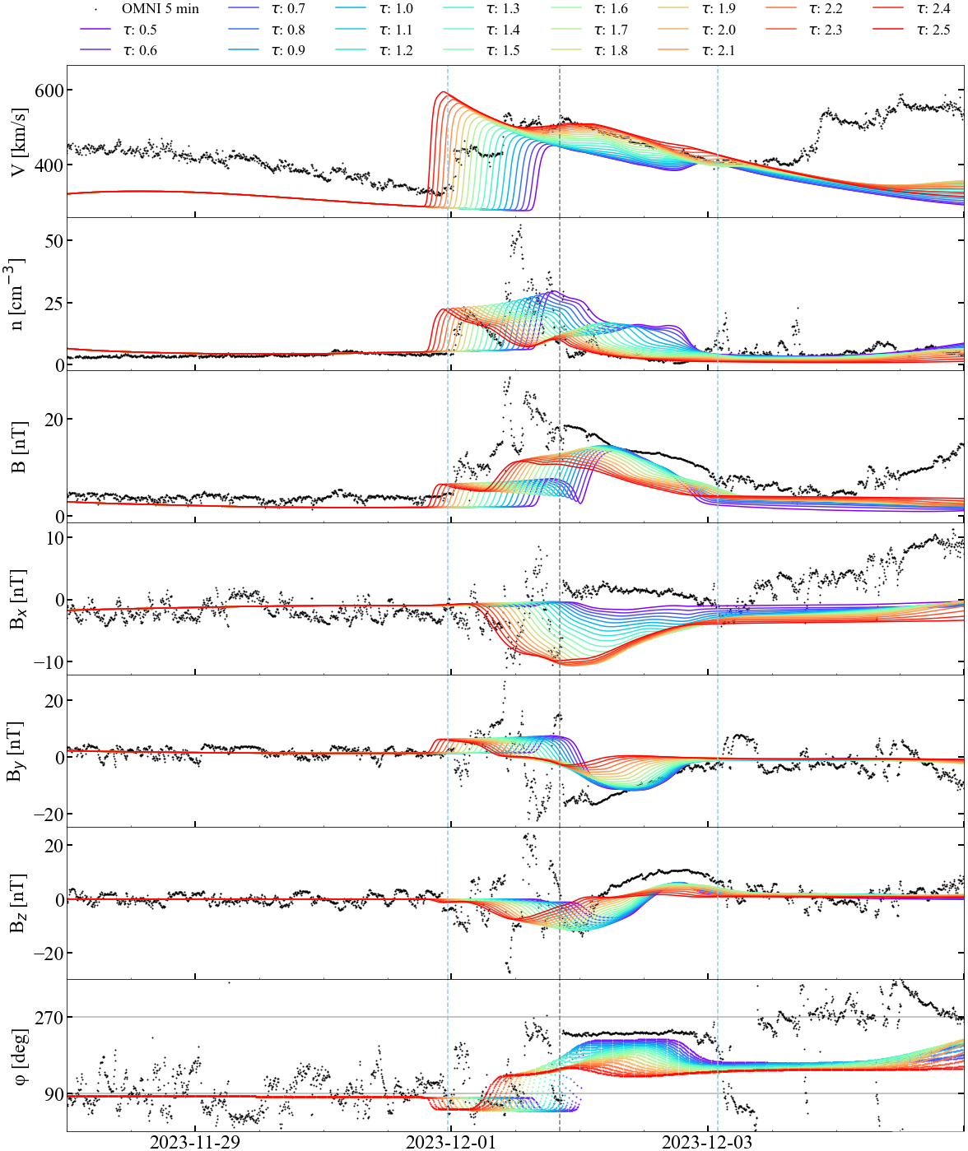
Motivation
5
How accurate is to use an average value for the twist?
We performed number of runs with FRi3D for one CME event, changing systematically the twist value.
More than 20 h difference in arrival time.
~ 30% variation in total magnetic field strength.
It is important to estimate the twist for CME modelling.
Dorsch et al. (to be submitted).
European Space Weather Week, 2025 – brenda.dorsch@oma.be

Slide 6
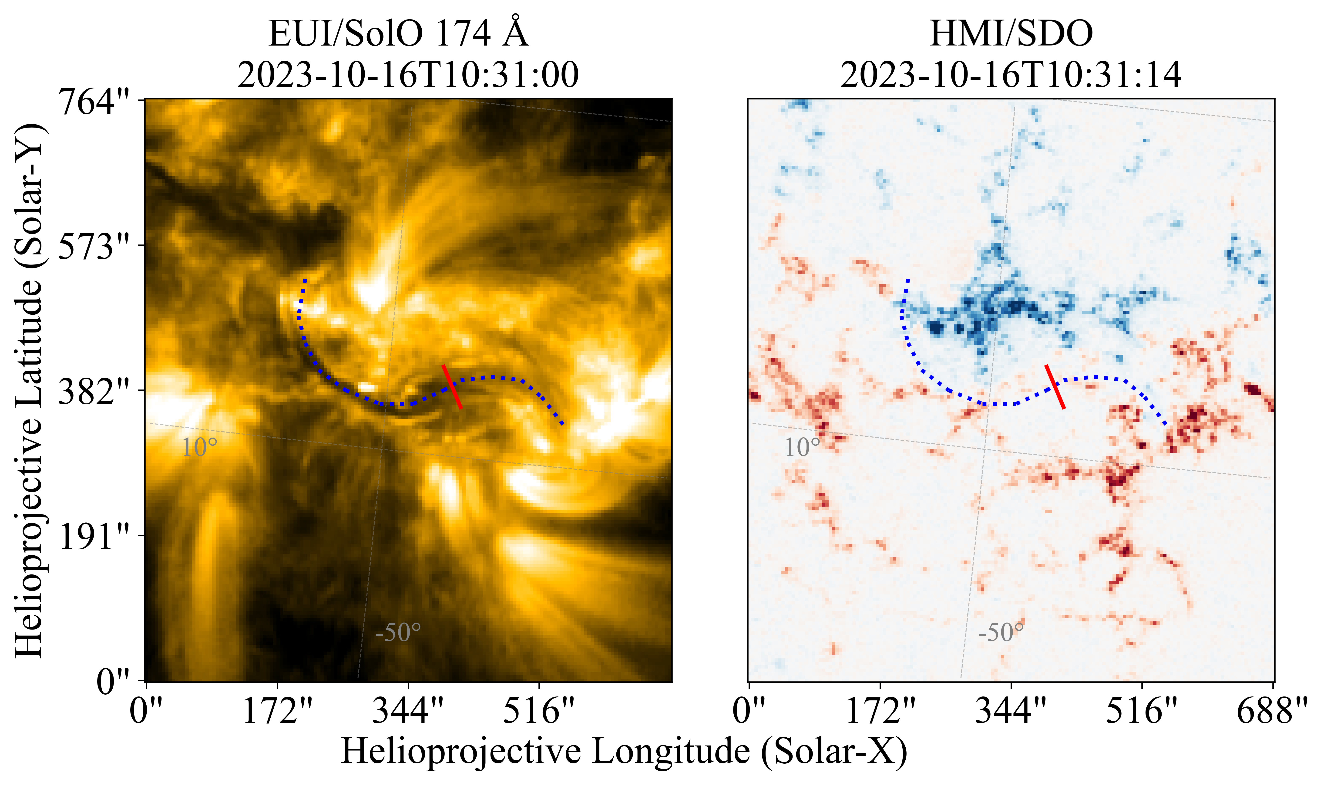

Methodology
6
We look for a methodology that:
  Is suitable in operational forecasting.
  Employs data available in real-time.
We use EUV images for ratio estimation.
2D approach.
$$\left|T_{w}\right|=0.26\frac{L}{r}−0.15$$
J. H. Guo, et al., 2021.
L and r are the length and small radius of a flux rope.
The formula is derived from
3D reconstruction of a magnetic flux rope.
European Space Weather Week, 2025 – brenda.dorsch@oma.be

Slide 7
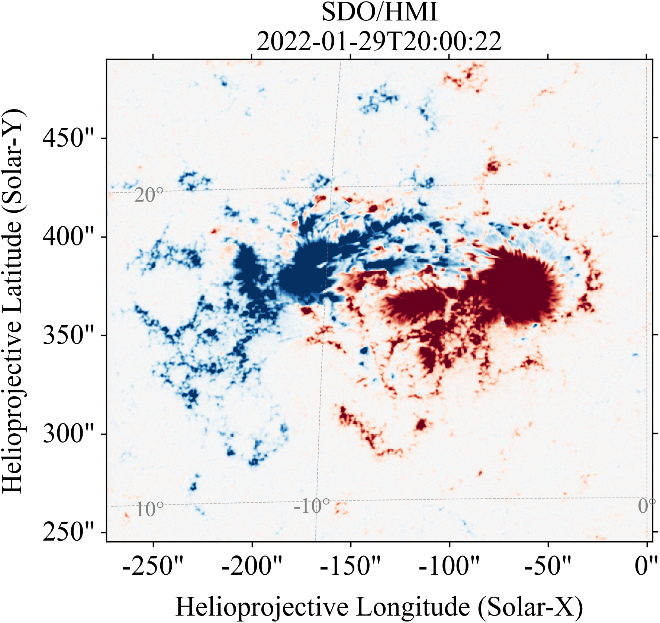
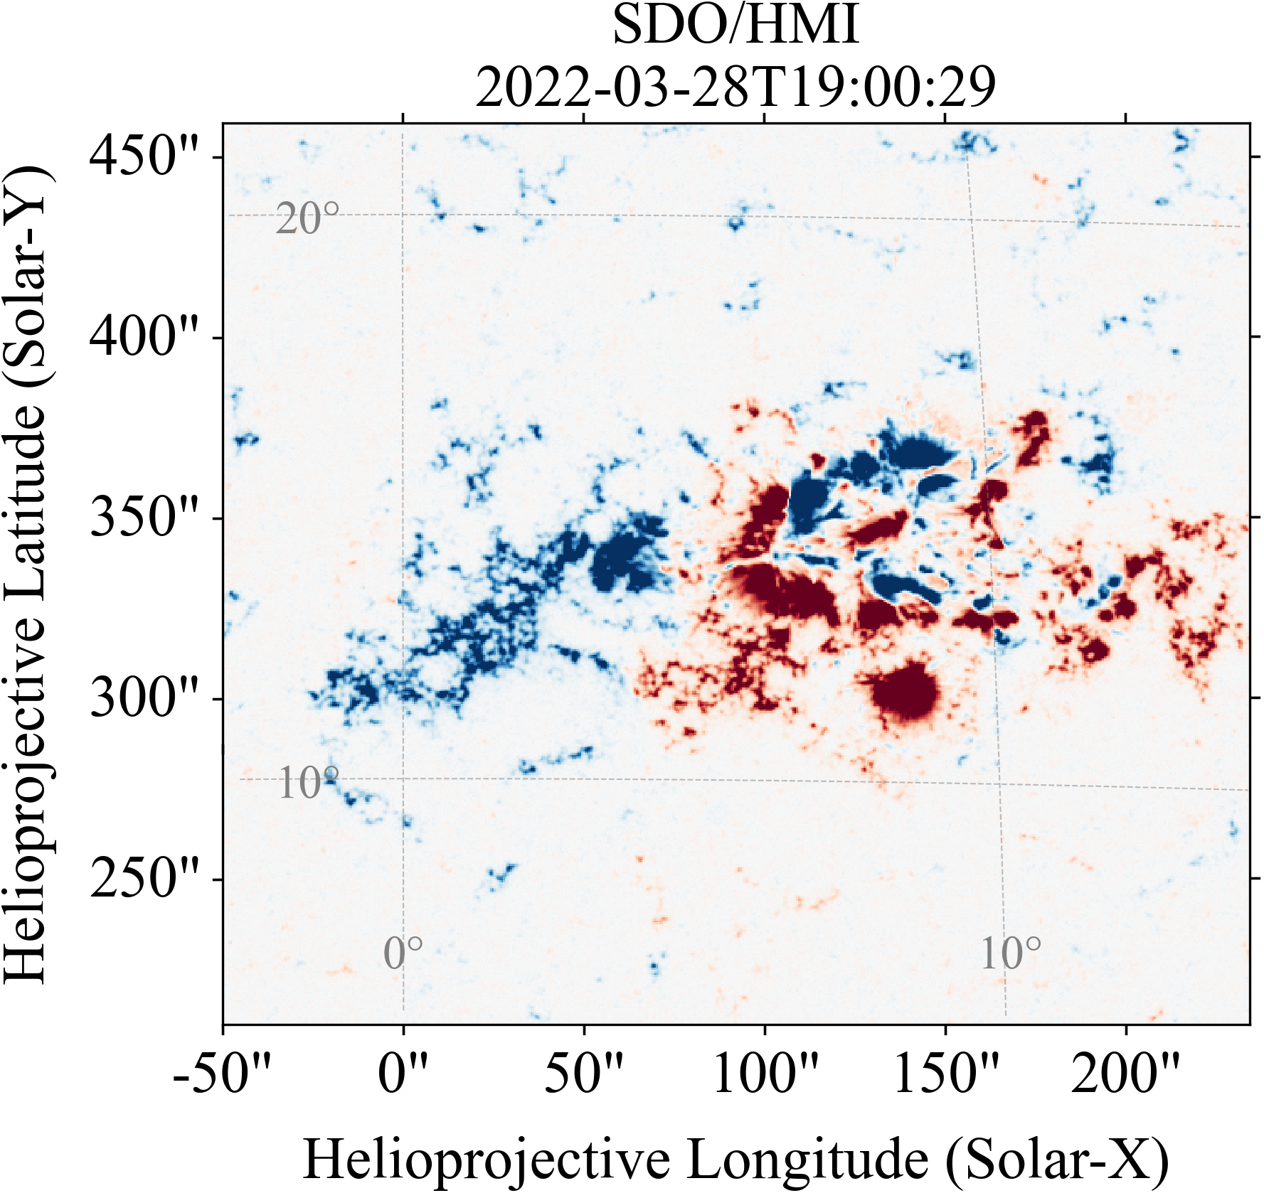
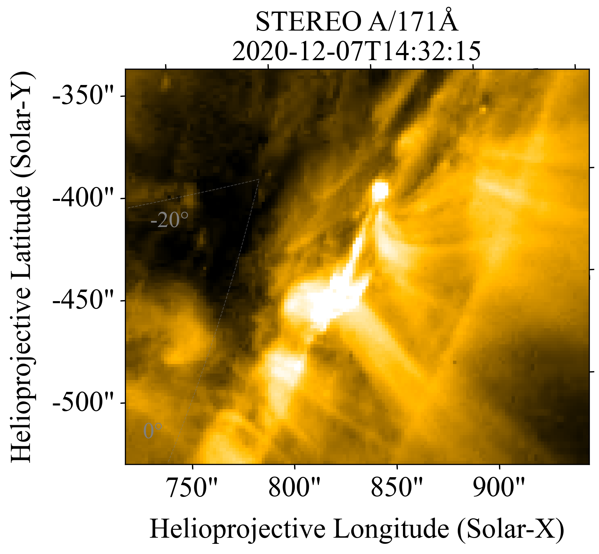
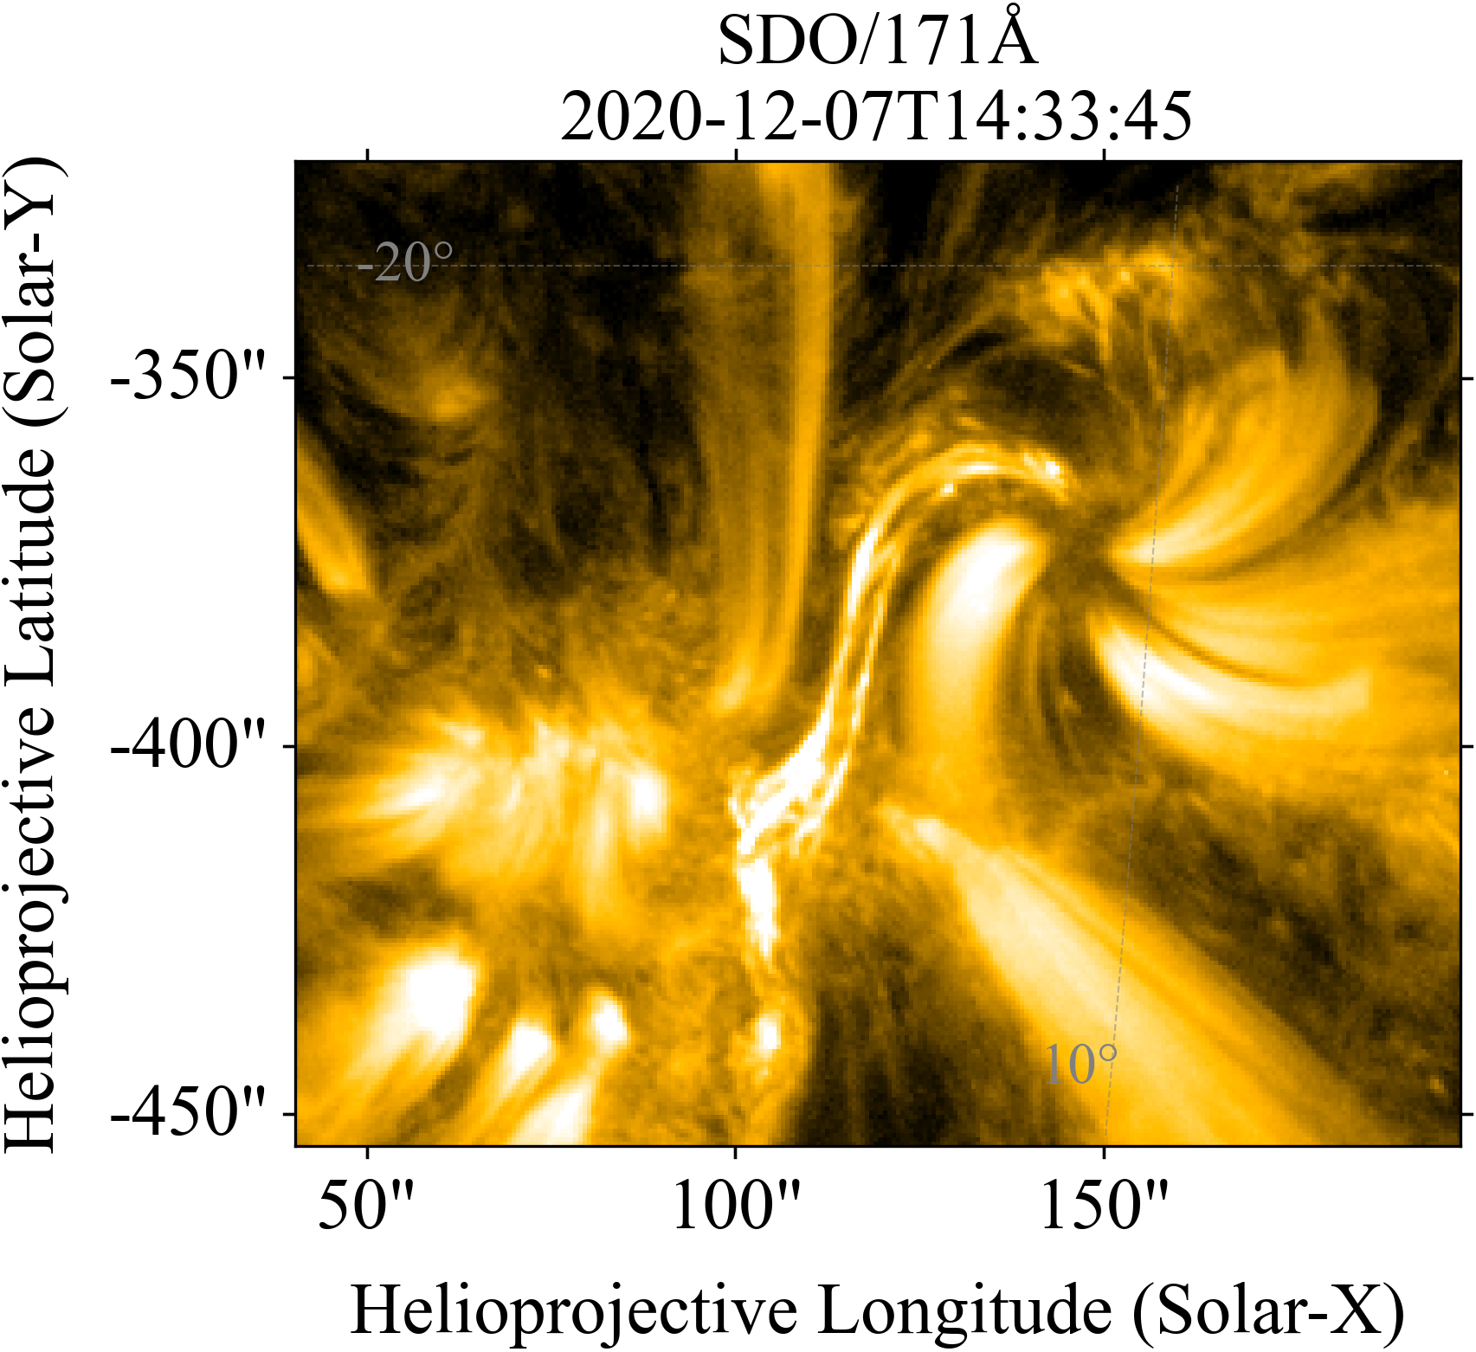
Methodology
7
Limitations.
MAGNETIC COMPLEXITY
Complexity of the active region directly affects the accurate identification of flux rope’s footpoints.
PROJECTION EFFECT
Depending on the viewing angle, the apparent geometry of the structure will differ.
European Space Weather Week, 2025 – brenda.dorsch@oma.be

Slide 8
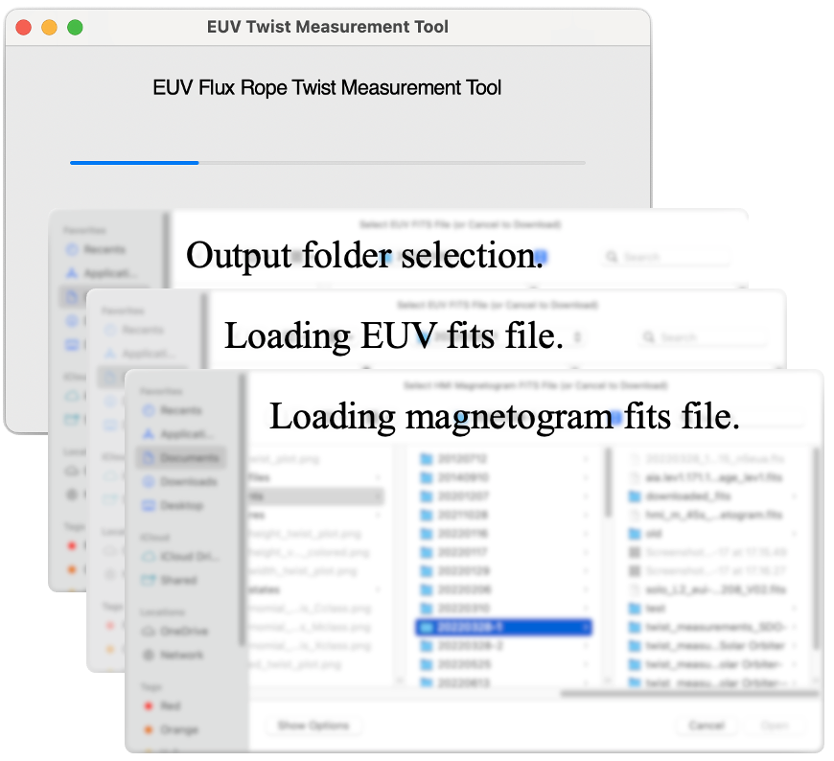
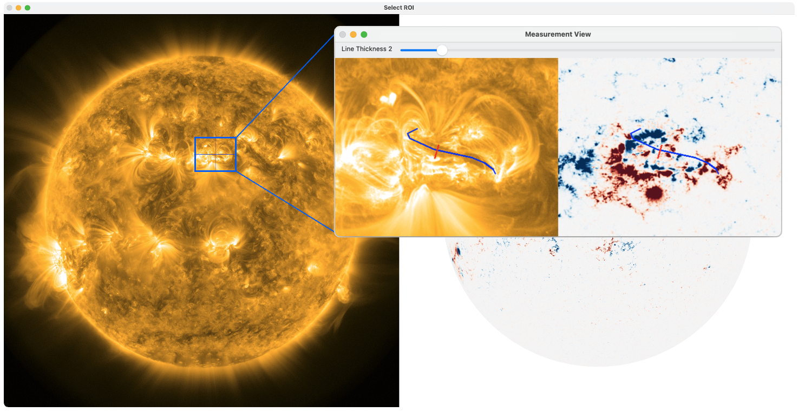
Methodology
8
Developed tool for twist estimation.
Area selection.
Twist measurement.
EUV + magnetogram fits files.
European Space Weather Week, 2025 – brenda.dorsch@oma.be

Slide 9
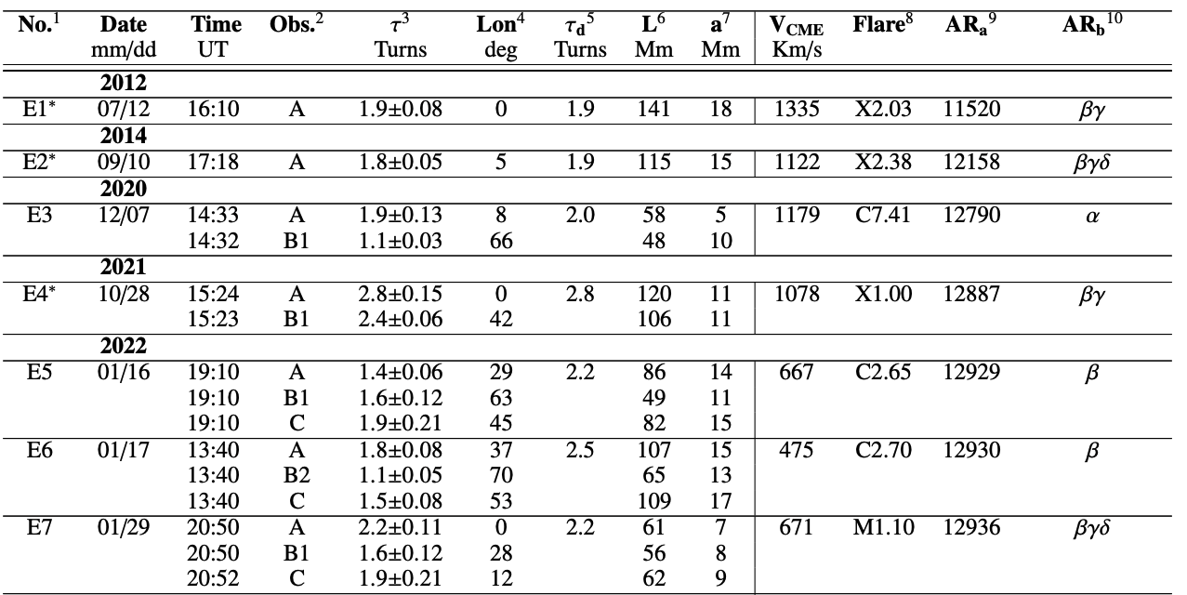
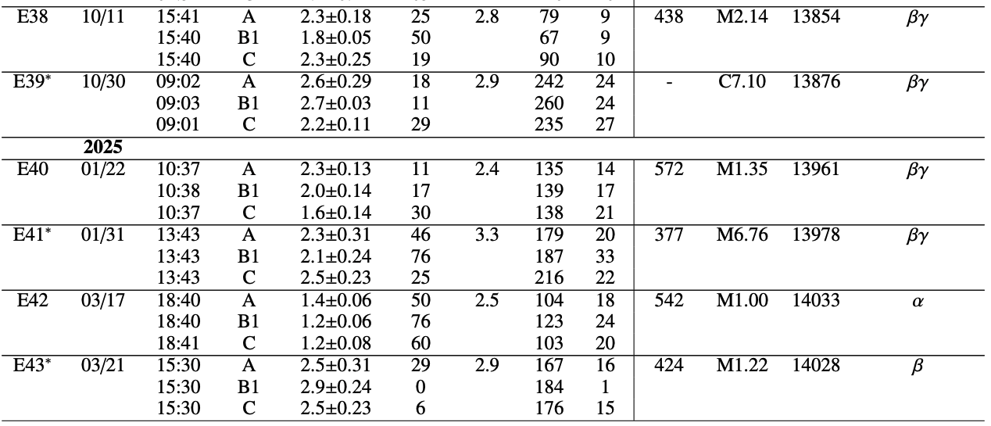
Application: Statistical study
9
We measured characteristics of 43 solar flux ropes.
SolO, SDO & STEREO.
5 measurements per event & instrument, we take the average value.
......
……
……
……
……
……
……
……
……
……
……
……
……
By using observations from multiple spacecraft, we address the projection effect.
CME speed from estimated from 3D reconstruction.
European Space Weather Week, 2025 – brenda.dorsch@oma.be

Slide 10
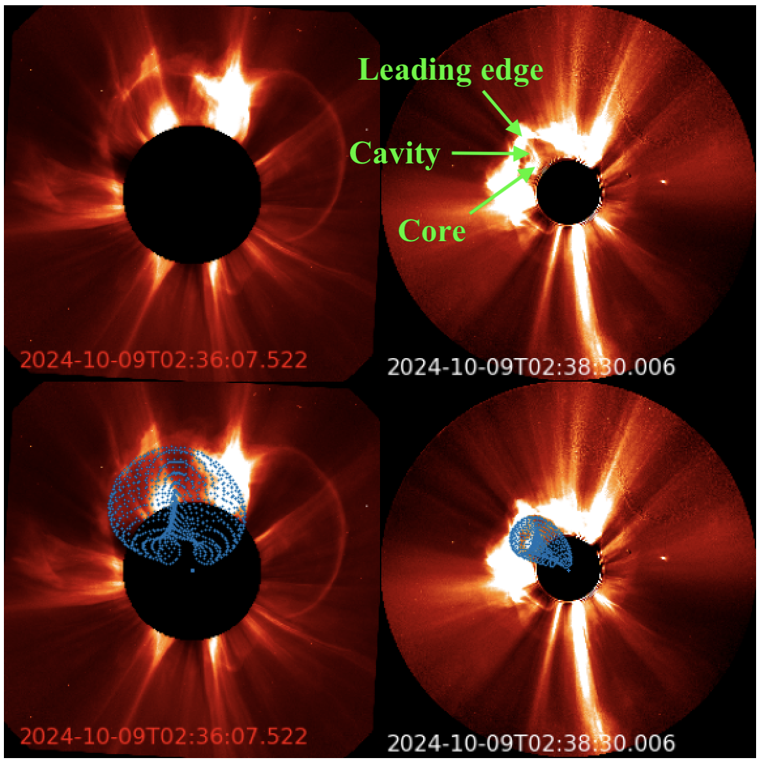
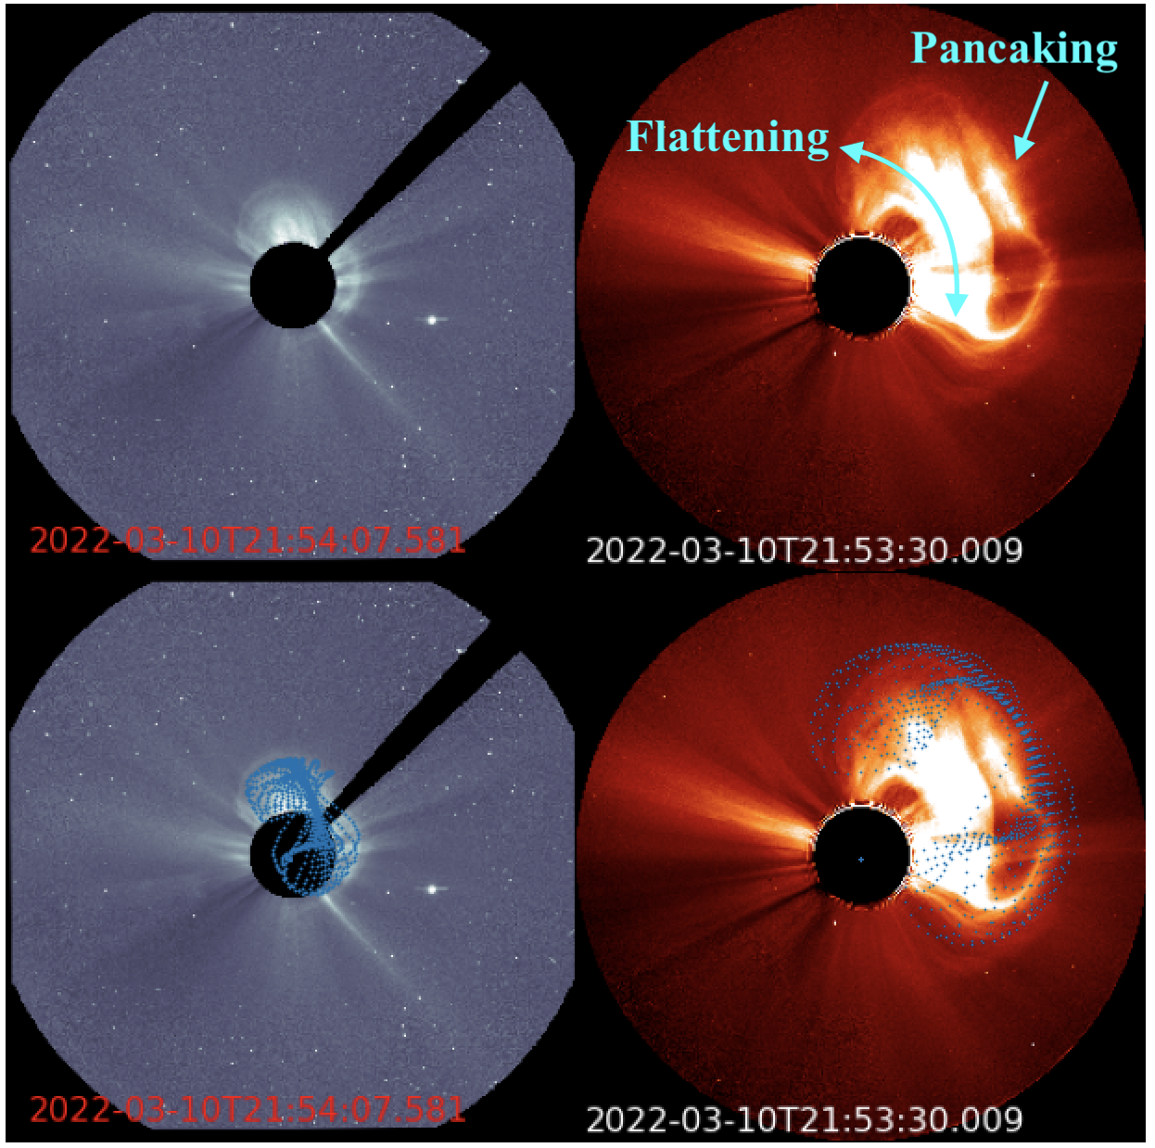
Application: Statistical study
10
3D CME reconstruction.
Based on FRi3D geometry.
European Space Weather Week, 2025 – brenda.dorsch@oma.be

Slide 11
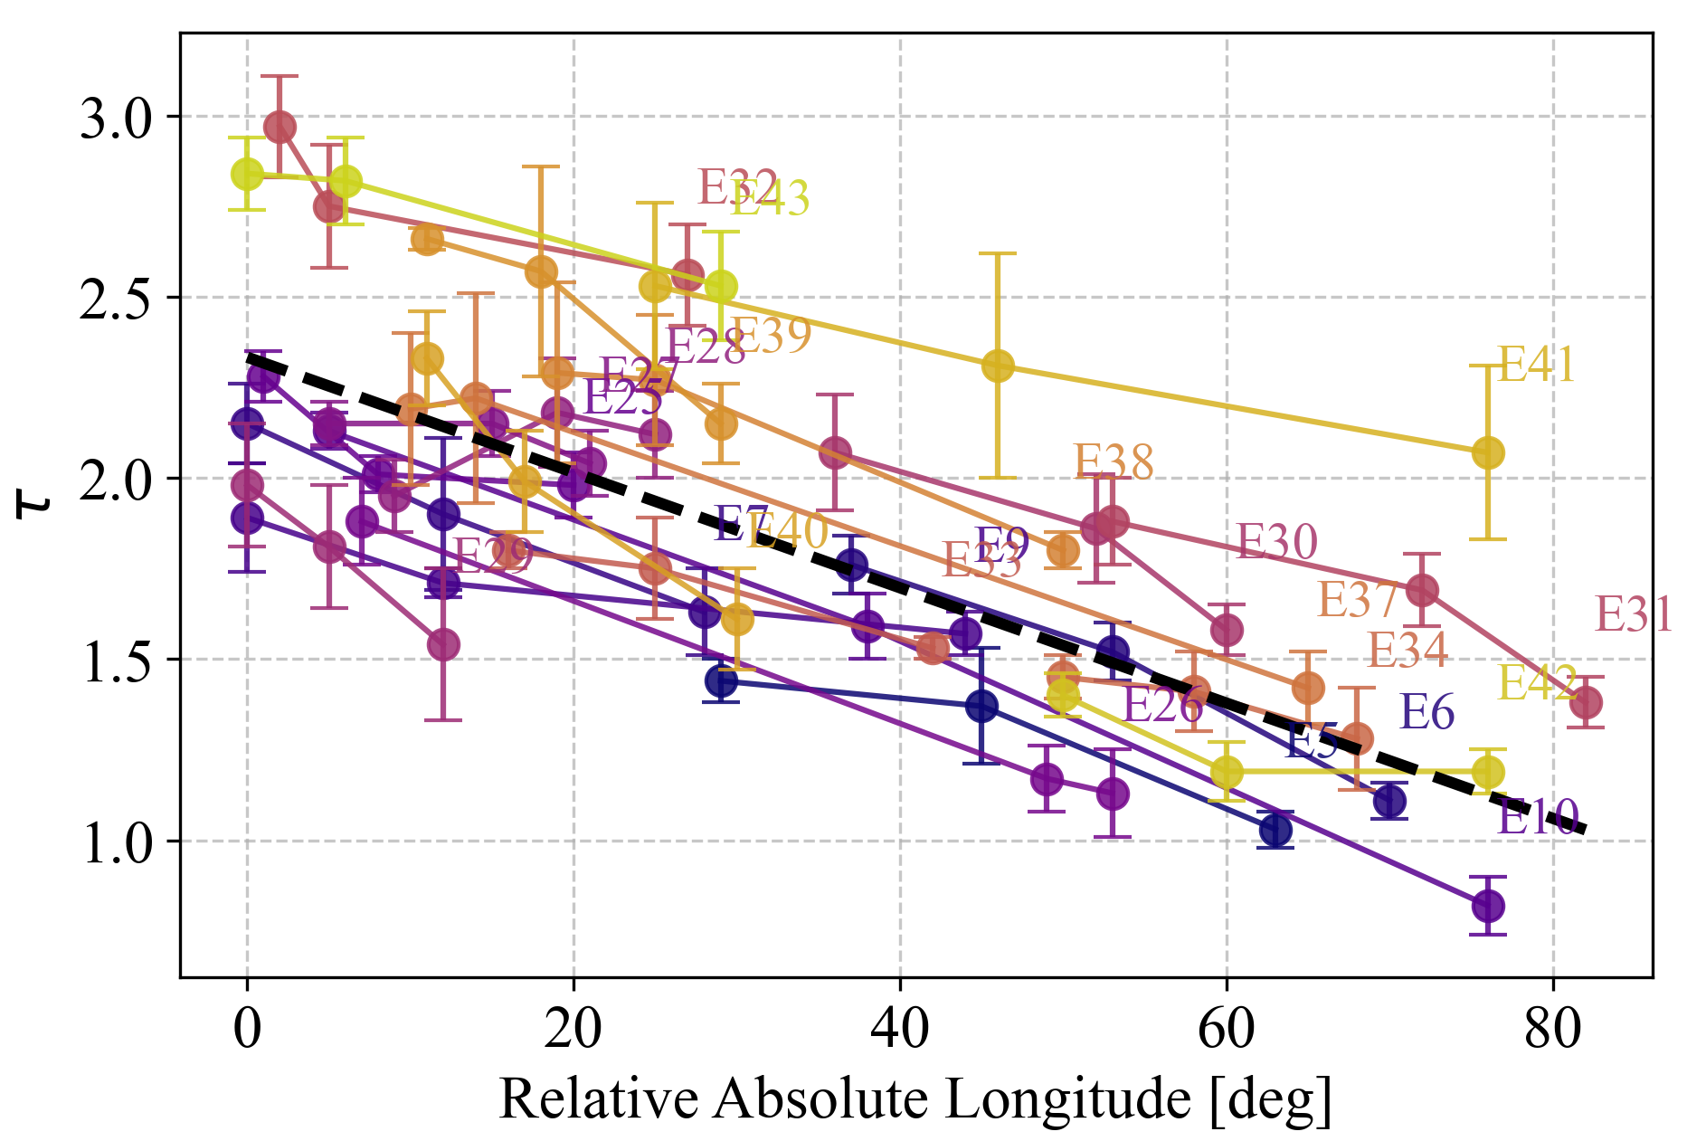
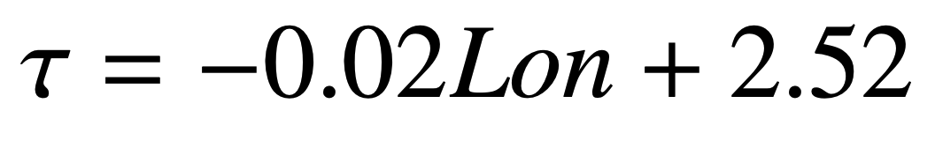
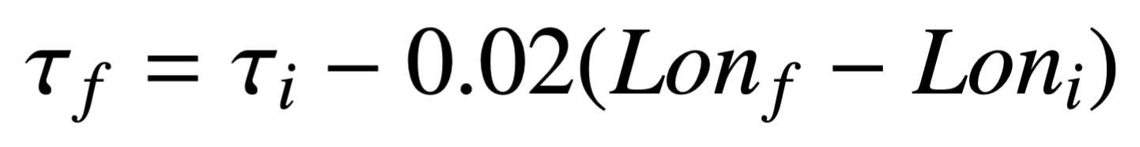
Statistical results
11
Deprojection.
23 events observed by 3 spacecraft only.
Strong dependence of the magnetic twist value on the observer vantage point was found.
General trend of decreasing twist with increasing longitude.
Used to deproject the twist value to the central meridian, 𝝉_{d}.
Dorsch et al. (to be submitted).
European Space Weather Week, 2025 – brenda.dorsch@oma.be

Slide 12
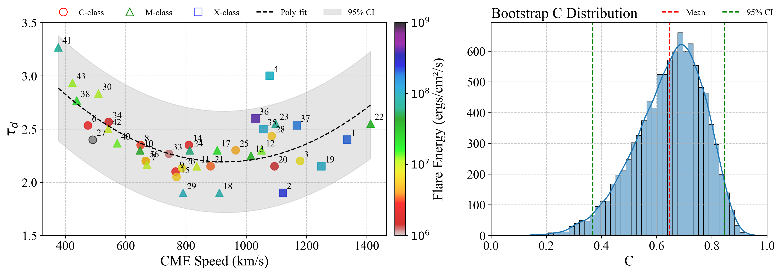
Statistical results
12
Twist vs. V_{CME} & flare.
For 40 cases, we used the deprojected twist value, 𝝉_{d}, and analysed the relation with the associated flare and CME speed.
We assessed the robustness of the correlation C by applying bootstrap resampling to the C statistic.
Mean C = 0.66
95% CI 0.38-0.85
X-class cases more scattered.
European Space Weather Week, 2025 – brenda.dorsch@oma.be

Slide 13
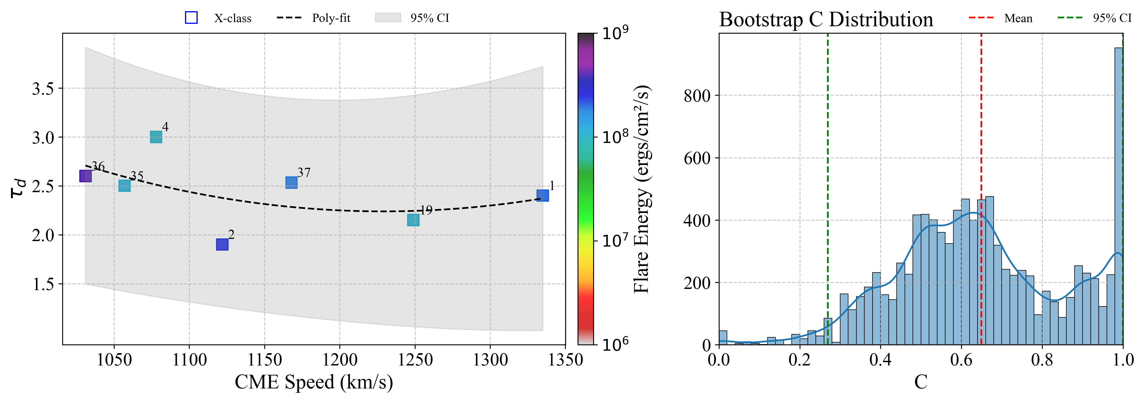
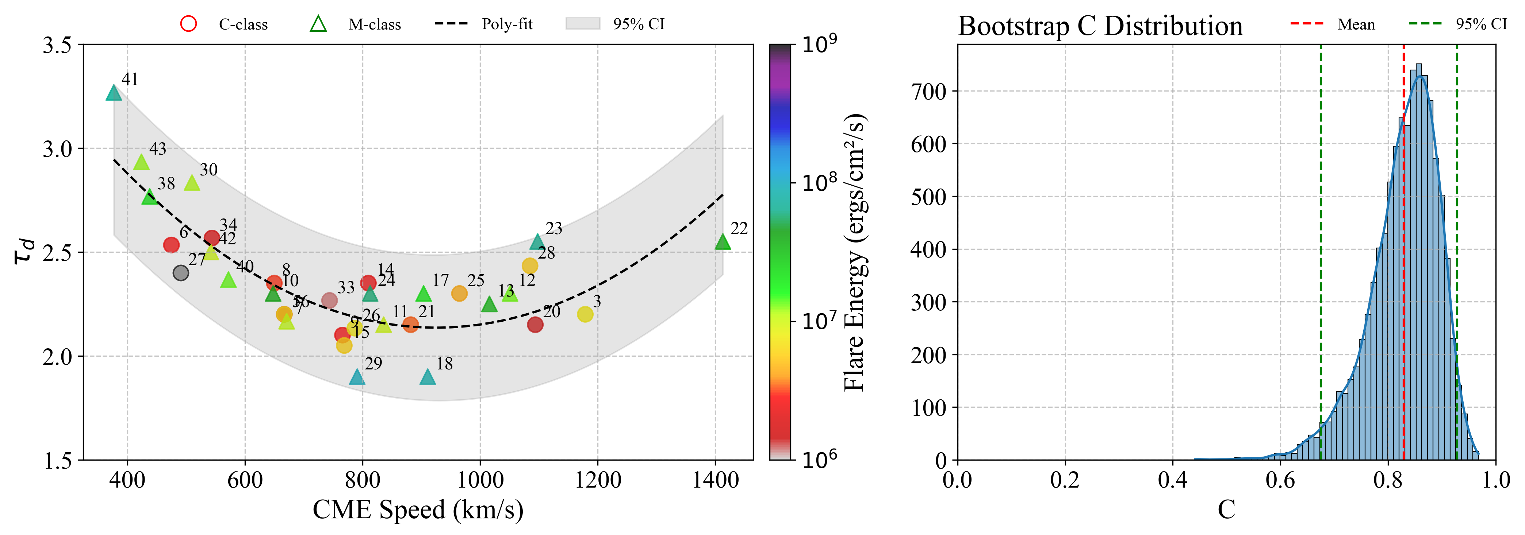
Statistical results
13
X-class. 7 cases.
Mean C = 0.68
95% CI 0.27-1
Correlation is significant despite the small sample, but CI is wide.
C-class + M-class. 33 cases.
Mean C = 0.83
95% CI 0.67-0.93
𝝉_{d} - CME speed relationship is significantly more robust for events associated with lower-energy flares.
European Space Weather Week, 2025 – brenda.dorsch@oma.be

Slide 14
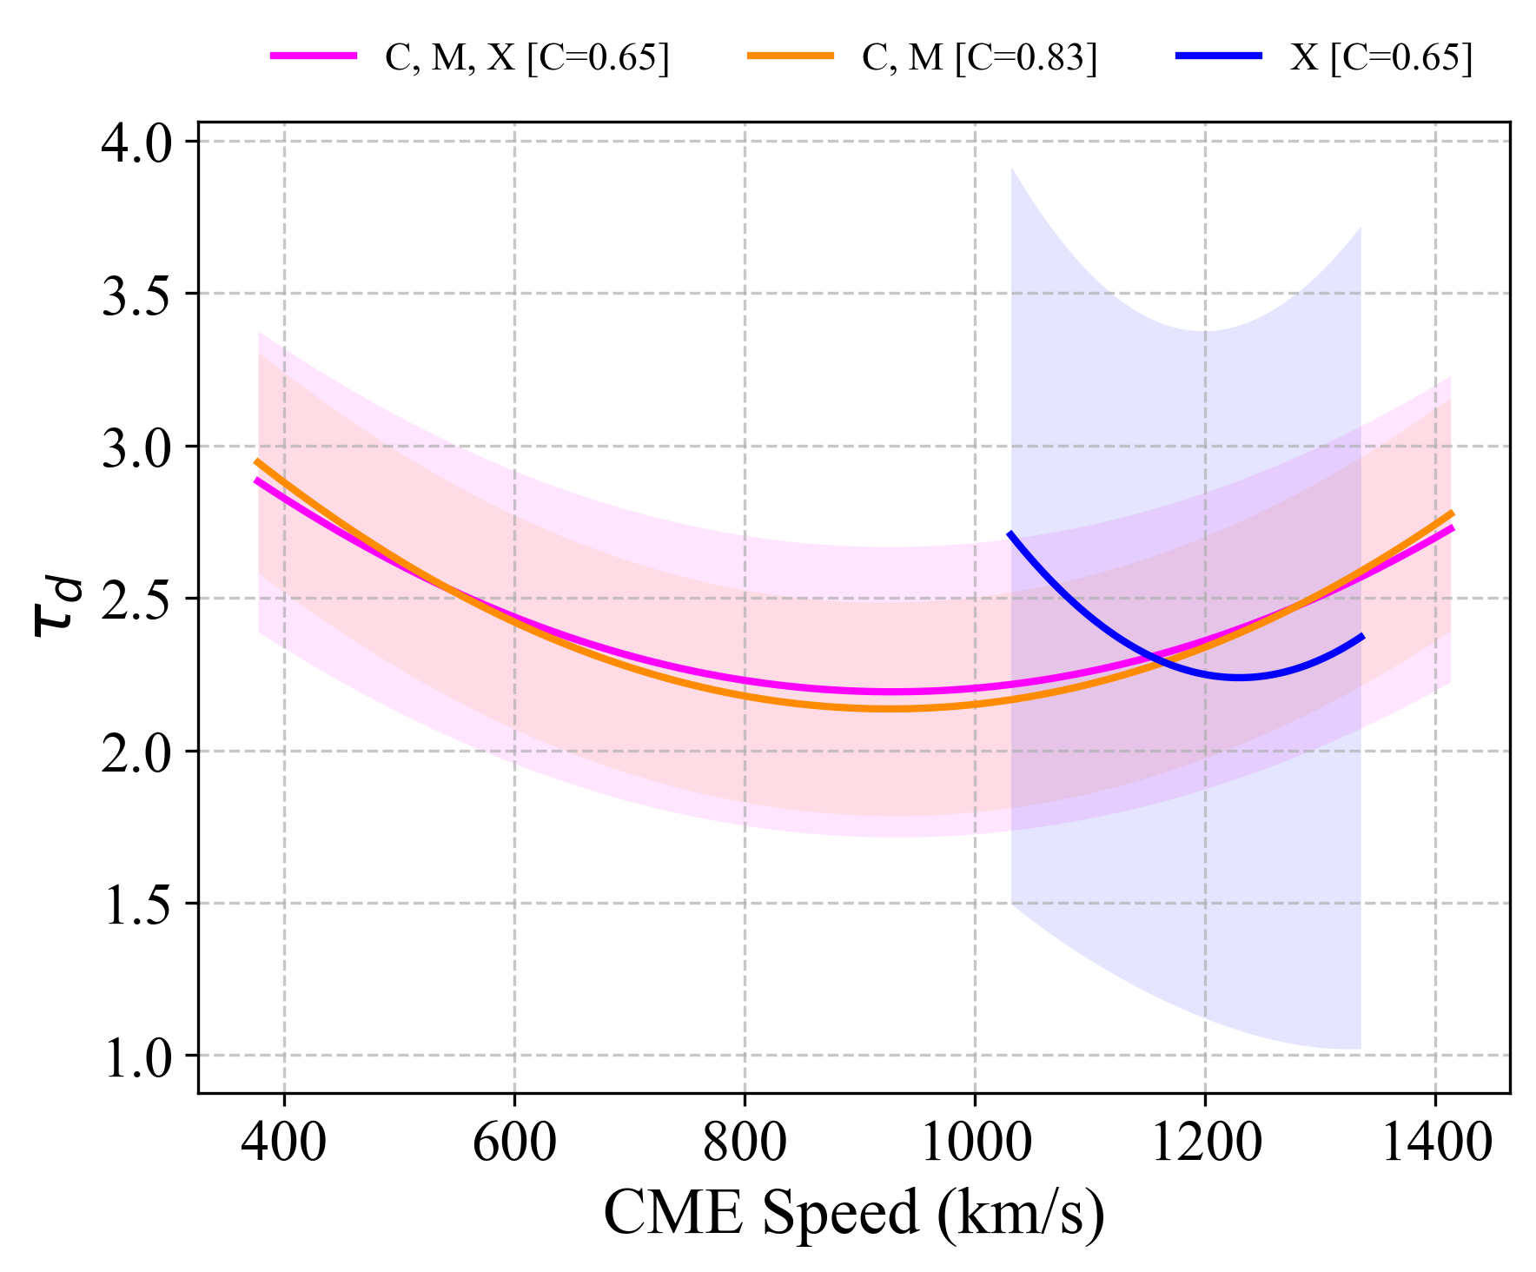
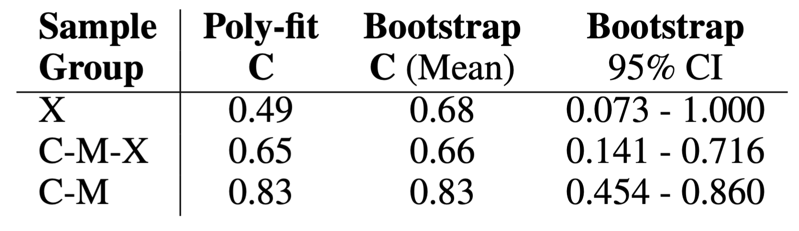
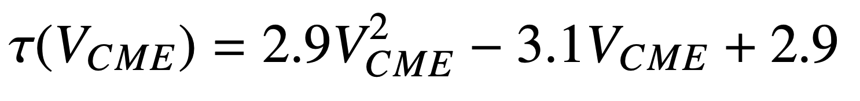
Statistical results
14
C,M,X-class & C,M-class groups fittings remain closely aligned.
𝝉_{d} - CME speed relationship is mainly defined by the C and M-class events and is only weakly perturbed by the inclusion of the X-class data.
Twist proxy
Need to assess dimensionality.
European Space Weather Week, 2025 – brenda.dorsch@oma.be

Slide 15
Summary
It is very important to estimate the twist of a magnetic flux rope as input parameter for CME modelling.
We proposed a method to measure the twist from EUV observations
& we developed a tool applicable for operational space weather services.
We applied the method to 43 cases and analysed:
  The projection effect associated to the observer POV.
  The relationship between twist and CME speed & flare.
Coherent dependence of the twist with the position (lon.) relative to the spacecraft.
C = 0.83
C-class + M-class group.
We propose a proxy to estimate the twist of a magnetic flux rope from the CME speed, which is rutinely calculated in space weather.
Tusen tack!!!
This work is presented in: B. D. Dorsch et al. (to be submitted).
European Space Weather Week, 2025 – brenda.dorsch@oma.be

