Slide 1
PhD Project : Long-term evolution of large-scale magnetic structures on USET images
ROYAL OBSERVATORY
OF BELGIUM
Grégory VANDEN BROECK
ROB Supervisors
Frédéric CLETTE Sabrina BECHET
ULiège Supervisor
Gregor RAUW

Slide 2
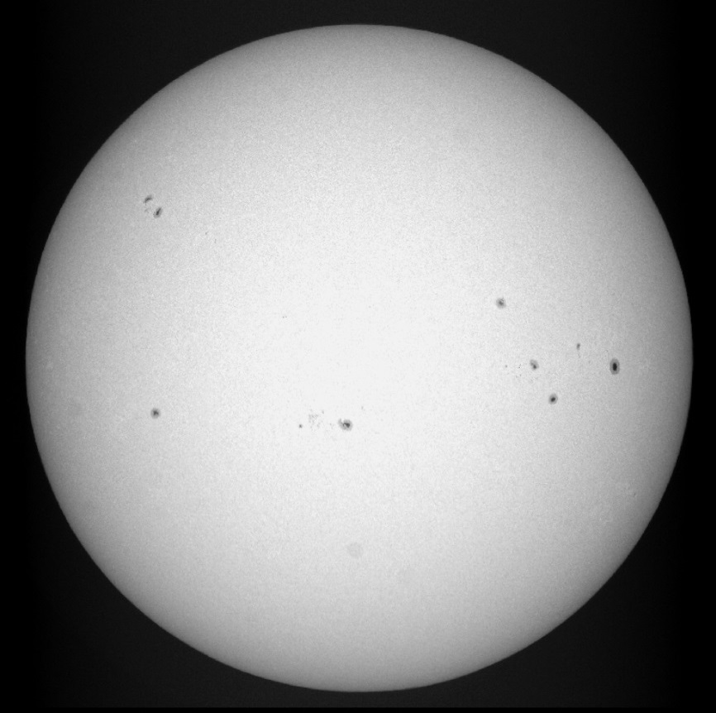
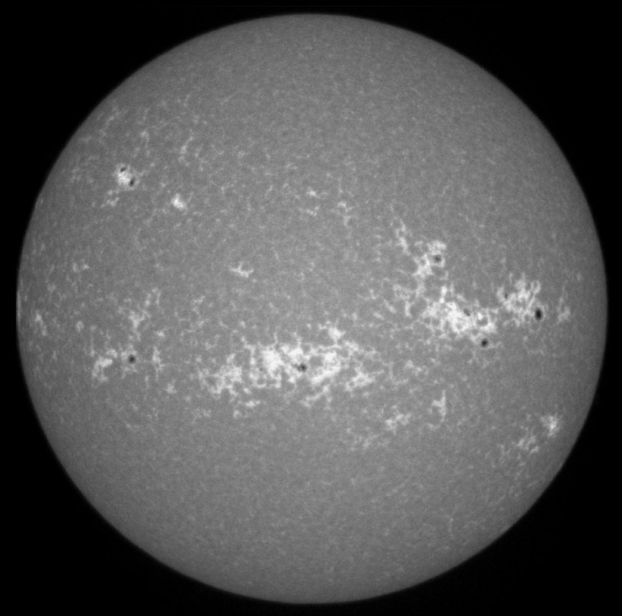
1. Introduction
Aim : - Better understand the evolution of solar magnetic structures
Sunspots :
Dark and cool features ($\sim$4000K)
Plages :
Bright and extended structures (higher temperature and density)
Sunspots groups
Bright plages
http://sidc.oma.be/uset/searchForm.php

Slide 3
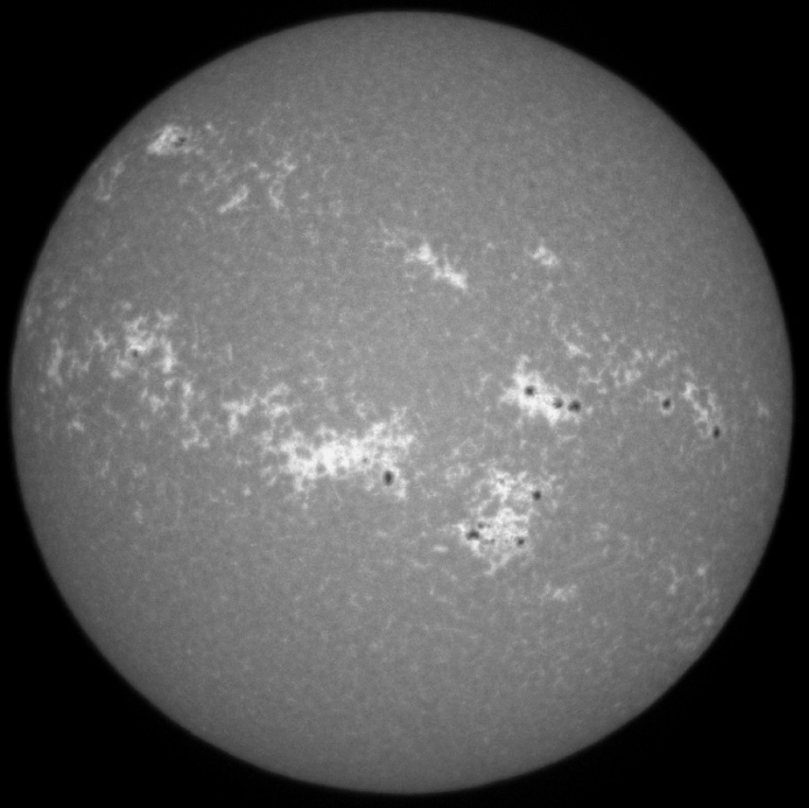
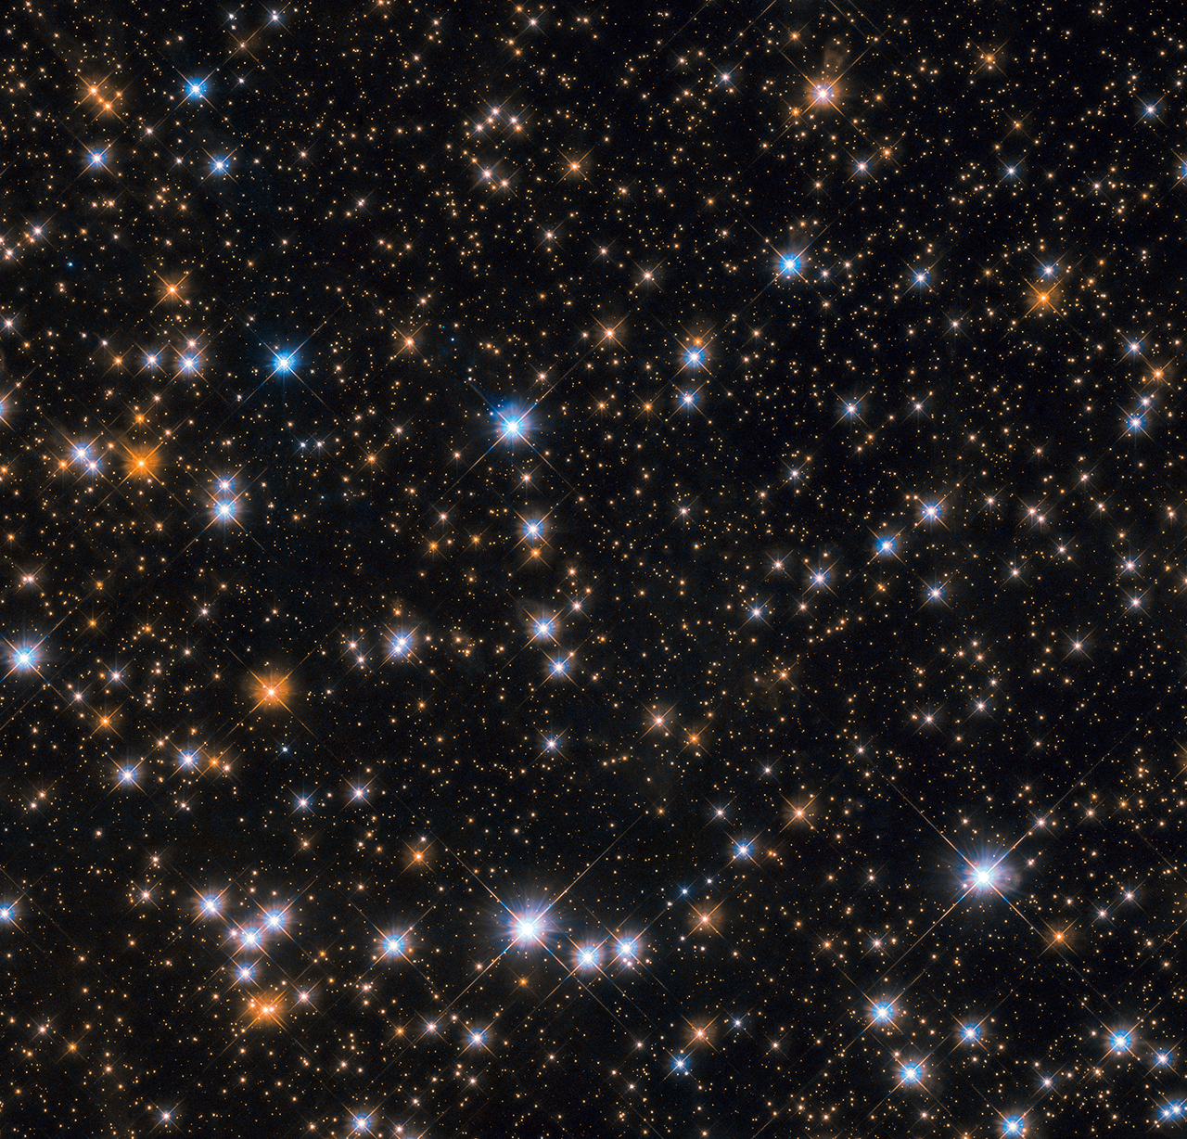
1. Introduction
Aim : - Better understand the evolution of solar magnetic structures - Compare solar magnetic activity with sun-like stars magnetic activity
https://www.nasa.gov/image-feature/goddard/2019/hubble-spots-flock-of-cosmic-ducks
Plages area
Integrated spectrum
???

Slide 4
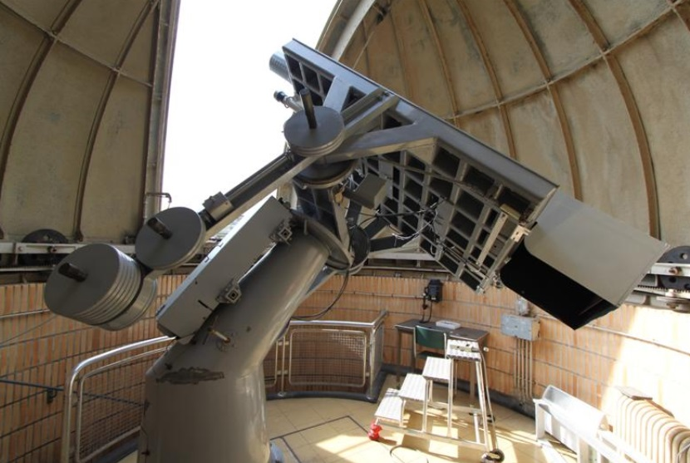
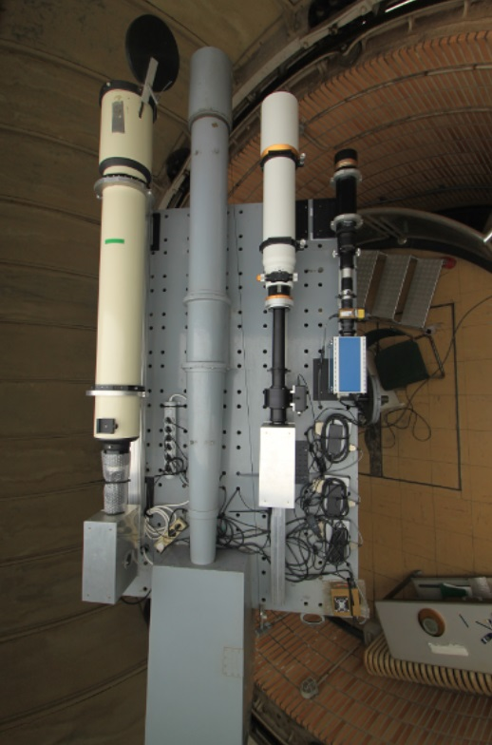
1. Introduction
Aim : - Better understand the evolution of solar magnetic structures - Compare solar magnetic activity with sun-like stars magnetic activity
How ? Exploitation of images taken on-site with USET (« Uccle Solar Equatorial Table »)
http://www.sidc.be/uset/usetpres.php

Slide 5
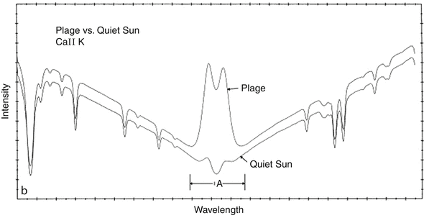
1. Introduction
Aim : - Better understand the evolution of solar magnetic structures - Compare solar magnetic activity with sun-like stars magnetic activity
How ? Exploitation of images taken on-site with USET (« Uccle Solar Equatorial Table »)
Ca II K line : 3933.7 Å
Filter bandpass : 2.7 Å
Pagano, I. (2013). Stellar Activity. In: Oswalt, T.D., Barstow, M.A. (eds) Planets, Stars and Stellar Systems. Springer, Dordrecht. https://doi.org/10.1007/978-94-007-5615-1_10
Chromosphere ($Ca$ II K)

Slide 6
2. Plage segmentation
1) Dataset sorting
USET Ca II K database : $\sim$ 21.000 images since July 2012 $→$ Aim : 1 image per day

Slide 7
2. Plage segmentation
1) Dataset sorting
USET Ca II K database : $\sim$ 21.000 images since July 2012 $→$ Aim : 1 image per day
How ? Removing bad quality images

Slide 8
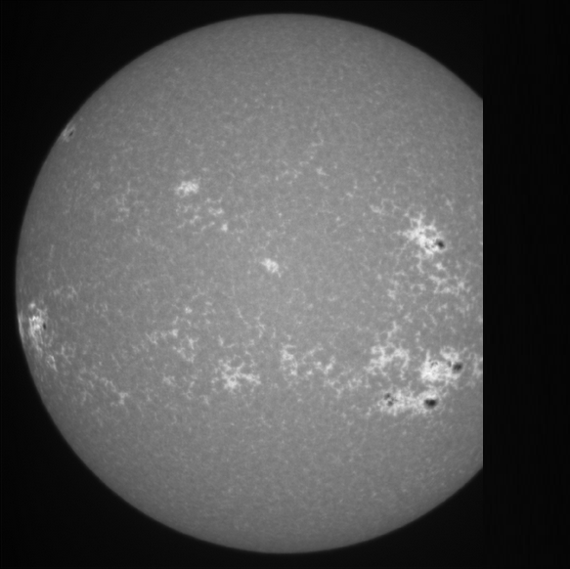
2. Plage segmentation
1) Dataset sorting
USET Ca II K database : $\sim$ 21.000 images since July 2012 $→$ Aim : 1 image per day
How ? Removing bad quality images
Cropped image
Missing information

Slide 9
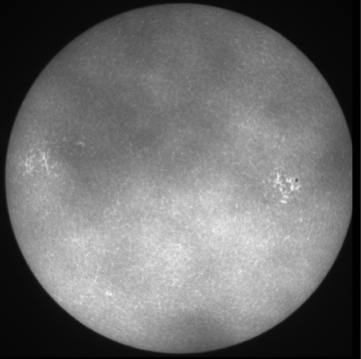
2. Plage segmentation
1) Dataset sorting
USET Ca II K database : $\sim$ 21.000 images since July 2012 $→$ Aim : 1 image per day
How ? Removing bad quality images
Cropped image
Clouds
Missing information
Hidden information

Slide 10
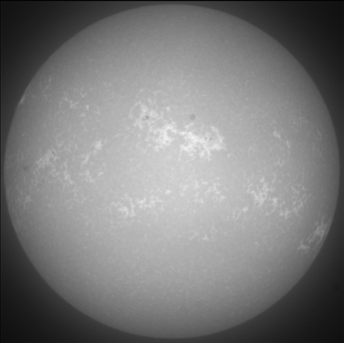
2. Plage segmentation
1) Dataset sorting
USET Ca II K database : $\sim$ 21.000 images since July 2012 $→$ Aim : 1 image per day
How ? Removing bad quality images
Cropped image
Clouds
Diffusion
Missing information
Hidden information
Information not very well resolved

Slide 11
2. Plage segmentation
1) Dataset sorting
USET Ca II K database : $\sim$ 21.000 images since July 2012 $→$ Aim : 1 image per day
How ? Removing bad quality images
Cropped image
Clouds
Diffusion
Missing information
Hidden information
Information not very well resolved
Final dataset : 2217 images

Slide 12
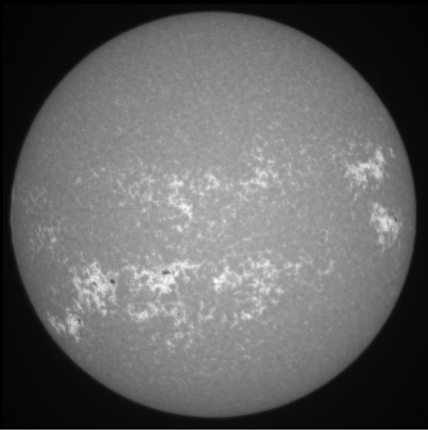
2. Plage segmentation
2) Limb darkening correction
Brighter at the center
Darker at the limb
Center-to-Limb
Variation

Slide 13
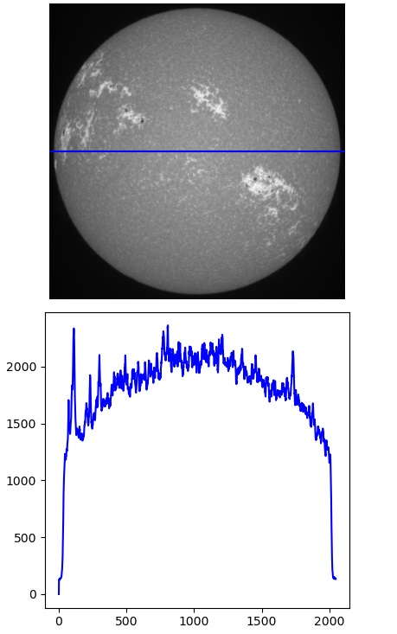
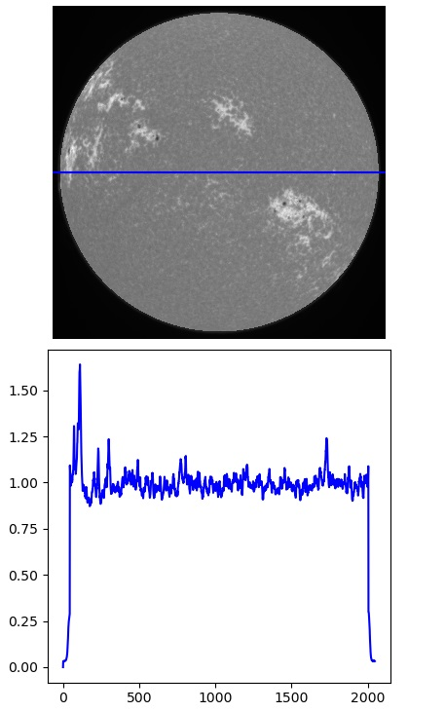
2. Plage segmentation
2) Limb darkening correction
Method :
Fit the intensity profile
Create a mask based on the fit
Divide the matrix by the mask
Remove the active regions
Repeat the steps 1, 2, 3

Slide 14
2. Plage segmentation
2) Limb darkening correction

Slide 15
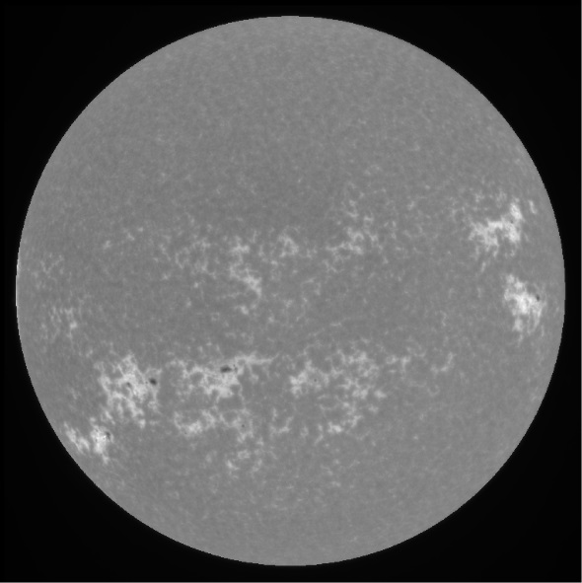
2. Plage segmentation
2) Limb darkening correction
AFTER CLV
CORRECTION

Slide 16
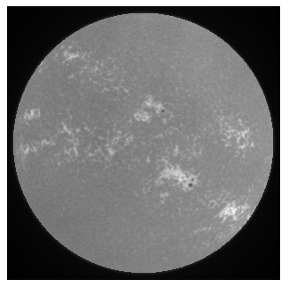
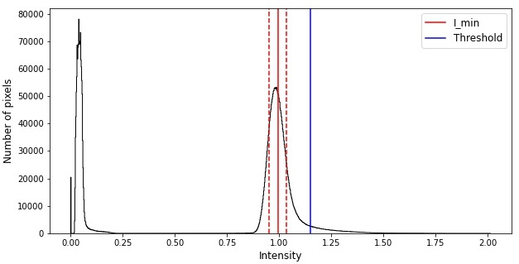
2. Plage segmentation
3) Segmentation method
$$\boxed{T_{plages}≥{\overline{I}}_{min}+m_{f} .σ_{min}}$$
where $m_{f}$ is an arbitrary multiplicative factor
● Assuming a Gaussian background brightness distribution
● Assuming a non-Gaussion contribution to the wings (sunspots and plages)
● Some computations with the mean intensity and the standard deviation

Slide 17
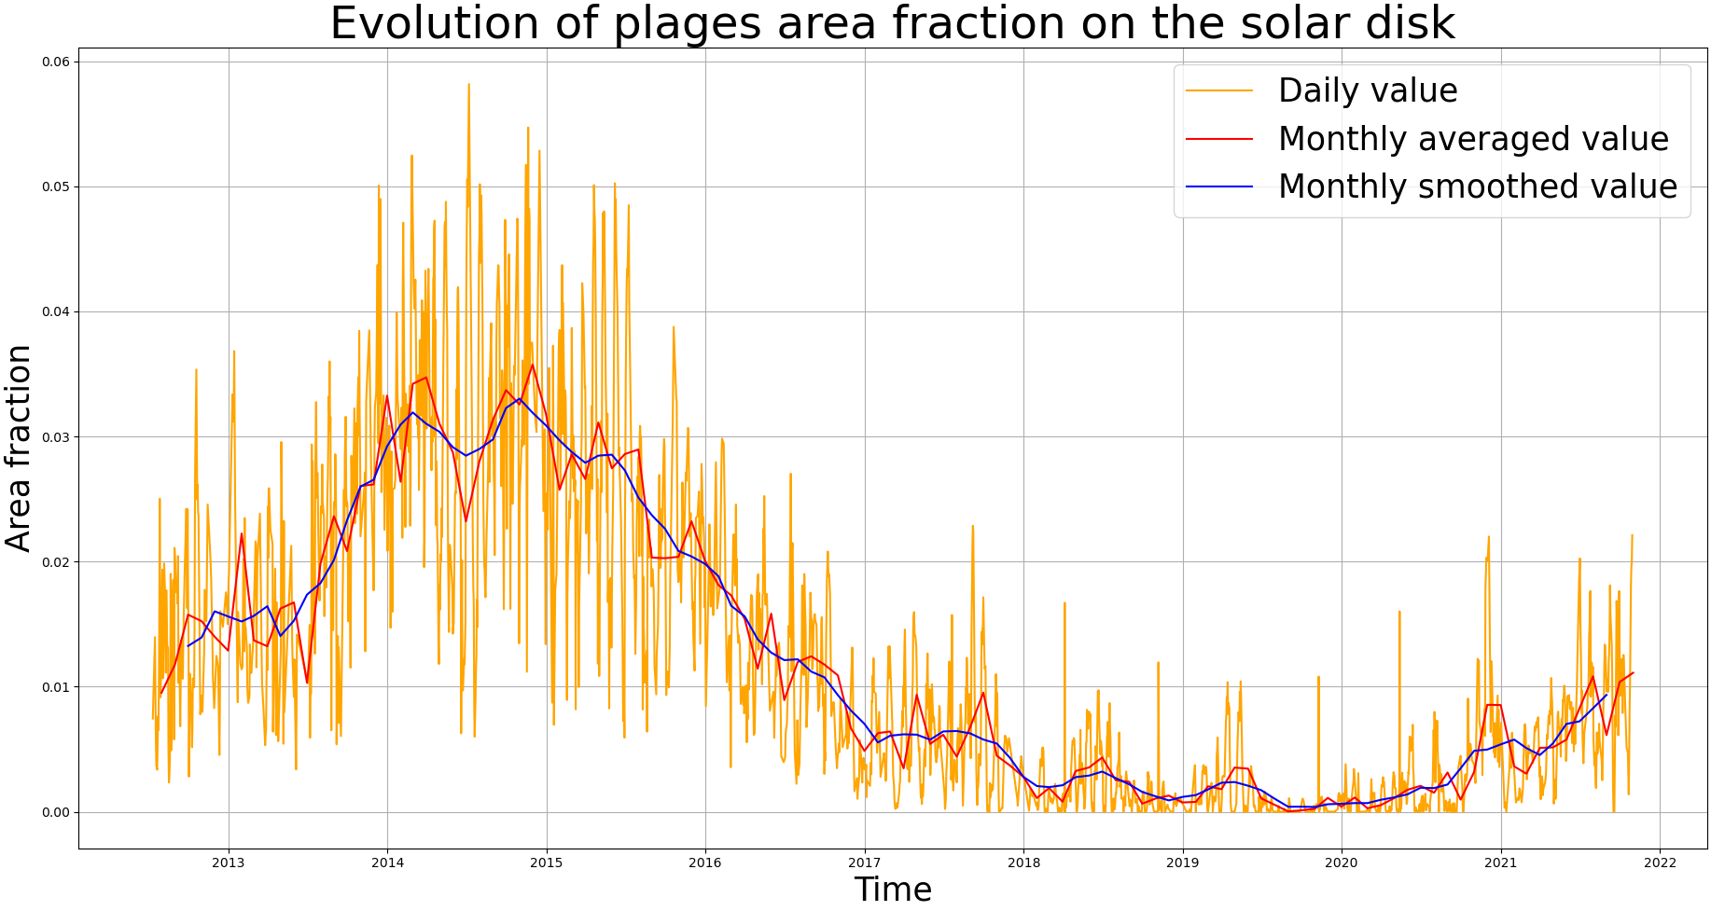
2. Plage segmentation
3) Segmentation method

Slide 18
2. Plage segmentation
4) Uncertainty calculations
How ? Using the full dataset of $\sim$ 21.000 images in the USET database

Slide 19
2. Plage segmentation
4) Uncertainty calculations
How ? Using the full dataset of $\sim$ 21.000 images in the USET database
Compute the area fraction for each image
Compute the standard deviation for each day
Remove the outliers
Assume a 1D relationship between plages area and standard deviation
Fit the data and get the equation

Slide 20
2. Plage segmentation
4) Uncertainty calculations
How ? Using the full dataset of $\sim$ 21.000 images in the USET database
Compute the area fraction for each image
Compute the standard deviation for each day
Remove the outliers
Assume a 1D relationship between plages area and standard deviation
Fit the data and get the equation

Slide 21
2. Plage segmentation
4) Uncertainty calculations
How ? Using the full dataset of $\sim$ 21.000 images in the USET database
Compute the area fraction for each image
Compute the standard deviation for each day
Remove the outliers
Assume a 1D relationship between plages area and standard deviation
Fit the data and get the equation

Slide 22
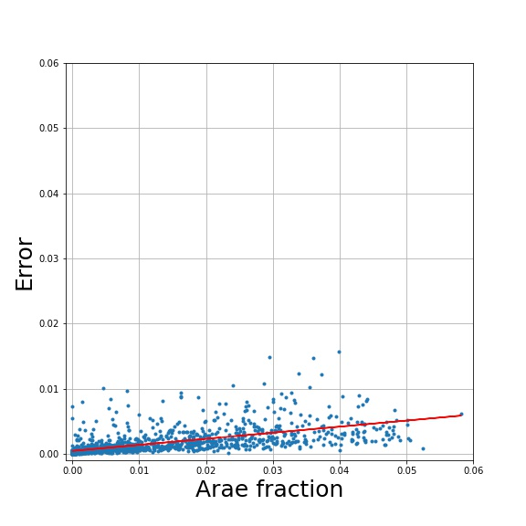
2. Plage segmentation
4) Uncertainty calculations
How ? Using the full dataset of $\sim$ 21.000 images in the USET database
Compute the area fraction for each image
Compute the standard deviation for each day
Remove the outliers
Assume a 1D relationship between plages area and standard deviation
Fit the data and get the equation
Area fraction

Slide 23
2. Plage segmentation
4) Uncertainty calculations
How ? Using the full dataset of $\sim$ 21.000 images in the USET database
Compute the area fraction for each image
Compute the standard deviation for each day
Remove the outliers
Assume a 1D relationship between plages area and standard deviation
Fit the data and get the equation
$$Error=0.0932 Area+0.0004$$
Area fraction

Slide 24
2. Plage segmentation
4) Uncertainty calculations
How ? Using the full dataset of $\sim$ 21.000 images in the USET database
Compute the area fraction for each image
Compute the standard deviation for each day
Remove the outliers
Assume a 1D relationship between plages area and standard deviation
Fit the data and get the equation
$⇒$ Error proportional to the area
$$Error=0.0932 Area+0.0004$$
Area fraction

Slide 25
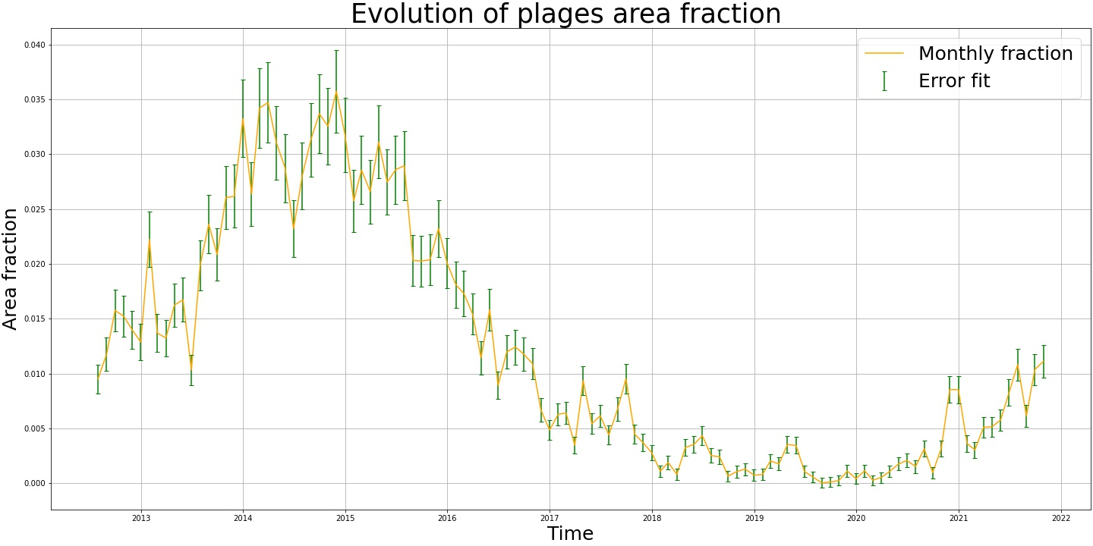
2. Plage segmentation
4) Uncertainty calculations

Slide 26
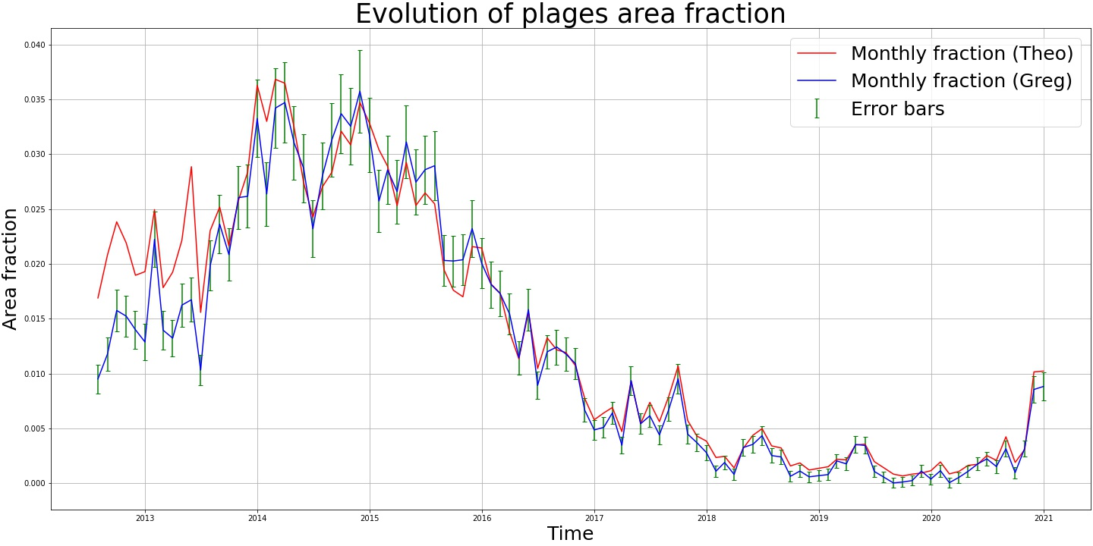
3. Data serie validation
How ? Comparison with Theodosios Chatzistergos results on USET dataset (Chatzistergos et al. 2020)
Chatzistergos, T., Ermolli, I., Krivova, N.A., et al. (2020). Analysis of full-disc Ca II K spectroheliograms. III. Plage area composite series covering 1892-2019, A&A, 639, A88, DOI 10.1051/0004- 6361/202037746

Slide 27
3. Data serie validation
Dataset problem
How ? Comparison with Theodosios Chatzistergos results on USET dataset (Chatzistergos et al. 2020)
Chatzistergos, T., Ermolli, I., Krivova, N.A., et al. (2020). Analysis of full-disc Ca II K spectroheliograms. III. Plage area composite series covering 1892-2019, A&A, 639, A88, DOI 10.1051/0004- 6361/202037746

Slide 28
3. Data serie validation
Dataset problem
How ? Comparison with Theodosios Chatzistergos results on USET dataset (Chatzistergos et al. 2020)
Problem :
On July 10, 2013 : Installation of a neutral density filter on the Ca II K telescope
Chatzistergos, T., Ermolli, I., Krivova, N.A., et al. (2020). Analysis of full-disc Ca II K spectroheliograms. III. Plage area composite series covering 1892-2019, A&A, 639, A88, DOI 10.1051/0004- 6361/202037746

Slide 29
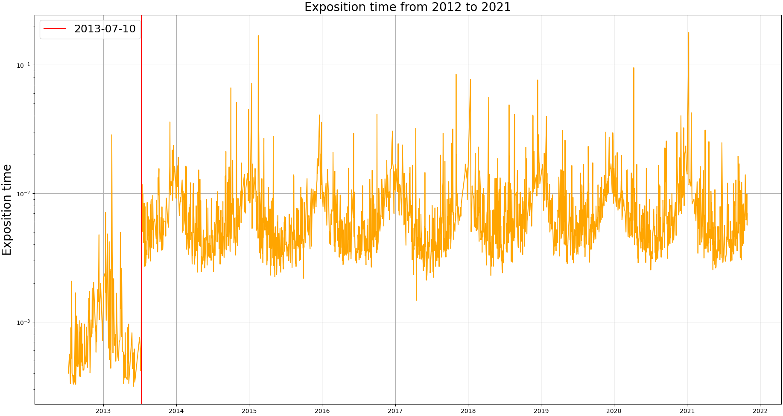
3. Data serie validation
Dataset problem
Problem :
On July 10, 2013 : Installation of a neutral density filter on the Ca II K telescope
Exposure time increased by a factor of 10

Slide 30
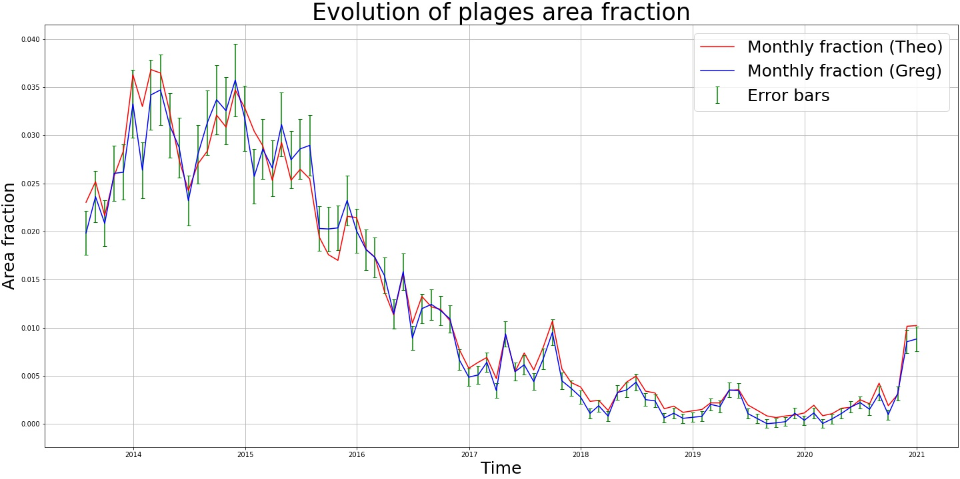
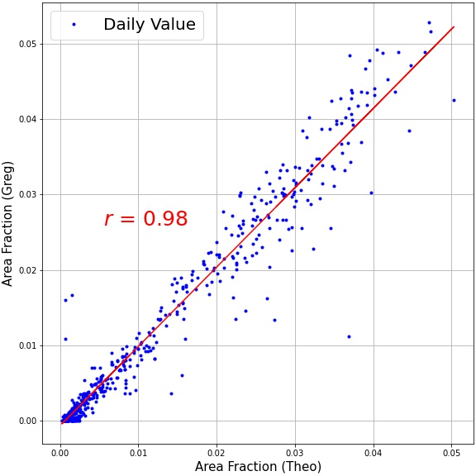
3. Data serie validation
How ? Comparison with Theodosios Chatzistergos results on USET dataset (Chatzistergos et al. 2020)
Chatzistergos, T., Ermolli, I., Krivova, N.A., et al. (2020). Analysis of full-disc Ca II K spectroheliograms. III. Plage area composite series covering 1892-2019, A&A, 639, A88, DOI 10.1051/0004- 6361/202037746

Slide 31
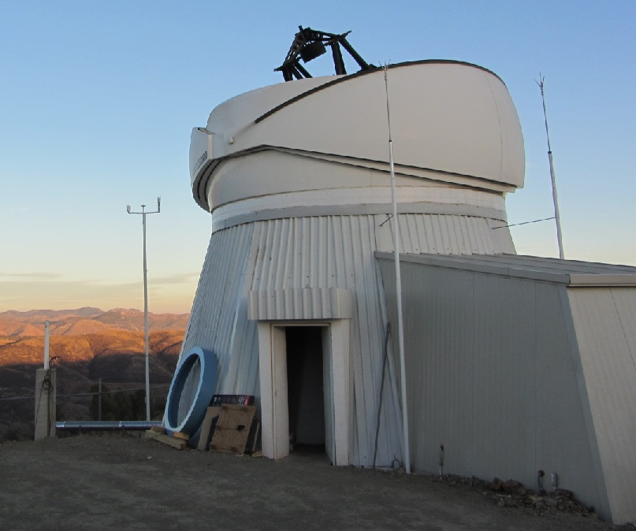
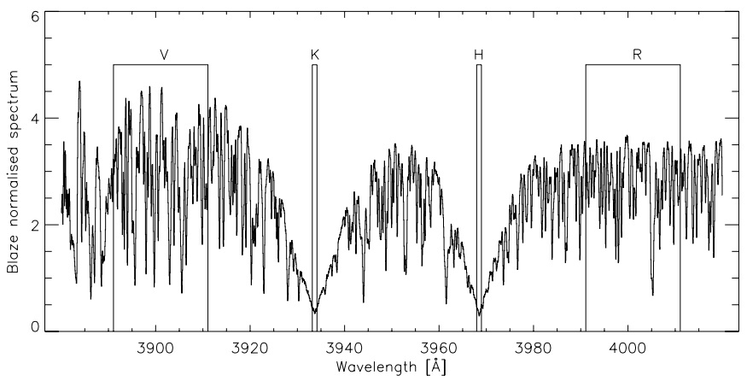
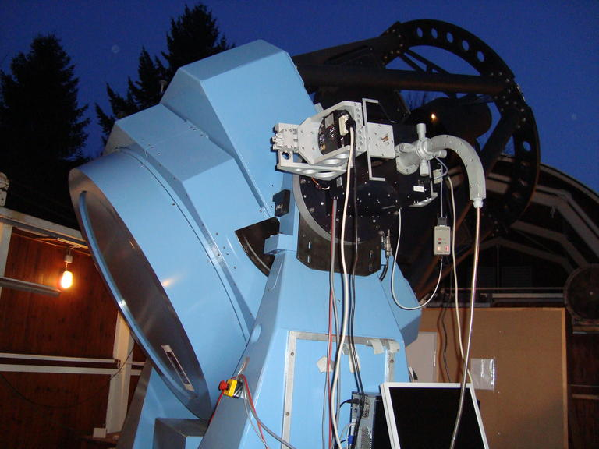
4. TIGRE S-Index
• TIGRE : Telescopio Internacional de Guanajuato Robótico Espectroscópico
• Location : Guanajuato, Mexico
• Activities : - Observing solar spectrum reflected by the Moon (since 08/2013)
- Observing solar-type stars spectrum
• TIGRE data : S-Index $→$ based on the flux in the Ca II H & K lines
$$S=α \frac{N_{H}+N_{K}}{N_{R}+N_{V}}$$
$α$is a calibration constant
A. Hempelmann, M. Mittag, J. N. Gonzalez-Perez, J. H. M. M. Schmitt, K. P. Schröder, G. Rauw, Measuring rotation periods of solar-like stars using TIGRE - A study of periodic CaII H+K S-index variability, A&A 586 A14 (2016)

Slide 32
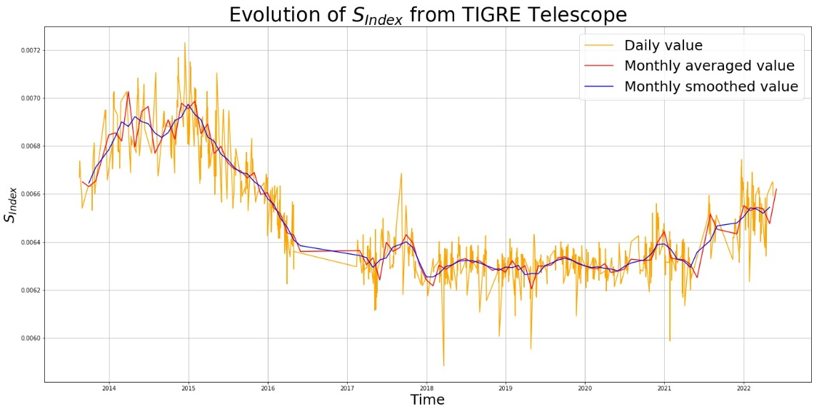
4. TIGRE S-Index
Solar S-Index
• Following the solar cycle (maximum in 2014-2015 and minimum in 2019-2020)
• Some technical issues that limited or hindered its functionalities (e.g. 2016-2017)

Slide 33
5. USET vs TIGRE
TIGRE S-Index
USET Ca II K plages
???

Slide 34
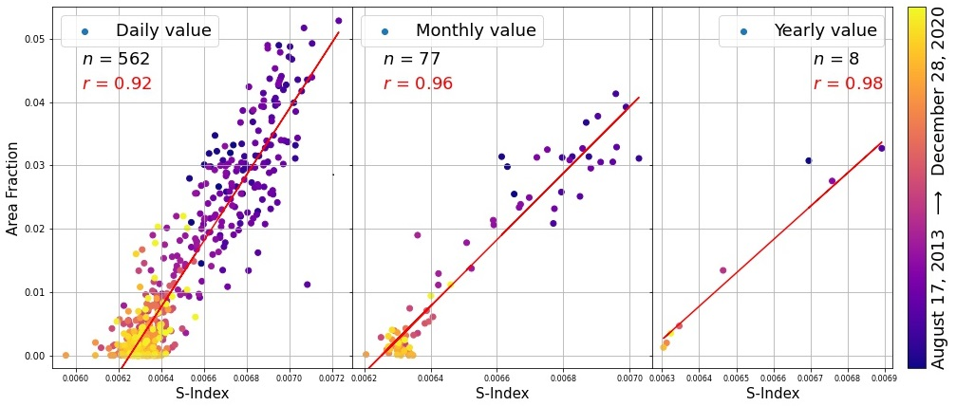
5. USET vs TIGRE
• Correlation coefficient > 0.92 $→$ Strong linear relationship between both variables
• Preliminary results to understand the relation between Ca II K plages and S-Index

Slide 35
6. Synoptic map
Aim : - Observe the distribution of the magnetic structures during a complete solar rotation
- Reconstruct solar images for different angles of view

Slide 36
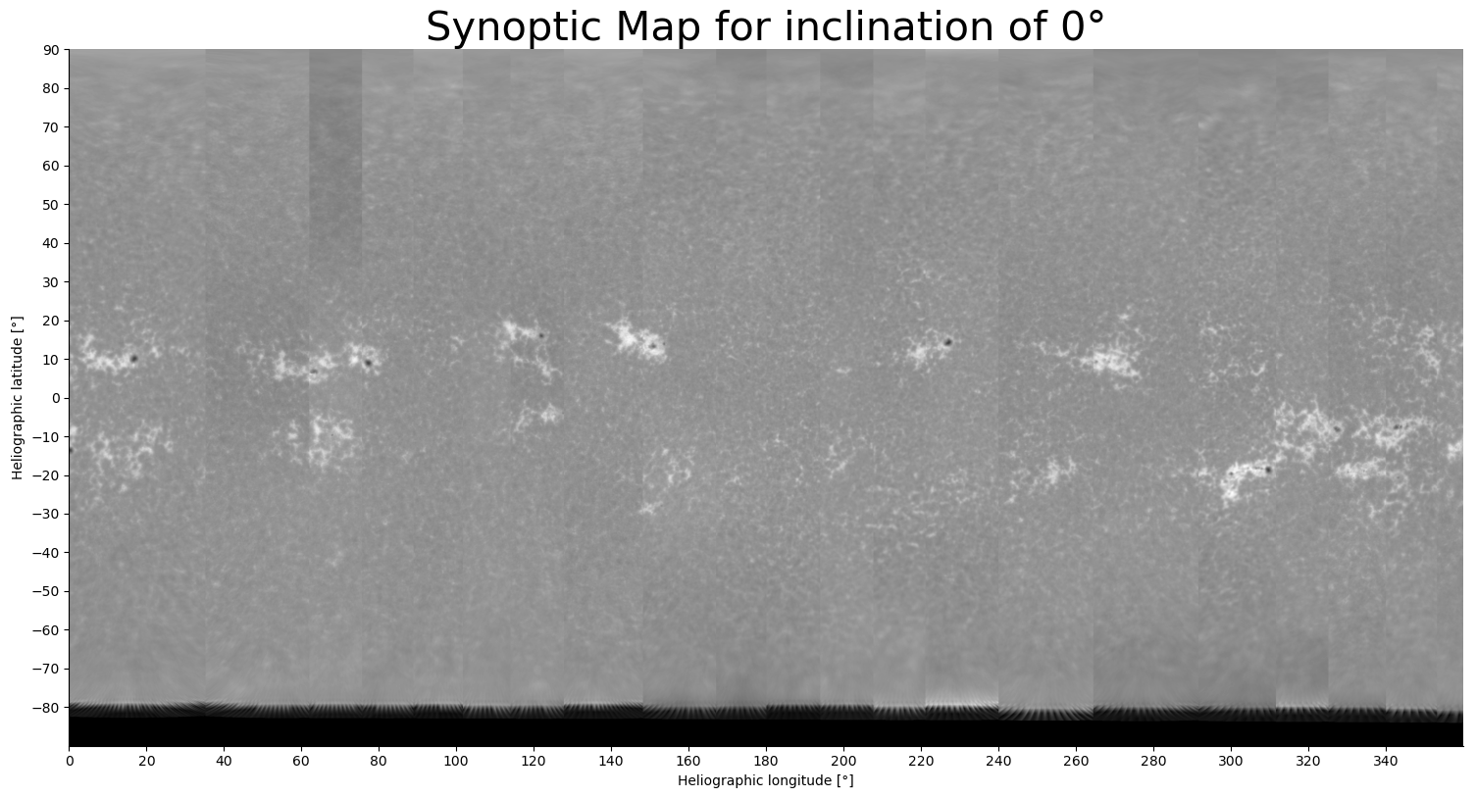
6. Synoptic map
Aim : - Observe the distribution of the magnetic structures during a complete solar rotation
- Reconstruct solar images for different angles of view

Slide 37
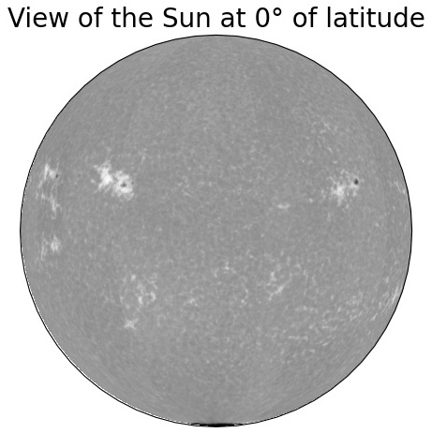
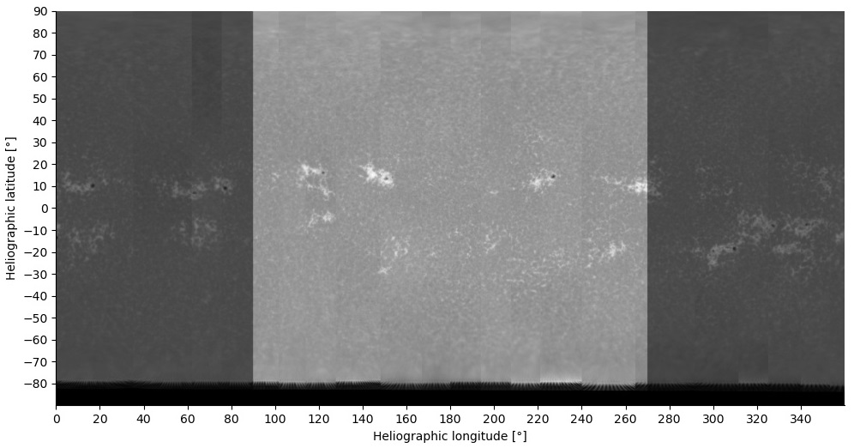
6. Synoptic map
Aim : - Observe the distribution of the magnetic structures during a complete solar rotation
- Reconstruct solar images for different angles of view

Slide 38
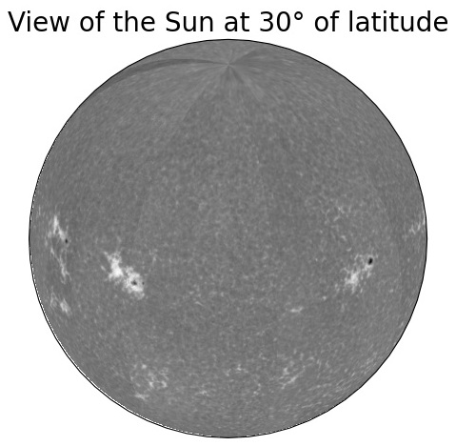
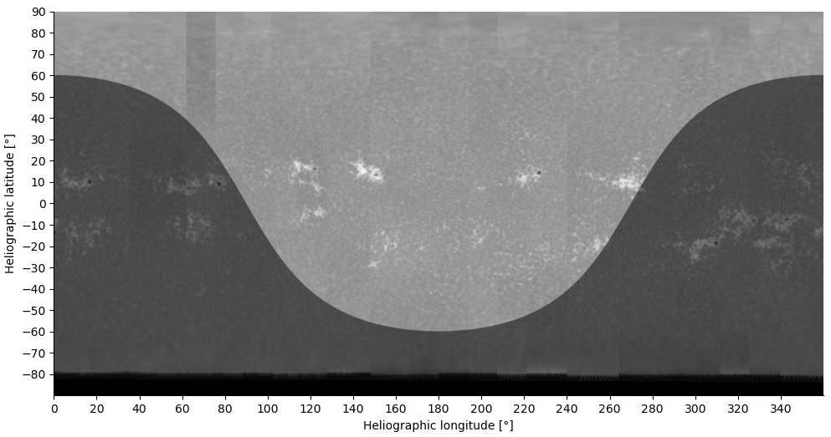
6. Synoptic map
Aim : - Observe the distribution of the magnetic structures during a complete solar rotation
- Reconstruct solar images for different angles of view

Slide 39
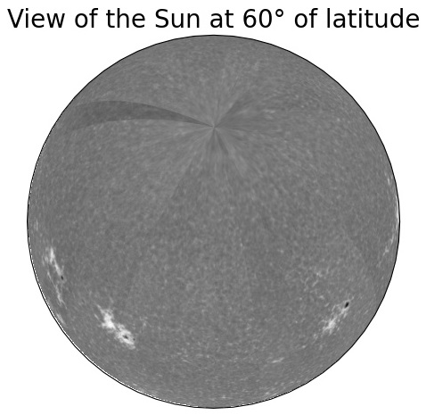
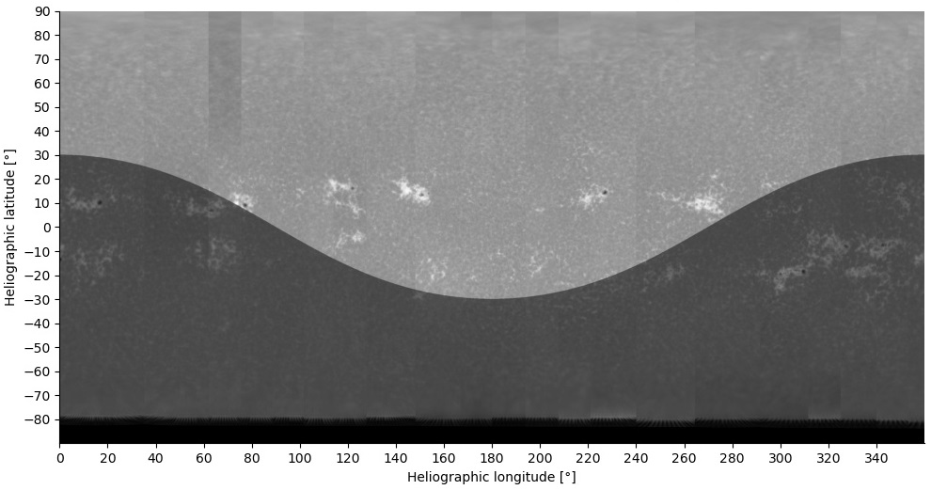
6. Synoptic map
Aim : - Observe the distribution of the magnetic structures during a complete solar rotation
- Reconstruct solar images for different angles of view

Slide 40
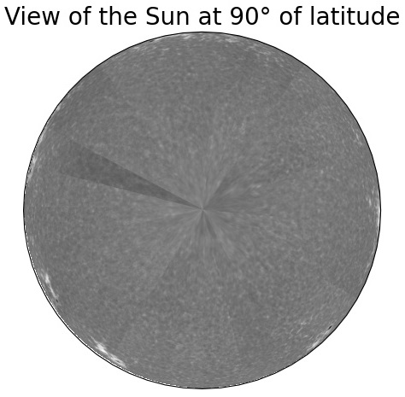
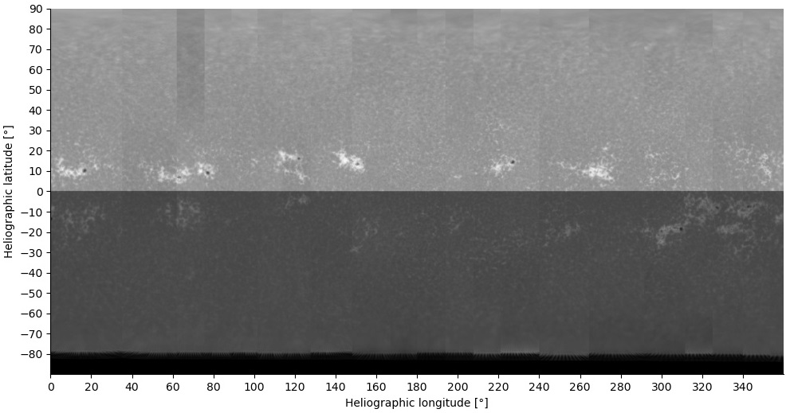
6. Synoptic map
Aim : - Observe the distribution of the magnetic structures during a complete solar rotation
- Reconstruct solar images for different angles of view

Slide 41
6. Synoptic map

Slide 42
7. Next steps
Computing Ca II K plages area for different inclinations
Getting S-Index for multiple solar-type stars
Comparing Ca II K plages with stellar S-Index to study the inclination angle of other stars
Study the possible other cycles during the solar cycle (solar rotation and other ?)

Slide 43
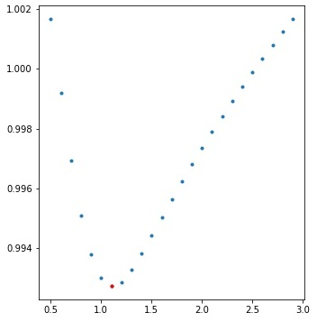
Plage segmentation
Segmentation method
1. Compute the mean intensity $\overline{I}$ and the standard deviation $σ_{I}$ over the disk
2. Identify pixels with intensity within $\overline{I} ±kσ_{I}$ (for $k$ in the range $0.5−3.0$)
3. Recalculate mean intensity and standard deviation for those intervals
4. The minimum of the calculated mean intensity ${\overline{I}}_{min}$best represents the QS regions
5. Intensity threshold to identify the plages is :
$$T≥{\overline{I}}_{min}+m_{f} .σ_{min}$$
where $m_{f}$ is an arbitrary multiplicative factor

Slide 44
TIGRE technical issues
• Issues with time losses from hours to days : internet cuts and power failures
• Issues with time losses from days to months : hardware failures, power supply

