Slide 1
Effect of the inclination angle of solar rotation axis on Ca II K structures using direct solar observations
ROYAL OBSERVATORY
OF BELGIUM
Grégory VANDEN BROECK
TESS, Dallas April 9, 2024

Slide 2
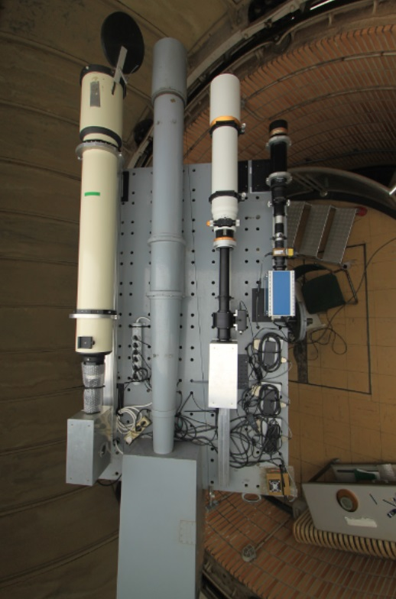
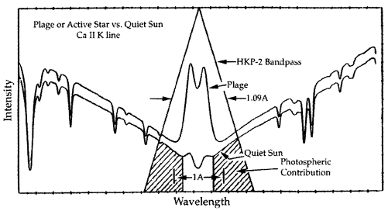
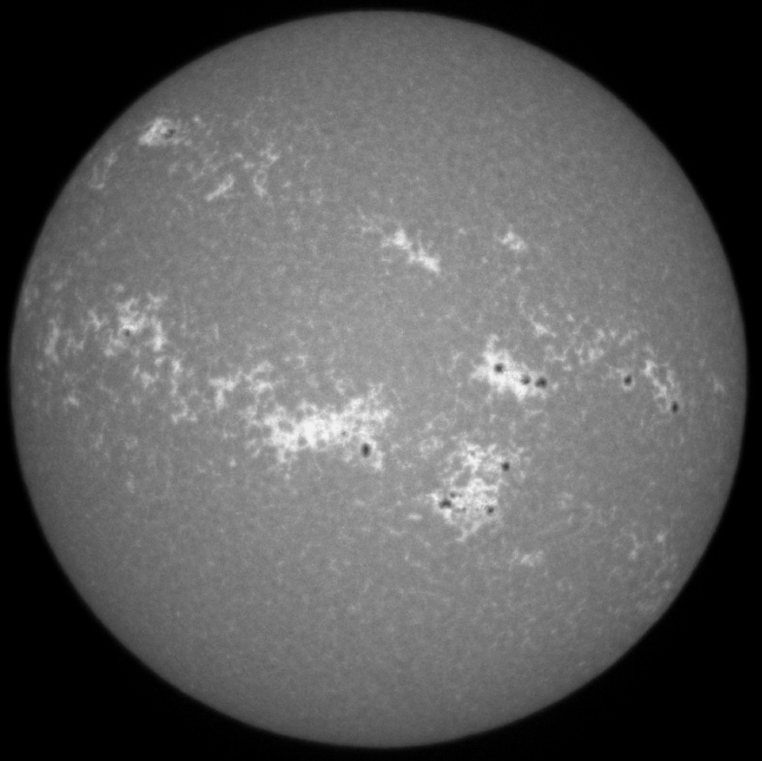
1. USET index
1.1. Dataset
Exploitation of Ca II K images taken with USET (« Uccle Solar Equatorial Table »)
Baliunas et al. 1998
Ca II K line centered at : 3933.7 Å
Filter bandpass : 2.7 Å
Dataset : $\sim$23.000 Ca II K images since July 2012
After sorting $→$ $\boxed{\text{2}\text{725} \text{images}}$
Chromosphere (Ca II K)
2

Slide 3
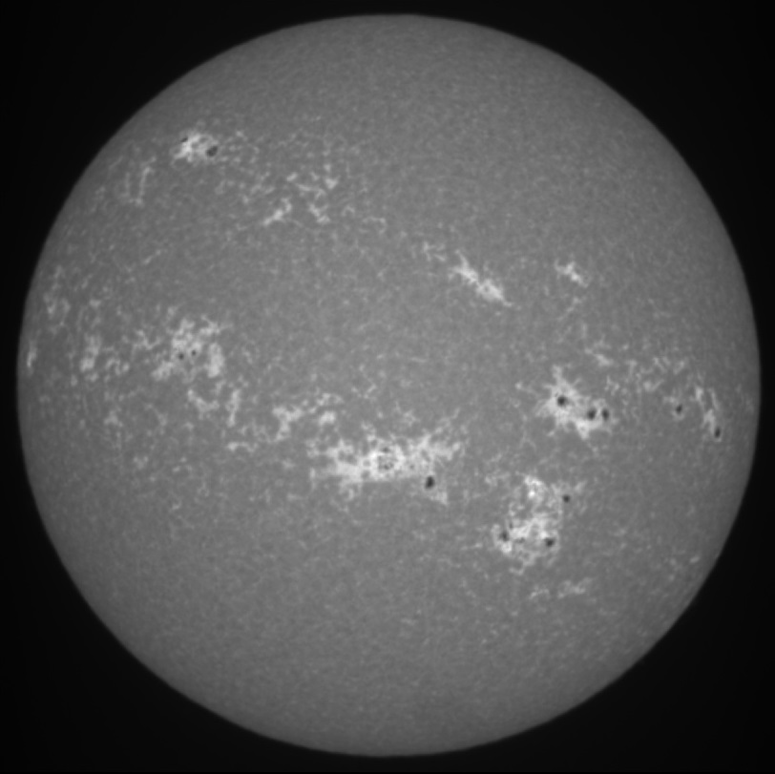
1. USET index
1.2. Image processing
● Image recentering

Slide 4
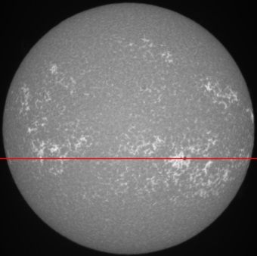
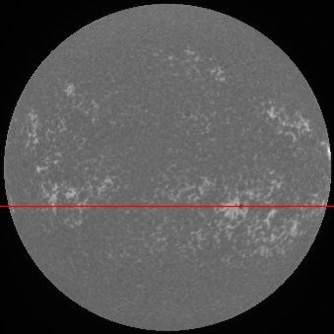
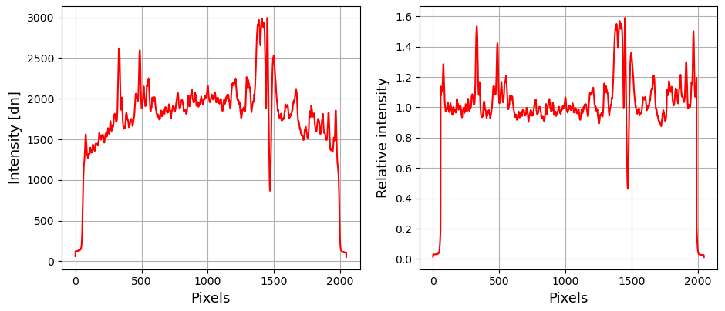
1. USET index
1.2. Image processing
● Image recentering
● Limb darkening correction
$→$ Brighter at the center
$→$ Darker at the limb

Slide 5
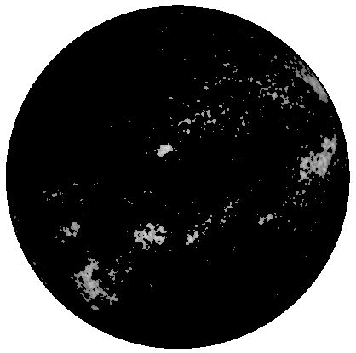
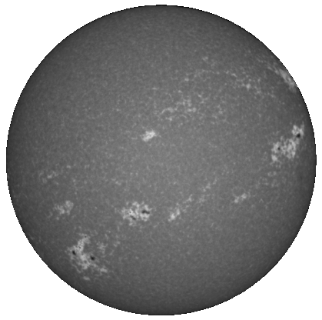
1. USET index
1.2. Image processing
● Image recentering
● Limb darkening correction
● Chromospheric structures segmentation
$→$ Algorithm based on an intensity threshold
$→$ Structures segmented :
- Plages (bright extended structures)
- Enhanced network (small regions of decaying plages)

Slide 6
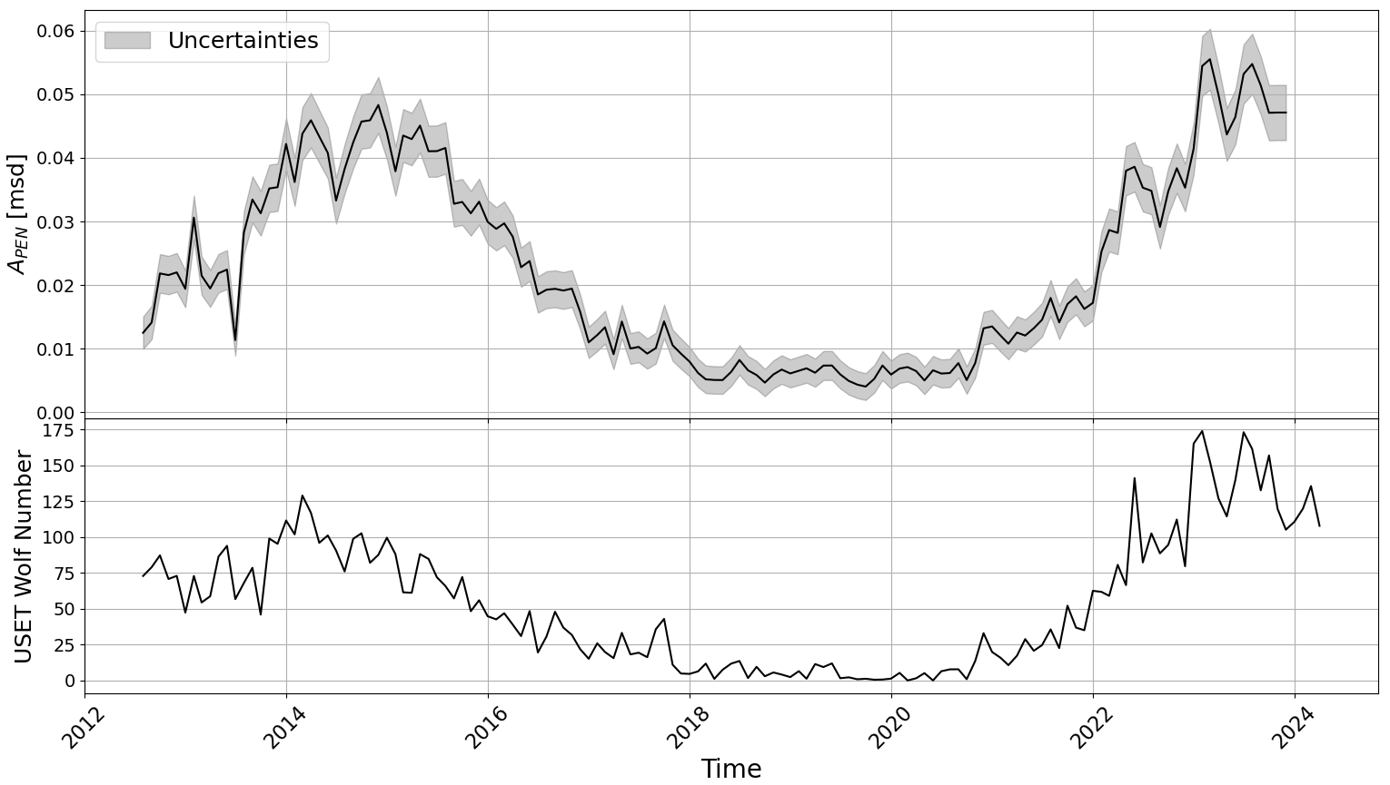
1. USET index
1.2. Image processing
● Image recentering
● Limb darkening correction
● Chromospheric structures segmentation
● Temporal evolution
Following the solar cycle
Uncertainties depending linearly on the area
Short-term variations associated to solar rotation (see further)
Vanden Broeck et al. 2024 (submitted)

Slide 7
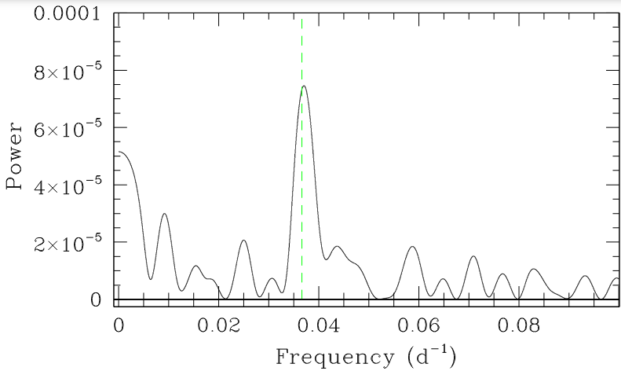
2. Periodic modulation
Fourier analysis
$→$ Search for presence of rotation modulation in the area fraction time series
• Fourier method : Existence of a periodic signal $⇒$ peak in the power spectrum
• Highest peak at $\sim 0.0367 d^{−1}$ (green line) : $⇒$ Carrington rotation period $(27.27 d)$
Conclusion : Solar rotation is present in area fraction time series
Question : Variation with the solar cycle ? Link with magnetic structures distribution ?
Vanden Broeck et al. 2024 (submitted)

Slide 8
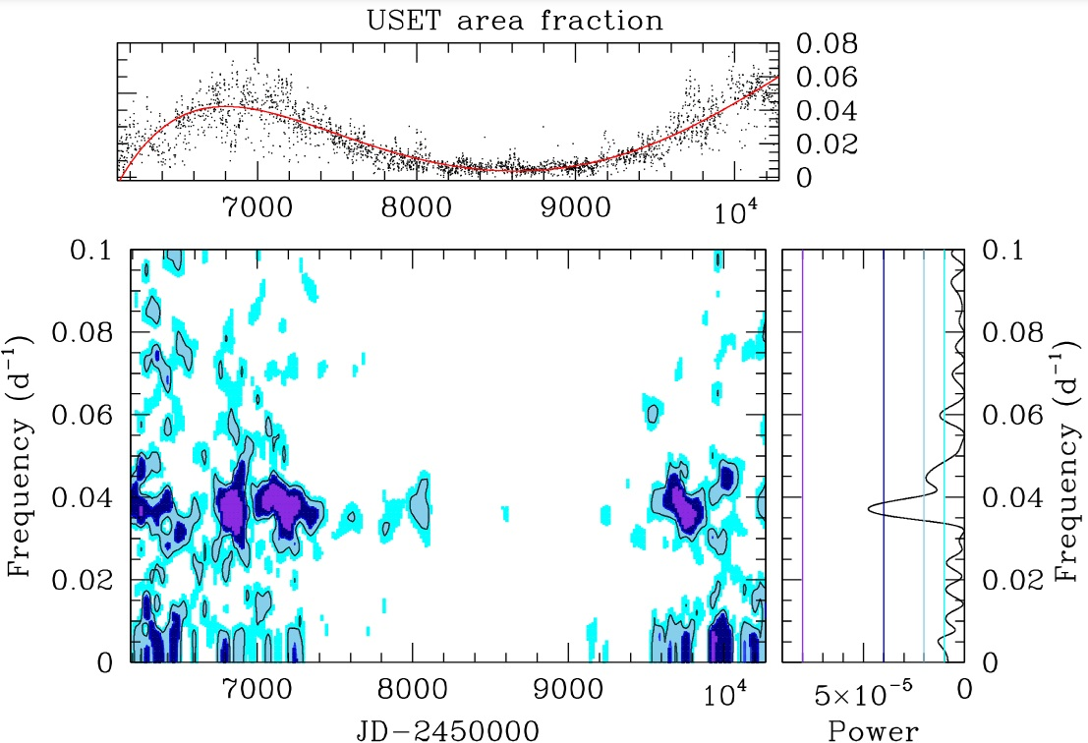
2. Periodic modulation
Time-frequency diagram
Rotational modulation
Absent during the solar minimum
Vanden Broeck et al. 2024 (submitted)

Slide 9
2. Periodic modulation
No modulation because :
Plage absent
If plage present $⇒$ it lasts for less than a rotation
Vanden Broeck et al. 2024 (submitted)

Slide 10
2. Periodic modulation
Time-frequency diagram
Rotational modulation
Absent during the solar minimum
Very prominent near the solar maxima
Vanden Broeck et al. 2024 (submitted)

Slide 11
2. Periodic modulation
Succession of episodes with compact groups of plages and episodes with less activity.
$→$ Possible reason : some longitudes seem more favourable for emergence of magnetic flux, called “active longitudes”
Vanden Broeck et al. 2024 (submitted)

Slide 12
2. Periodic modulation
Time-frequency diagram
Rotational modulation
Absent during the solar minimum
Very prominent near the solar maxima
Not clearly detected
even near the solar maxima
Vanden Broeck et al. 2024 (submitted)

Slide 13
2. Periodic modulation
No clear detection because distribution nearly uniform in longitude
Vanden Broeck et al. 2024 (submitted)

Slide 14
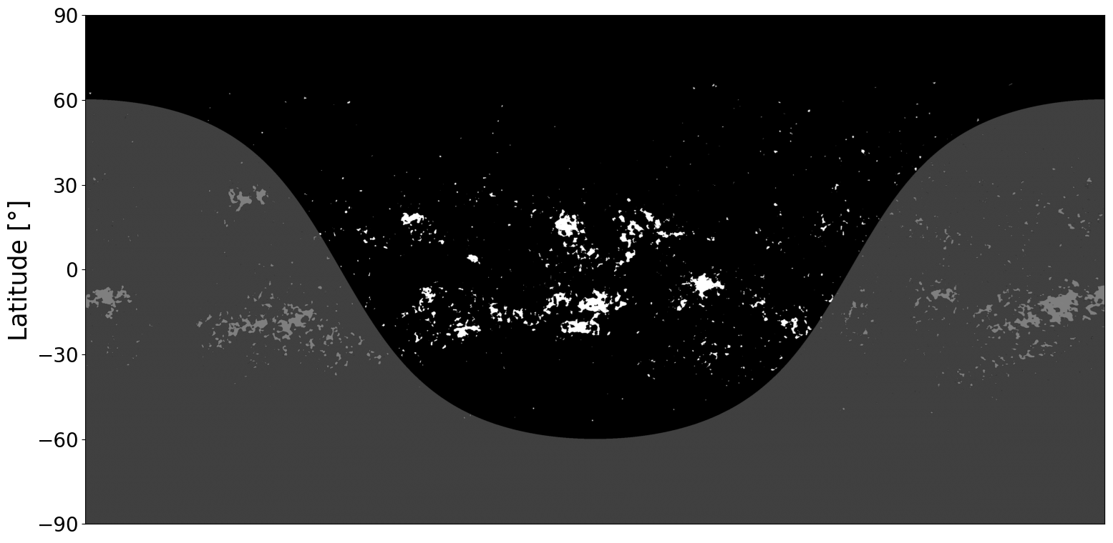
3. Sun from different inclinations
3.1. Construction of inclinated solar images

Slide 15
3. Sun from different inclinations
3.1. Construction of inclinated solar images

Slide 16
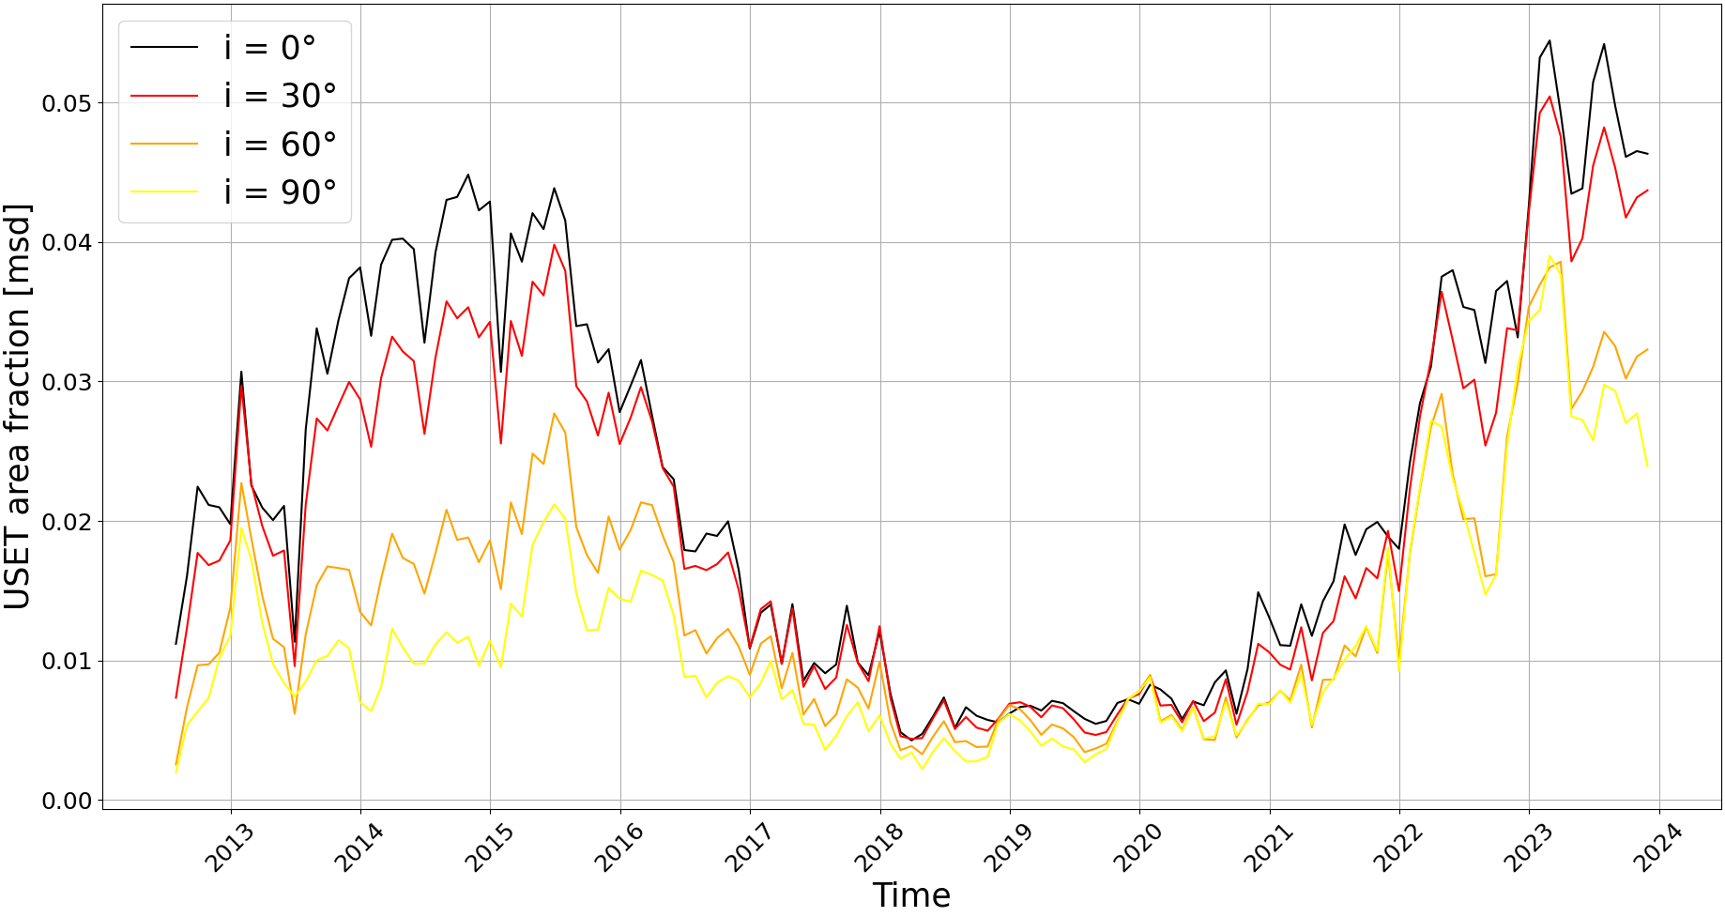
3. Sun from different inclinations
3.2. Effect of inclination on area fraction
Temporal evolution of area fraction for solar Equator’s view (0°) to North Pole view (90°)
The more we observe from the Poles
The more the area fraction decreases

Slide 17
3. Sun from different inclinations
3.3. Effect of inclination on solar modulation
North hemisphere
South hemisphere

Slide 18
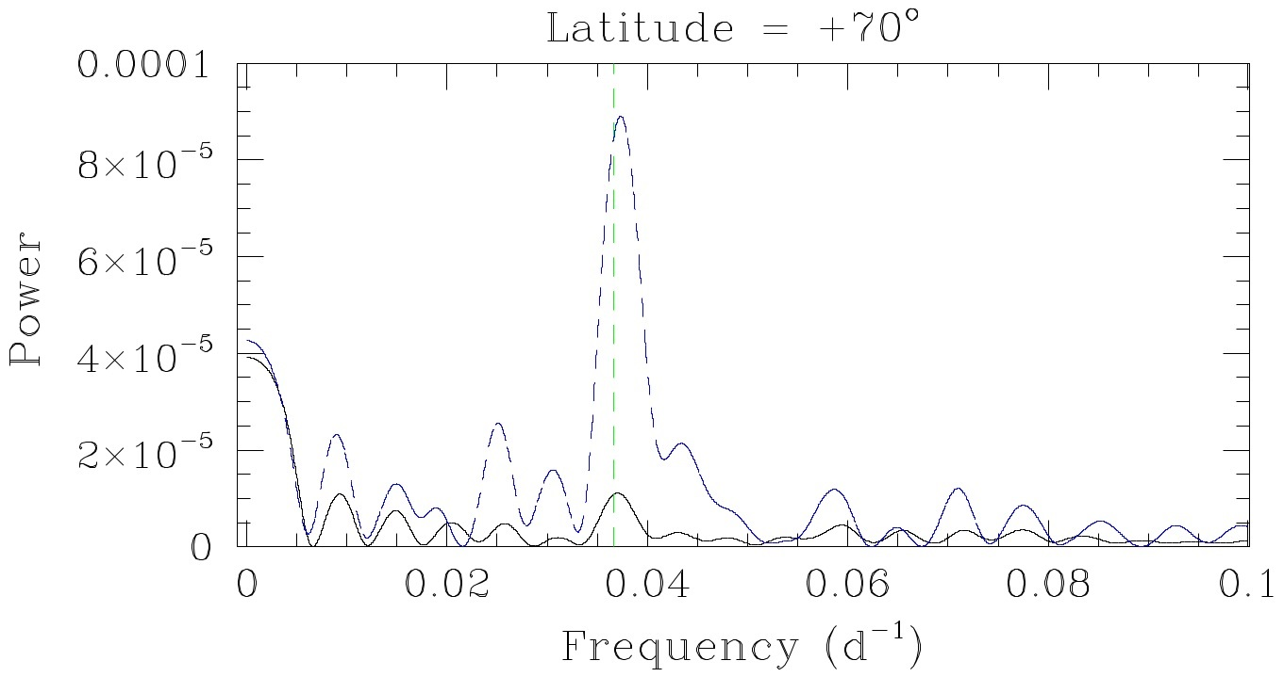
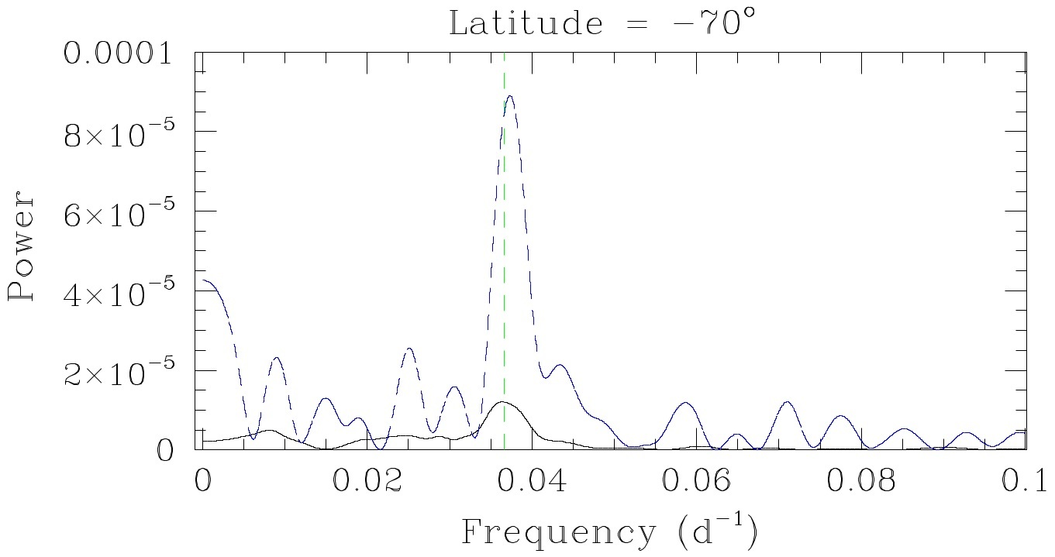
3. Sun from different inclinations
3.3. Effect of inclination on solar modulation
North hemisphere
South hemisphere
$⇒$Rotational modulation detected until an inclination of 70°
$⇒$ Assomption : Solar-type stars with rotation axis inclinated by > 70° $→$ rotation period not visible

Slide 19
4. Summary
● Detection of rotation period related to asymmetry in longitudinal distribution of bright structures
● Solar images reconstructed from every angles of view
● Solar rotation period detected until 70° of inclination $→$ application for solar-type stars

Slide 20
4. Summary
● Detection of rotation period related to asymmetry in longitudinal distribution of bright structures
● Solar images reconstructed from every angle of view
● Solar rotation period detected until 70° of inclination $→$ application for solar-type stars

Slide 21
4. Summary
● Detection of rotation period related to asymmetry in longitudinal distribution of bright structures
● Solar images reconstructed from every angles of view
● Solar rotation period detected until 70° of inclination $→$ application for solar-type stars

Slide 22
Thank you for your attention !

Slide 23
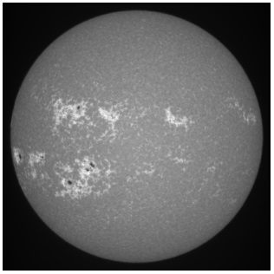
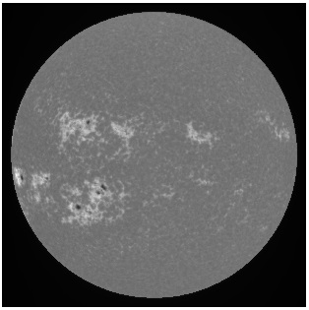
Structures segmentation
Limb darkening correction
Method :
Fit the intensity profile
Create a mask based on the fit
Divide the matrix by the mask
Remove the bright plages
Repeat the steps 1. 2. & 3.

Slide 24
Structures segmentation
Limb darkening correction

Slide 25
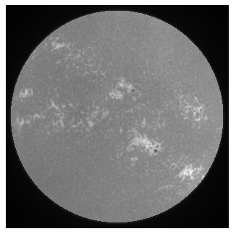
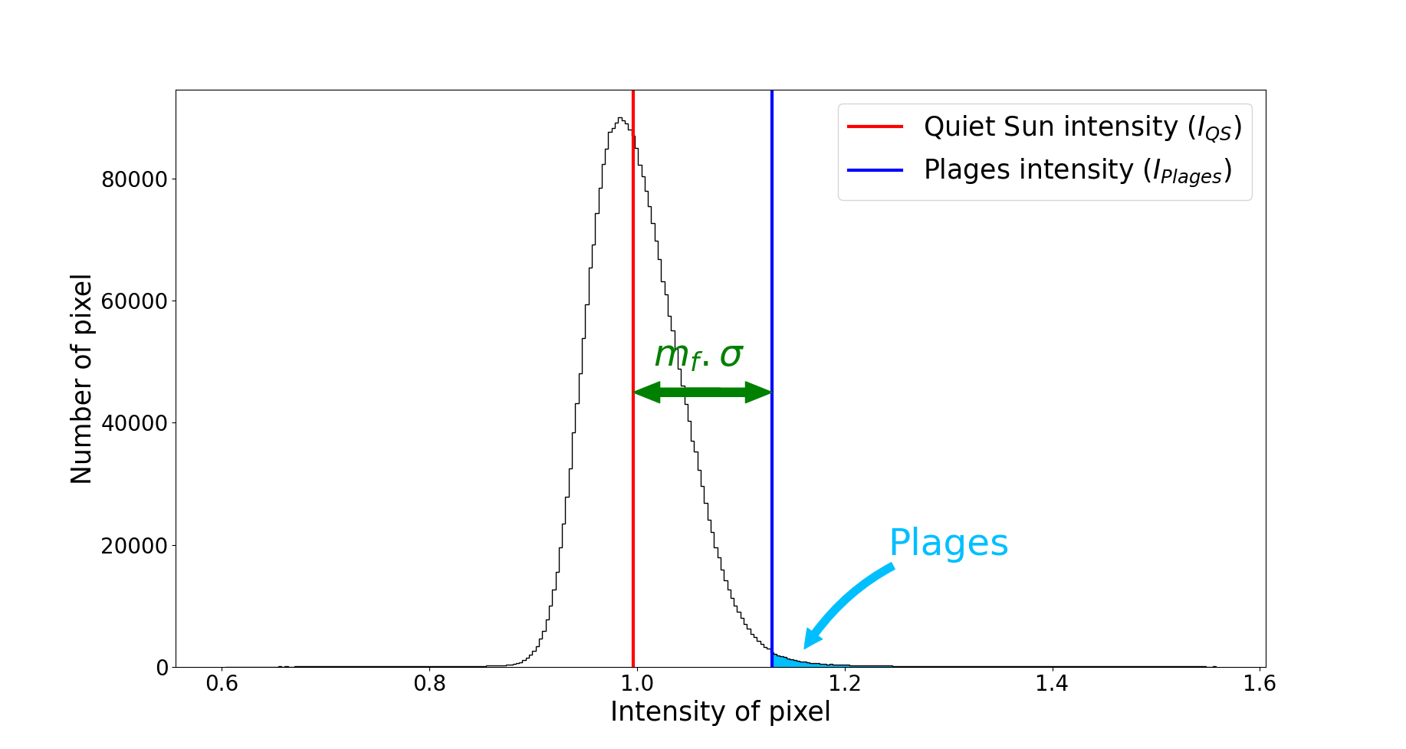
Structures segmentation
Segmentation method
Assumptions : • Gaussian background brightness distribution
• Non-gaussian contribution to the wings (sunspots and plages)
Quiet Sun doesn’t vary in time $⇒$ Threshold non affected by the solar activity
● Compute the QS intensity : $I_{QS}$
● Compute the standard deviation $σ$ with an empirical multiplicative factor $m_{f}$
Plages intensity : $\boxed{I_{Plages}≥I_{QS}+m_{f} . σ}$

Slide 26
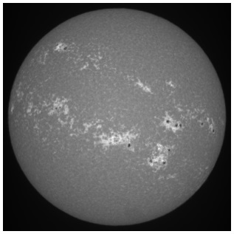
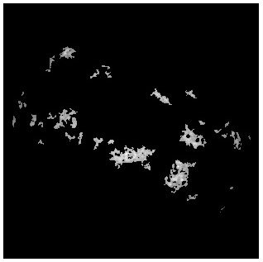
Structures segmentation
Segmentation method
1. Compute the mean intensity $\overline{I}$ and the standard deviation $σ_{I}$ over the disk
2. Identify pixels with intensity within $\overline{I} ±kσ_{I}$ (for $k$ in the range $0.5−3.0$)
3. Recalculate mean intensity and standard deviation for those intervals
4. The minimum of the calculated mean intensity ${\overline{I}}_{min}$best represents the QS regions, $I_{QS}$
5. Intensity threshold to identify the plages is :$\boxed{I_{plages}≥I_{QS}+m_{f} .σ_{min}}$ ($m_{f}$ is an empirical multiplicative factor)

Slide 27
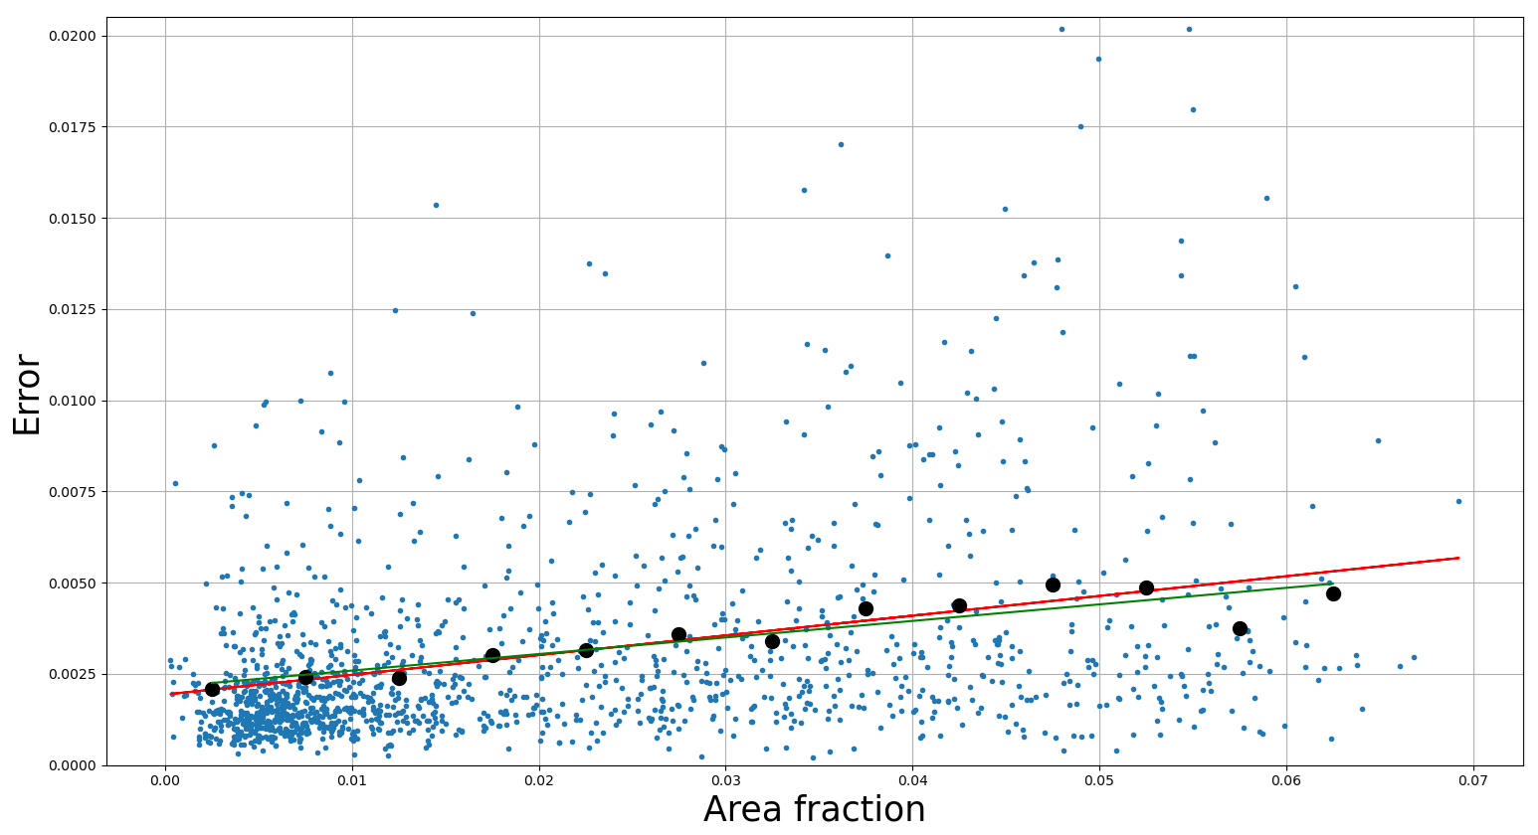
Structures segmentation
Uncertainty calculations
How ? Using the full dataset of $\sim$ 23.000 images in the USET database
Compute the area fraction for each image
Compute the standard deviation for each day
Remove the outliers
Fit the data (red curve)
Bin data by step of 0.25 (black dots)
Fit the data (green curve)
$⇒$ Error proportional to the area

