Slide 1
The SOLARNET Virtual Observatory (SVO) …………
Making Solar physics data findable and accessible
Authors: R. Vansintjan, B. Mampaey and V. Delouille
Royal Observatory of Belgium
This research has received financial support from the European Union’s Horizon 2020
research and innovation program under grant agreement No. 824135 (SOLARNET)

Slide 2
The SOLARNET Virtual Observatory (SVO)
Developed in the FP7 & H2020 SOLARNET project.
FAIR: Findable, Accessible, Interoperable and Reusable
At its heart lies a database populated with meta-data from datasets taken by space- and ground based instruments.
It lets you find and access data through a Web App, IDL and Python API and is easily interoperable with external tools (RESTful API).
This research has received financial support from the European Union’s Horizon 2020
research and innovation program under grant agreement No. 824135 (SOLARNET)

Slide 3
Making data findable with the SVO
Requires four keywords but rich metadata encouraged.
Keywords: DATE_BEG, DATE_END, WAVEMIN, WAVEMAX
Data needs to be accessible through HTTP(S).
Data under embargo can be searched but not downloaded.
Searching across datasets by date of observation, wavelength, tags and telescope.
This research has received financial support from the European Union’s Horizon 2020
research and innovation program under grant agreement No. 824135 (SOLARNET)

Slide 4
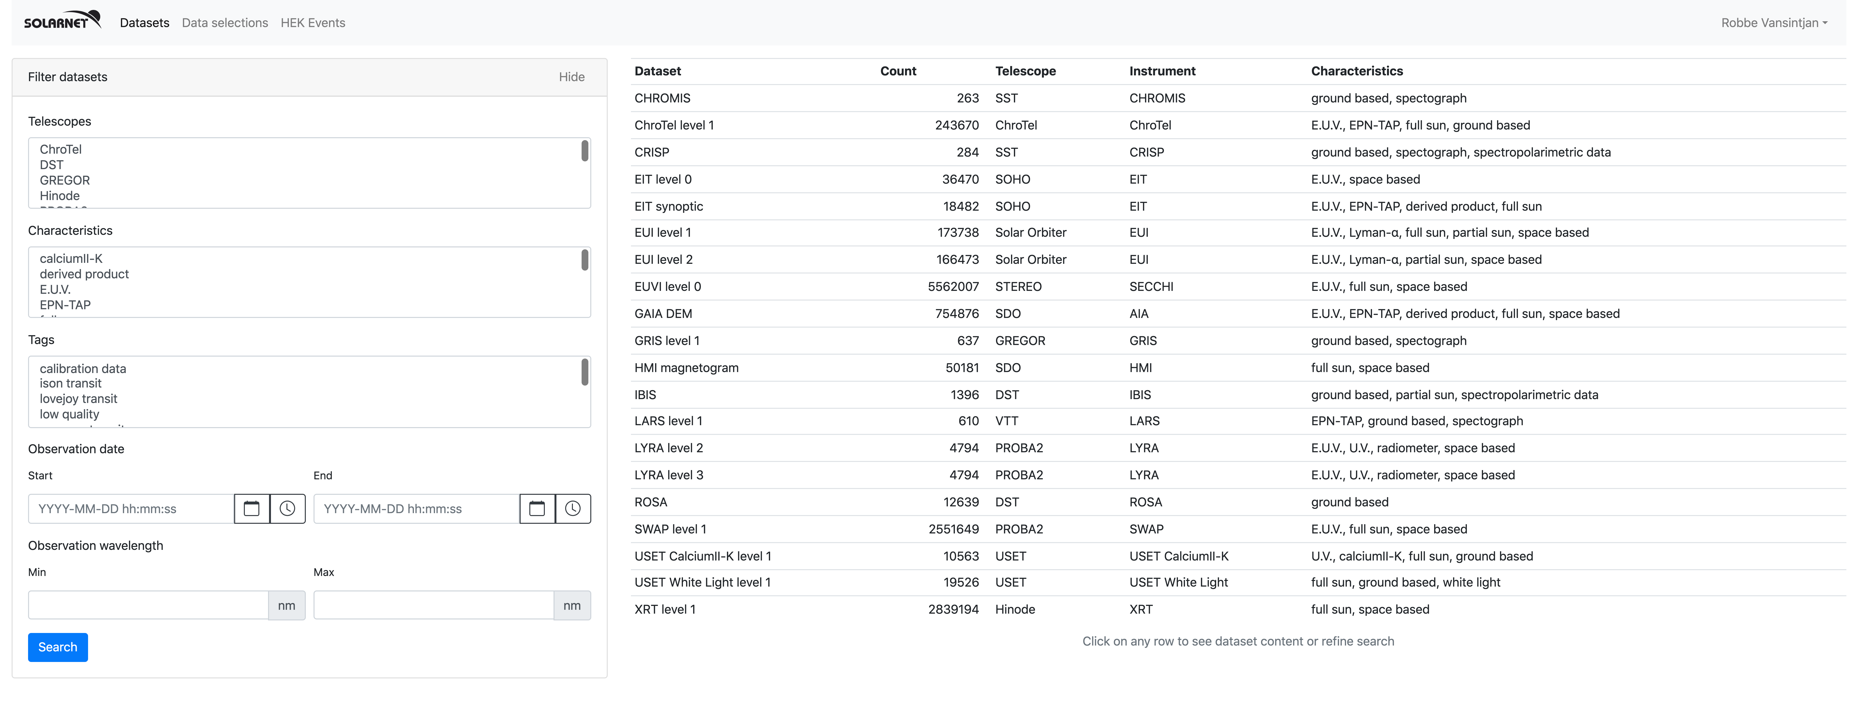
Making data findable with the SVO
This research has received financial support from the European Union’s Horizon 2020
research and innovation program under grant agreement No. 824135 (SOLARNET)

Slide 5
Making data findable with the SVO
Searching a single dataset using specific criteria.
Quick-look with thumbnail (if available) and FITS header.
Co-observation searches i.e. the date of observation overlap.
Searching by solar events date.
This research has received financial support from the European Union’s Horizon 2020
research and innovation program under grant agreement No. 824135 (SOLARNET)

Slide 6
Making data findable with the SVO
This research has received financial support from the European Union’s Horizon 2020
research and innovation program under grant agreement No. 824135 (SOLARNET)

Slide 7
Making data findable with the SVO
Searching a single dataset using specific criteria.
Quick-look with thumbnail (if available) and FITS header.
Co-observation searches i.e. the date of observation overlap.
Searching by solar events date.
This research has received financial support from the European Union’s Horizon 2020
research and innovation program under grant agreement No. 824135 (SOLARNET)

Slide 8
Making data findable with the SVO
This research has received financial support from the European Union’s Horizon 2020
research and innovation program under grant agreement No. 824135 (SOLARNET)

Slide 9
Making data findable with the SVO
Searching a single dataset using specific criteria.
Quick-look with thumbnail (if available) and FITS header.
Co-observation searches i.e. the date of observation overlap.
Searching by solar events date.
This research has received financial support from the European Union’s Horizon 2020
research and innovation program under grant agreement No. 824135 (SOLARNET)

Slide 10
Making data findable with the SVO
This research has received financial support from the European Union’s Horizon 2020
research and innovation program under grant agreement No. 824135 (SOLARNET)

Slide 11
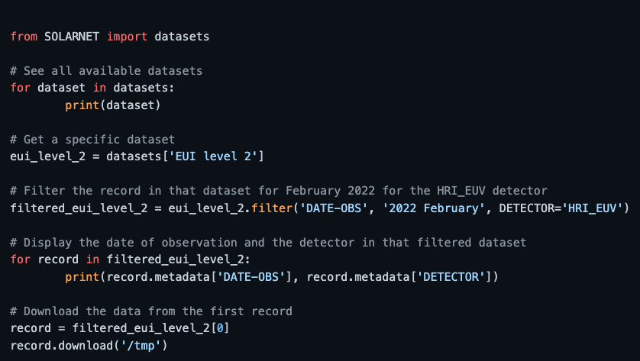
Making data accessible with the SVO
Python and IDL API
Restful API
Data can be download by http(s)
Data selection can be made and shared
Data selection can be download by FTP and ZIP (if not too large)
This research has received financial support from the European Union’s Horizon 2020
research and innovation program under grant agreement No. 824135 (SOLARNET)

Slide 12
Making data accessible with the SVO
This research has received financial support from the European Union’s Horizon 2020
research and innovation program under grant agreement No. 824135 (SOLARNET)

Slide 13
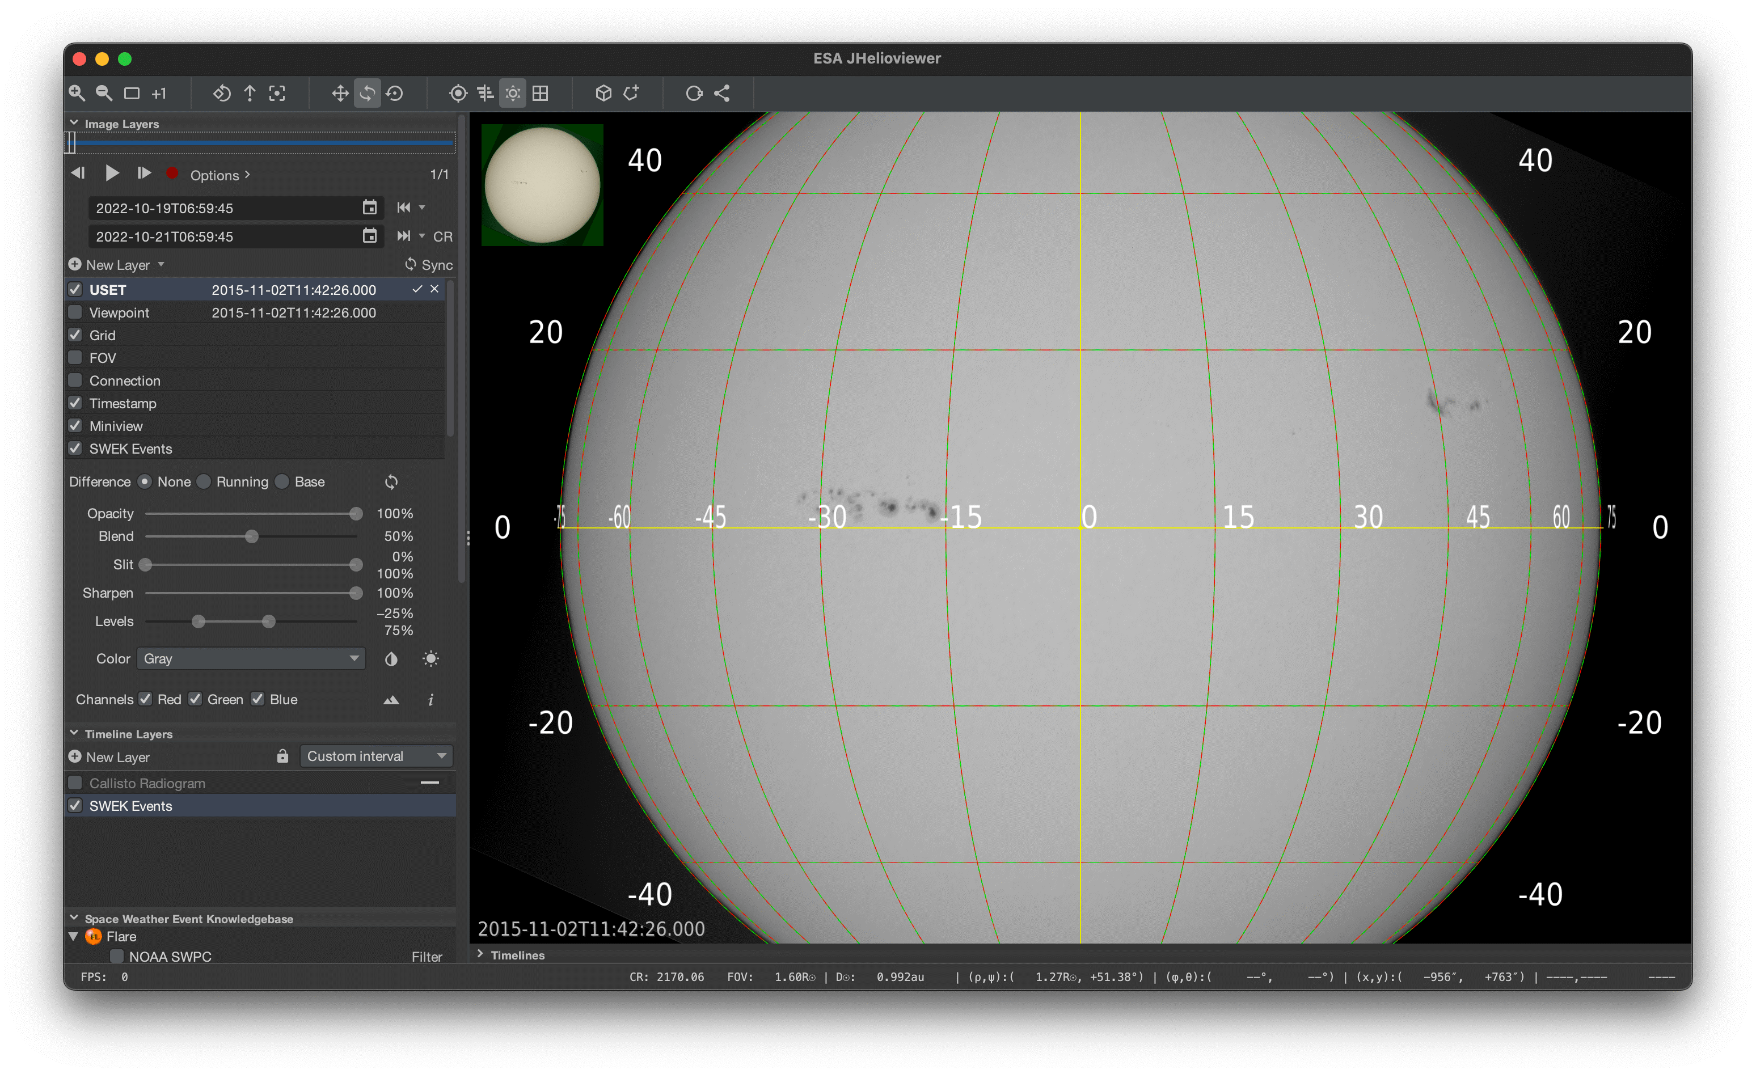
Making data interoperable with the SVO
The SVO is an EPN-TAP client
ChroTel, MEDOC/EIT Synoptic & GAIA DEM maps, VVT/LARS
Translation between the EPN-TAP parameters and SOLARNET metadata keywords was made
In the future we want to interface the SVO with jHelioviewer
This research has received financial support from the European Union’s Horizon 2020
research and innovation program under grant agreement No. 824135 (SOLARNET)

Slide 14
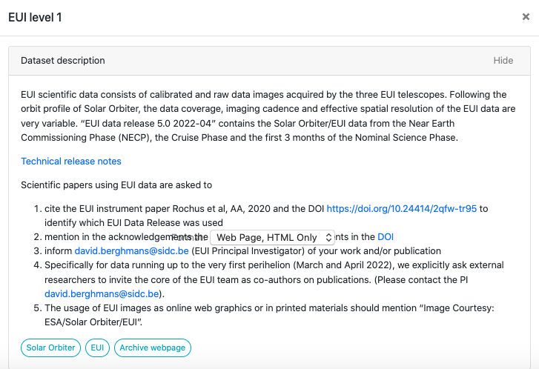
Making data reusable with the SVO
SVO encourages the use of SOLARNET metadata recommendations, available at http://sdc.uio.no/open/solarnet
Data set reference papers and how to cite the data by provider are shown in the interface.
This research has received financial support from the European Union’s Horizon 2020
research and innovation program under grant agreement No. 824135 (SOLARNET)

Slide 15
The SOLARNET Virtual Observatory (SVO)
Please, have a look!
https://solarnet.oma.be/
https://sidc.be/SVO
This research has received financial support from the European Union’s Horizon 2020
research and innovation program under grant agreement No. 824135 (SOLARNET)

