Slide 1
Integrating High Resolution Solar Physics
The SDO and SVO datacenters
…………
3rd-SOLARNET Forum for telescopes and databases
15/11/2021
Authors: M. Carlsson, R. Vansintjan
This project has received funding from the European Union’s Horizon 2020 research and innovation programme under grant agreement No 824135.

Slide 2
Virtual Access from BE-WISSDOM
BE-WISSDOM hosts the SDO data center and the Solar Virtual Observatory (SVO)
The SDO data center provides easy access to AIA and HMI data from the SDO satellite
URL: http://sdoatsidc.oma.be/
The SVO lets you cross-search and download data from satellite and ground based solar observatories and search for data based on Solar events.
This helps researchers to discover and access solar datasets from synoptic observations as well as data taken during short observation campaigns
URL: https://solarnet.oma.be/

Slide 3
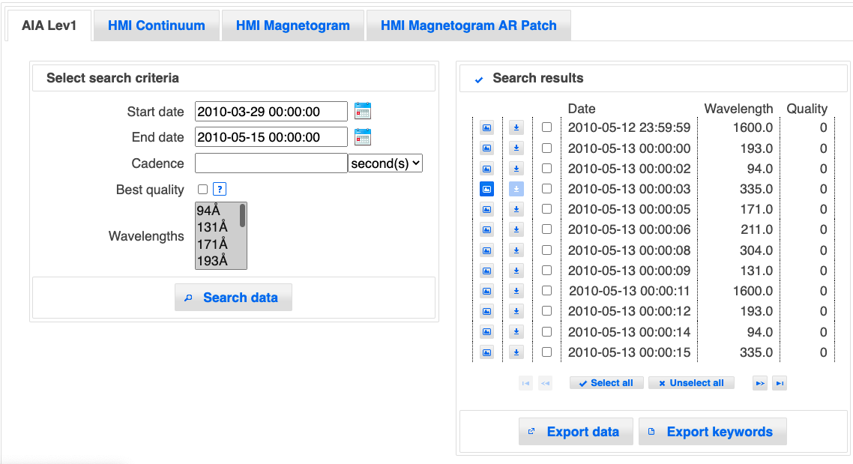
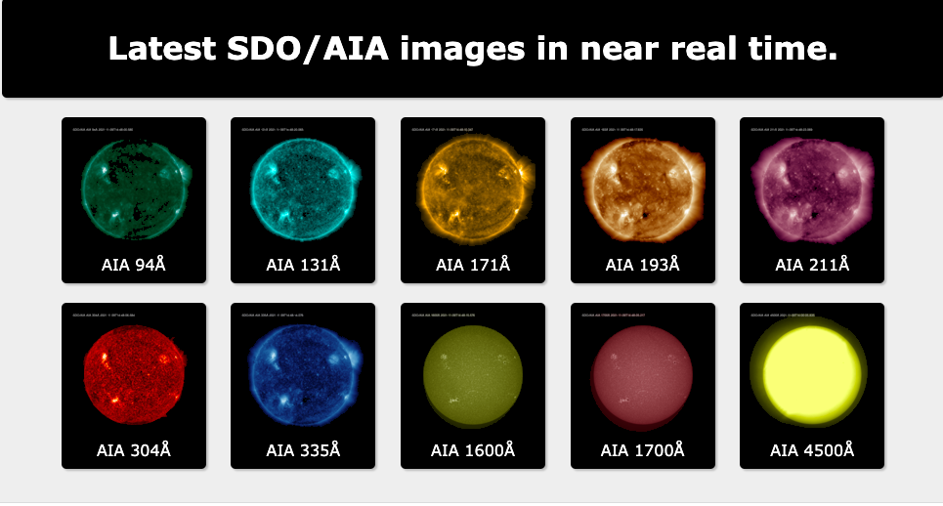
The SDO data center
The SDO data center provides:
4k by 4k AIA and HMI data through our Web interface, IDL and Python
The latest 24h AIA quick look data in movie format
A 1 hour synoptic set of AIA and HMI data through ftp
A 2 min synoptic set of 1k by 1k AIA 94Å and 211Å data through ftp

Slide 4
SVO: Dataset specific searches and quick-look
Notes:
Data specific searches Quicklook – Meta data
Cross data searches
Search by solar events
Data Selection
Python - IDL

Slide 5
SVO: Cross data searches

Slide 6
SVO: Search by solar events

Slide 7
SVO: Data selection

Slide 8
Thank you
For your attention

