Slide 1
VSWMC validation activities
Authors: R. Vansintjan, S. Poedts, A. Kochanov, G. Deprez, P. Jiggens, R. Keil,
J. Magdalenic, C. Verbeke, E. Samara, A. Niemela, A. Maharana, D. Shukhobodskaia
L. Rodriguez, J. De Keyser, E. Botek, E. Dedonder, S. Brun, A. Rouillard, B. Swalwell,
S. Dalla, J. W. B. Eggington, J. Eastwood, M. Balikhin, R. Boynton, R. Boynton, S. Walker,
A. Aylward, C. Borries and D. Jackson

Slide 2
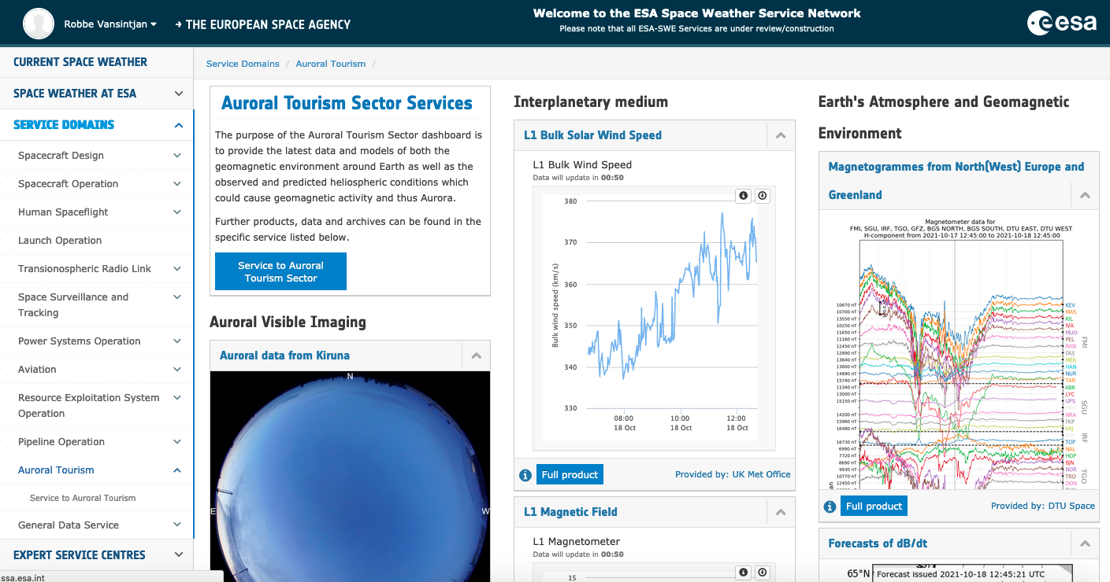
VSWMC validation activities
The ESA Virtual Space Weather Modelling Centre (VSWMC) is a tool that lets you run space weather models either in a stand-alone way or coupled together. The interfaced models allow for end-to-end simulations from the surface of the Sun to the Earth’s magnetosphere
It’s part of ESA’s SWE Service Network which brings together Europe's SWE expertise and assets which it provides as a service to groups affected by SWE, like: Spacecraft designers & operators, Human Spaceflight, Power system operators, Aviation, Auroral tourists etc. but we consider SWE forecasters as our target audience.
Our main aim is to validate the system as a service and not for model development.
ESA Space Weather Network Morphology © ESA

Slide 3
VSWMC validation activities
https://swe.ssa.esa.int/

Slide 4
VSWMC validation activities
A short description of the available and upcoming models in the VSWMC:
EUHFORIA consists of a coronal module and a heliospheric solar wind module that enables superimposed CME evolution
Wind-Predict is a numerical model of the solar wind and lower corona
MULTI-VP is a numerical model of the solar wind composed of 3 internal models.
Geo-effects models consist of empirical equation for Kp, Dst and equations from the Shue model for the Magnetopause standoff distance
NARMAX (SNRB and SNGI) are two forecast models based on machine learning SNRB for electron fluxes at GEO and SNGI for Kp
BAS-RBM solves a Fokker-Planck equation for the high energy electron flux in the Earth’s radiation belts

Slide 5
VSWMC validation activities
A short description of the available and upcoming models in the VSWMC:
SPARX is a physics-based model for forecasting Solar Energetic Particles
BPiM is a semi-empirical, 3D dynamic model of the plasmasphere
CTIP calculates the time-dependent state of the thermosphere and the ionosphere by solving the coupled equations of momentum, energy and continuity for neutral particles and ions
GORGON enables efficient 3D global simulations of planetary magnetospheres by solving the MHD equations
DICTAT is a 1-D engineering code for predicting the risk of internal dielectric charging.
GUMICS-4 solves ideal MHD equations in the magnetosphere and couples them to an electrostatic ionosphere.

Slide 6
VSWMC validation activities
Our primary way of validation is to compare the output of coupled models to measurement data.
A second way would be by cross-validating model chains that have different models but comparable output.
Model chains | Measurement data
EUHFORIA Corona -> EUHFORIA Heliosphere -> Geo-effect models | ACE and DSCOVR solar wind data at L1, Kp by GFZ-Potsdam, Dst Index by WDC Kyoto, Cluster Plasma and Magnetic field data
Wind-Predict -> EUHFORIA Heliosphere -> Geo-effect models
MULTI-VP -> EUHFORIA Heliosphere -> Geo-effect models
EUHFORIA Corona -> EUHFORIA Heliosphere -> SNEFGI (NARMAX) | Kp by GFZ-Potsdam
SPARX | GOES proton flux data
EUHFORIA Corona -> EUHFORIA Heliosphere -> SNGI + ODI (F10.7) -> CTIP & BPiM | Van Allen Probes electron density data
EUHFORIA Corona -> EUHFORIA Heliosphere -> SNRB (NARMAX)-> DICTAT | GOES electron flux data Use cases
EUHFORIA Corona -> EUHFORIA Heliosphere -> Gorgon | Cluster Plasma and Magnetic field data

Slide 7
VSWMC validation activities
We’re wrapping up integrating and coupling the models within the system for this phase of the project. This includes the model developers validating their installation
Start verifying (Does what we build work?) and validating (Does it give meaningful results?) the system
Building the validation software in the system so it can be run automatically and repeatedly when models get updated.
Our validation code will run the models using the VSWMC-CLI written in Python (https://pypi.org/project/vswmc-cli/) which is available to all users
We’ve made a selection of metrics to compare the models output against measurement data
Notes:
https://doi.org/10.1016/j.jastp.2021.105624

Slide 8
VSWMC validation activities
We selected different types of metrics and for metrics suited for data that spans multiple orders of magnitude
Work of S. K. Morley
Measures of Model Performance Based On the LogAccuracy Ratio
Challenges and Opportunities in Magnetospheric Space Weather Prediction
Python module: https://pypi.org/project/PyForecastTools/
Work of Michael W.Liemohn
Model Evaluation Guidelines for Geomagnetic Index Predictions
RMSE is not enough: Guidelines to robust data-model comparisons for magnetospheric physics
The STONE Curve: A ROC Derived Model Performance Assessment Tool
C. Verbeke who will talk later in this session
Benchmarking CME Arrival Time and Impact: Progress on Metadata, Metrics, and Events

Slide 9
VSWMC validation activities
Metrics describe an aspect of the models performance as a quantitate value
Fit performance and detection performance metrics
Categories of metrics
Accuracy is the closeness of the model values to the data values
Bias is the model systematically overestimating and underestimating the observations
Type | Fit performance | Detection performance
Accuracy | $RMSD=\sqrt{\frac{\sum{{\left(m_{i}−o_{i}\right)}^{2}}}{N}}$, $MAE= \sum{\frac{\left|m_{i}−o_{i}\right|}{N}}$, $MAD=Median\left(\left|o_{i}−m_{i}\right|\right)$ | $$CSI= \frac{H}{H+F+M}$$
Bias | $ME$ = $\sum{\frac{\left(m_{i}−o_{i}\right)}{N}}$ | $$FB=\frac{H+F}{H+M}$$
Notes:
Accuracy gives an unsigned value the data is transformed so that the direction of difference is removed
Low bias values means the centroid of the data and model match

Slide 10
VSWMC validation activities
Different categories of metrics
Precision: Seeks to quantify the similarity in the clustering of the data and model values, after the centroid onset has been removed.
Association: quantify the ability of the model to capture the up-and-down trends of the data.
Skill accuracy relative to another model
Type | Fit performance | Detection performance
Precision | $$YI= \frac{max\left(M\right)−min\left(M\right)}{max\left(O\right)−min\left(O\right)}$$
Association | $$R= \frac{\sum{\left(o_{i}−\hat{o}\right)}\left(m_{i}−\hat{m}\right)}{\sqrt{\sum{{\left(\left(o_{i}−\hat{o}\right)\right)}^{2}\sum{{\left(\left(m_{i}−\hat{m}\right)\right)}^{2}}}}}$$ | $$ORSS=\frac{\left(H∗C\right)−\left(F∗M\right)}{\left(H∗C\right)+\left(F∗M\right)}$$
Notes:
Precision is the complement of bias A model with high precision could still have symmetrical differences between the model and the data
Association They often don’t take into account how close the model values are to the data value bot whether the model captures the motion of the data

Slide 11
VSWMC validation activities
Metrics for data that spans multiple orders of magnitude
Scale dependent: deviations of the same magnitude have equal importance at different magnitudes
It should be robust to outliers and bad data.
Under-prediction and over-prediction should be penalized equally
It should be easy to interpret (have the same units as the data)
Median Symmetric Accuracy (MSA) and the Symmetric Sign Percentage Bias (SSPB)
Type | Fit performance
Accuracy | $MAPE=100\frac{1}{N}\sum{\left|\frac{m_{i}−o_{i}}{o_{i}}\right|}$, $MSA=100\left(exp\left(Median\left(\left|log\left(\frac{m_{i}}{o_{i}}\right)\right|\right)\right)−1\right)$
Bias | $$SSPB=100 sign\left(Median\left(log\left(\frac{m_{i}}{o_{i}}\right)\right)\right)\left(exp\left(Median\left(\left|log\left(\frac{m_{i}}{o_{i}}\right)\right|\right)\right)−1\right)$$
Notes:
MAPE problems: Undefined when dividing through zero, asymmetric to overcasting and undercasting, it’s constrained to be positive so it’s distribution is positively skewed and not resistant to outliers
Using the absolute value instead of using the square root makes the metric more robust and using the median instead of the arithmetic mean also makes it more robust
Taking the log and absolute value ensures that the metric is symmetric
Exponent is taken to transform back to the same units and scale and subtract by 1 to set lower bound to zero
Bias multiply with the sign of the median log ratio

Slide 12
VSWMC validation activities
Summary of the models, comparison data and metrics
Model | Output - Data | Metrics
EUHFORIA corona/MULTI-VP/Wind-Predict -> EUHFORIA heliosphere | Solar wind at L1 – ACE/DSCOVR CME arrival time | RMSE, MAE, MAD, ME, R, CSI and FB
Geo-effect models | Kp, Dst & Dso (Cluster) | RMSE, MAE, MAD, ME, R
SNEFGI (NARMAX) | Kp (Potsdam) Dst (Kyoto) | RMSE, MAE, MAD, ME, R
SNRB (NARMAX) | Electron flux - GOES | RMSE, MAE, MAD, ME, R
BPiM | Electron density – Van Allen Probes | RMSE, MAPE, MSA and SSPB
SPARX | Proton flux - GOES | RMSE, MAPE, MSA and SSPB

Slide 13
VSWMC validation activities
Thank you for your attention
Please feel free to contact us with any future enquiries or feedback.
Email: robbe.vansintjan@oma.be
Email: helpdesk.swe@ssa.esa.int

