Slide 1
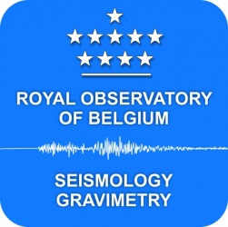
Repeated gravity measurements across the Rhenish massif
Michel Van Camp
Klaus-G. Hinzen, T. Camelbeeck, C. Fleischer, S. Castelein, B. Frederick, C. Caudron

Slide 2
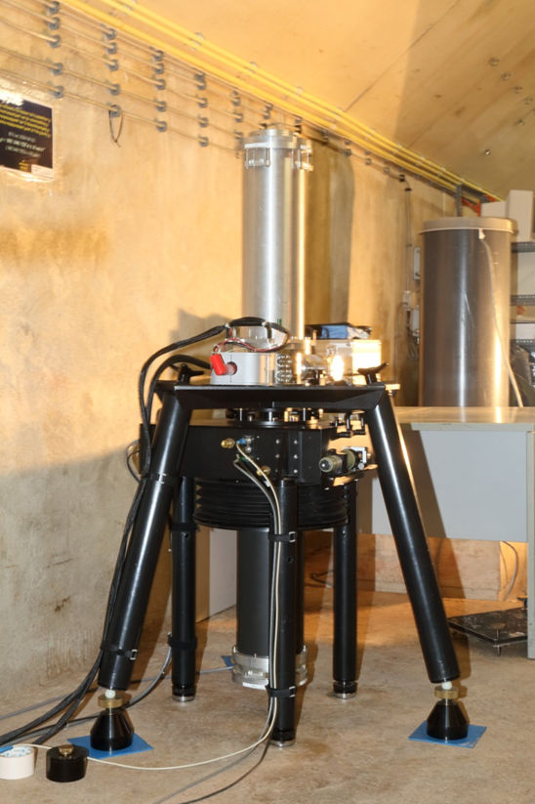
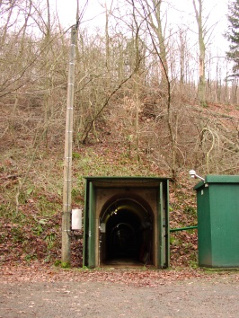
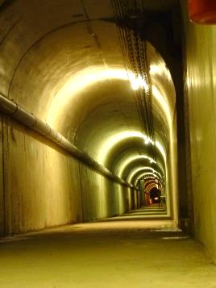
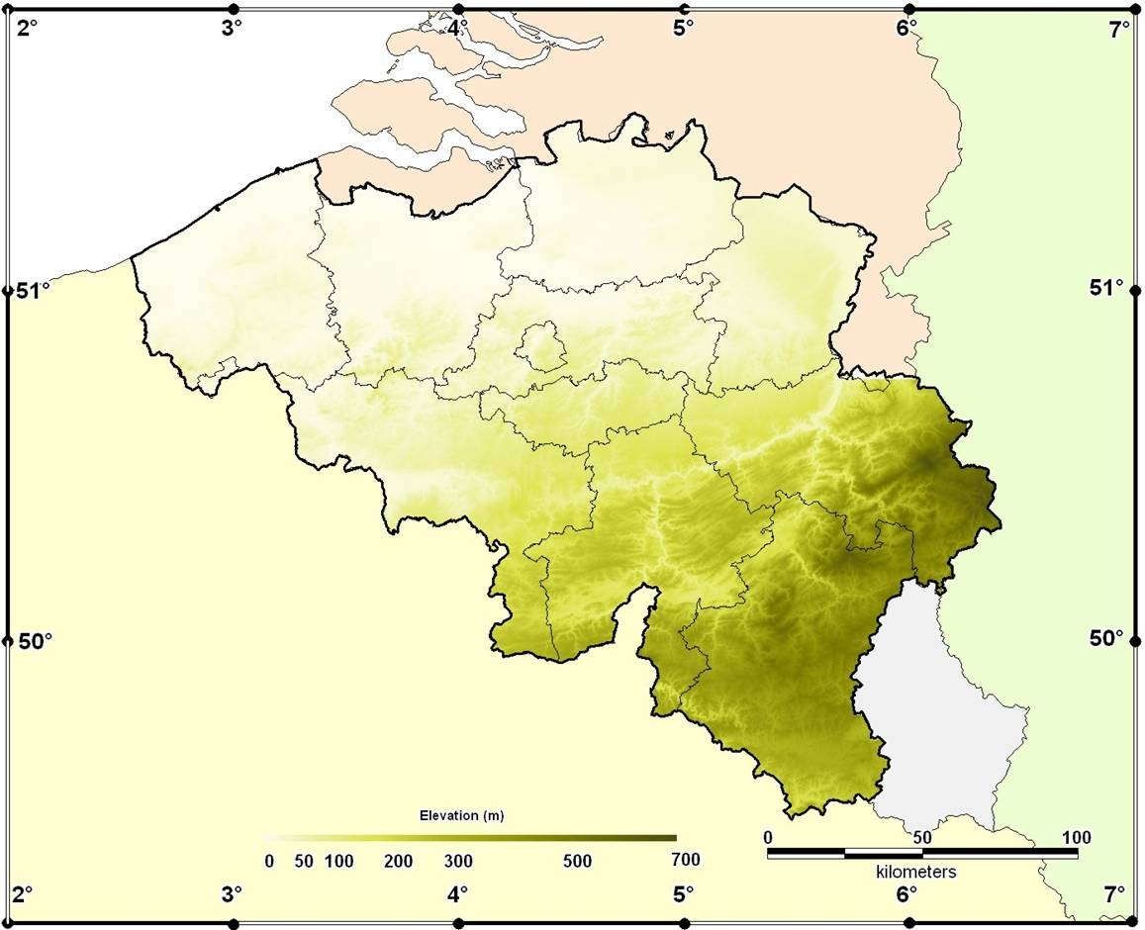
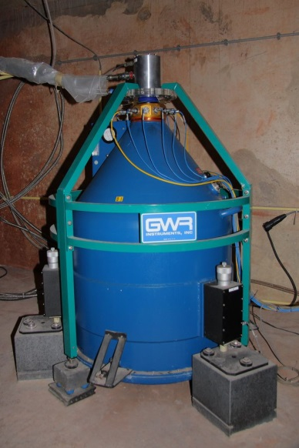
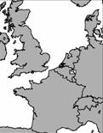
The Membach station
140 m long tunnel
Absolute gravimeter: 1/month since 1996
Superconducting gravimeter:
Continuously since 1995
g

Slide 3
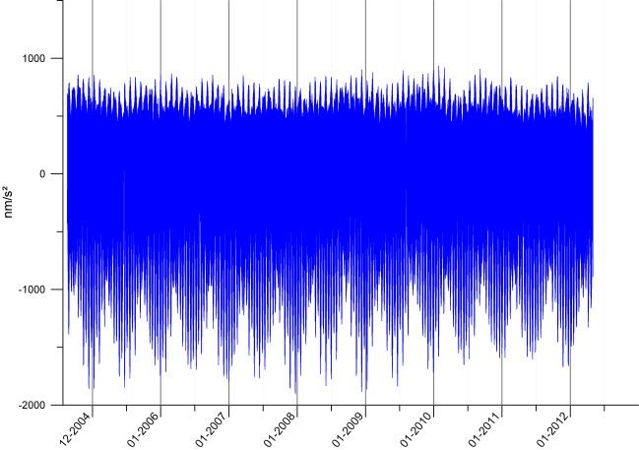
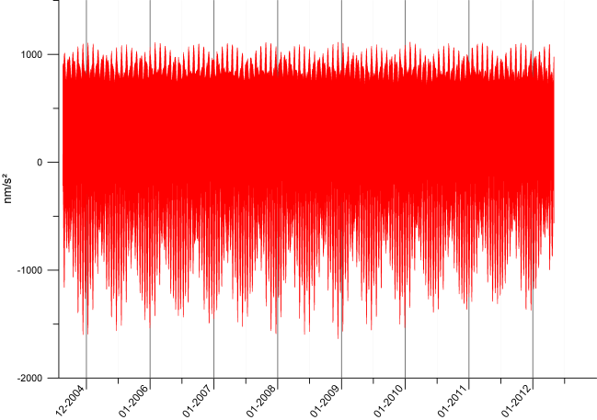
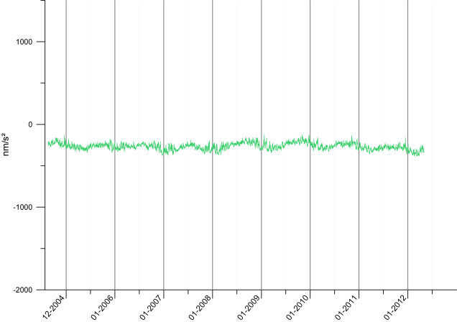
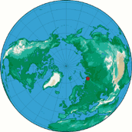
Gravity time series 2004-2012
1000 nm/s²
or 10⁻⁷ g
1 yr
Observed signal
Modeled tide
After correcting for Earth tide
X10 ➔

Slide 4
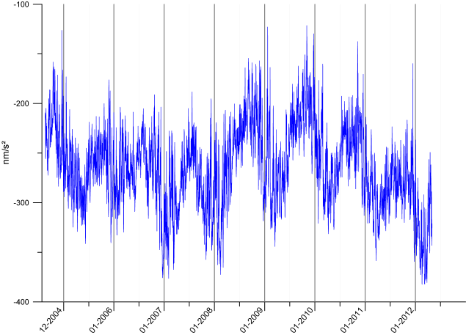
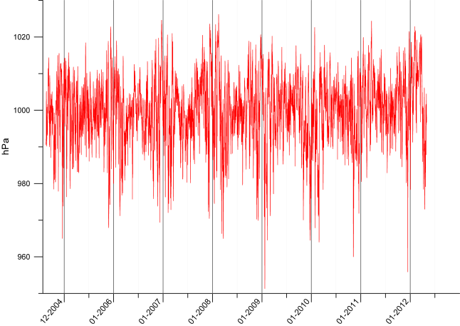
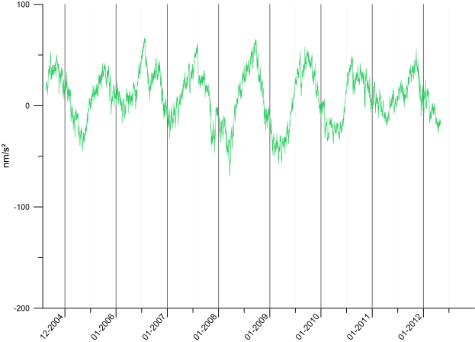
Gravity time series 2004-2012
100 nm/s²
or 10⁻⁸ g
1 yr
Atmospheric pressure
Soupehe.com
Newtonian :
-4 nm/s²/hPa
After correcting for tide and pressure
Loading : +1 nm/s²/hPa
X2.5 ➔

Slide 5
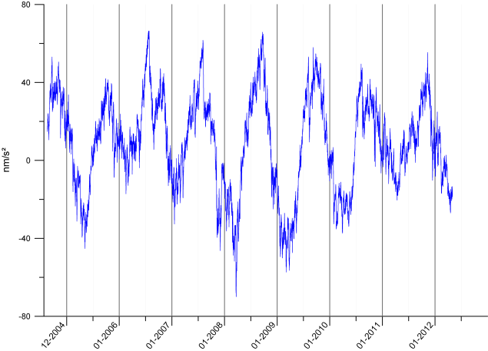
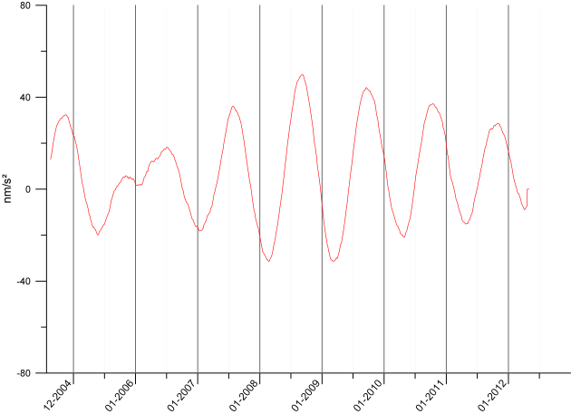
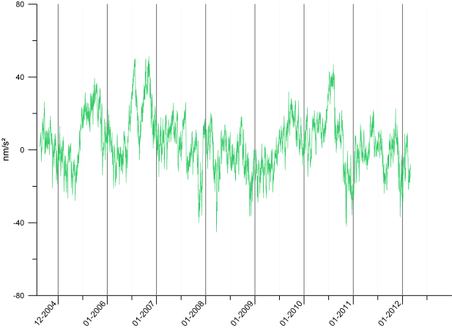
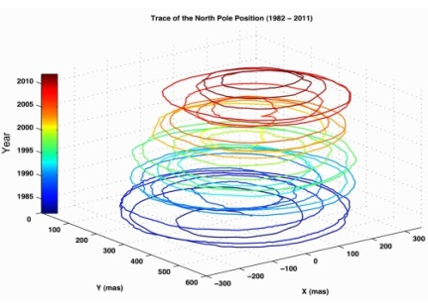
Gravity time series 2004-2012
Polar motion
1 yr
40 nm/s² or 4 10⁻⁹ g
Observed signal
-tide
-pressure
After correcting for tide, pressure, pole
0.1 arcsec = 3 m
From Chen et al., GRL 2013

Slide 6
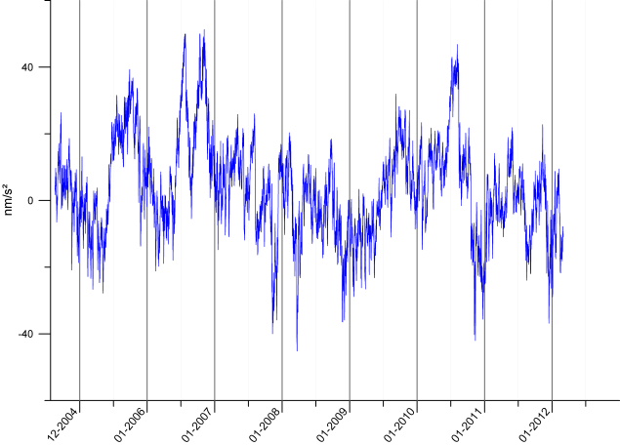
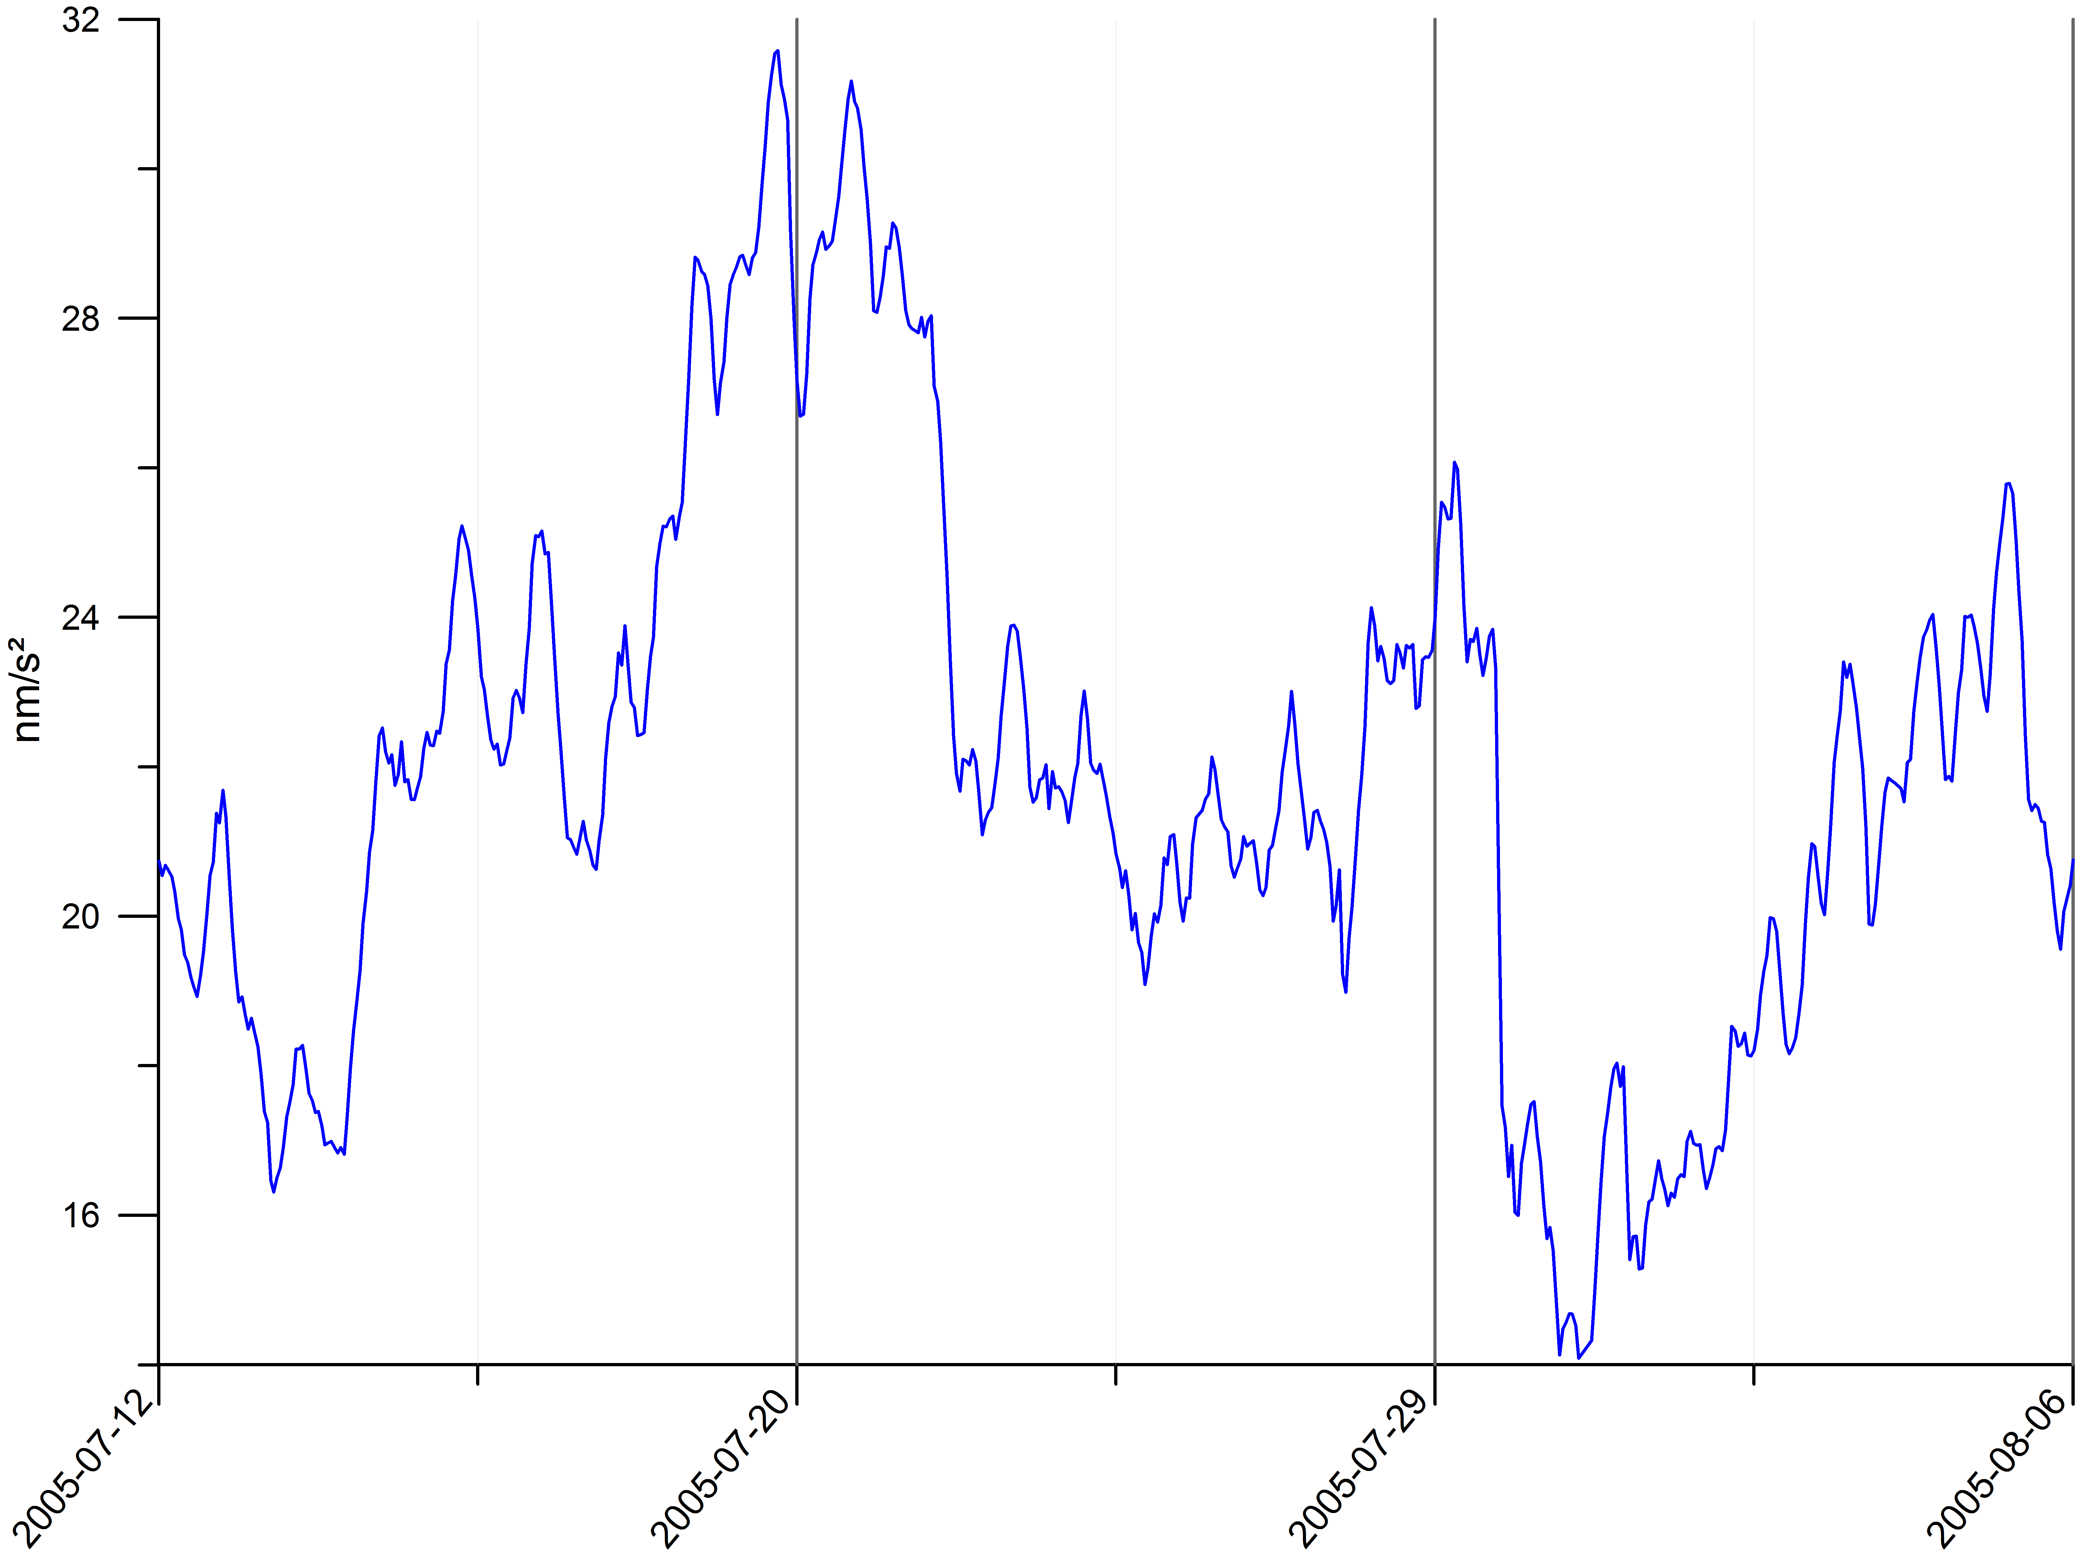
Hydrological effects on g
X 10
4 nm/s²
⬄
4 10⁻¹⁰ g
4 nm/s²
or 4 10⁻¹⁰ g
4 10⁻⁹ g
1 yr
9 days
Seasonal variations !
( g lower during winter because more water is above the gravimeter )
We work at a few 10⁻¹¹ g level

Slide 7
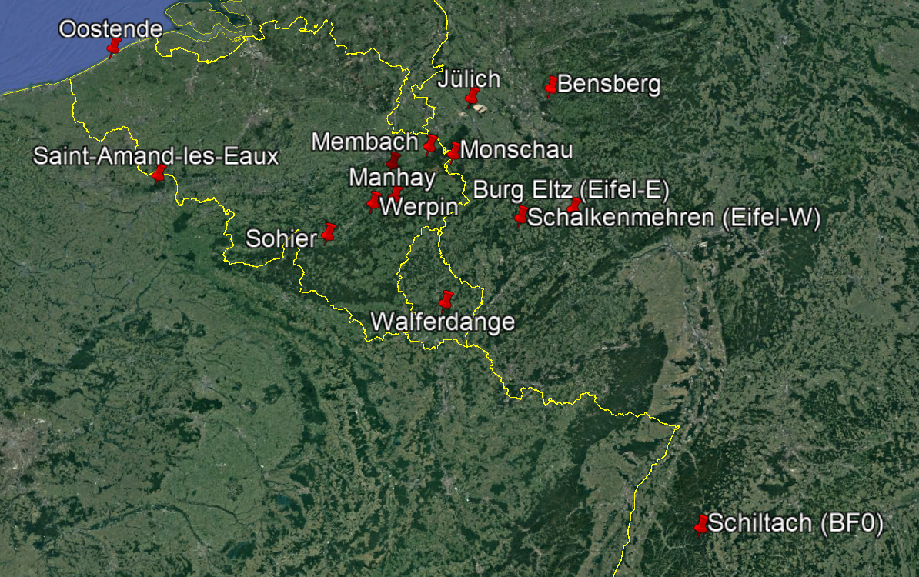
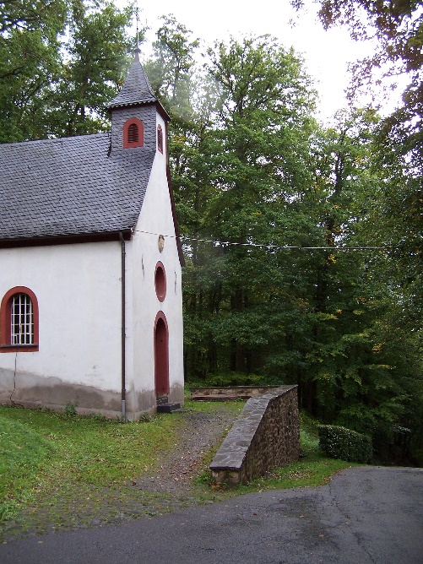
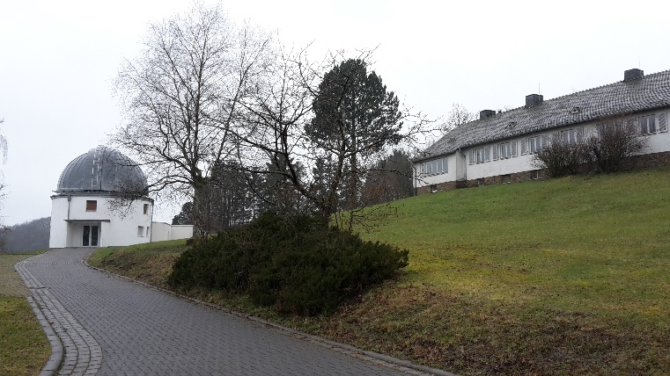
Repeated gravity measurements
since 1996
Burg Eltz
Schalkenmehren
Possible land vertical movements:
between 0 and +1 mm/yr (+/- 0.5 mm @2σ )

Slide 8
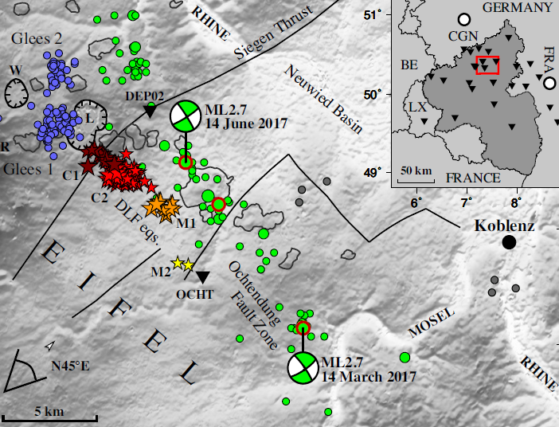
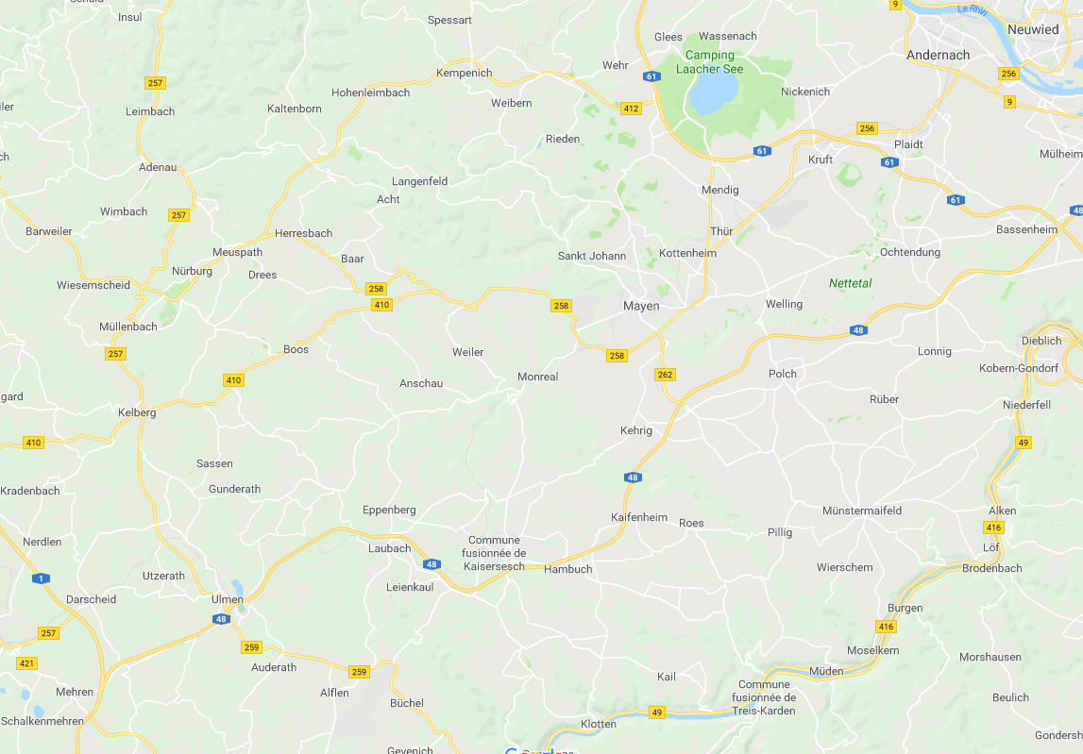
AG measurements in Eifel
Kruft (Bahnerhof)
Hensch et al., 2019
Burg Eltz
Schalkenmehren
Notes:
steamdriven=: hydrothermal or phreatic

Slide 9
Why measuring gravity rates of change?
➔ upper limit on elusive vertical land motion in slowly deforming, intraplate areas (Van Camp et al., JGR 2011)

Slide 10
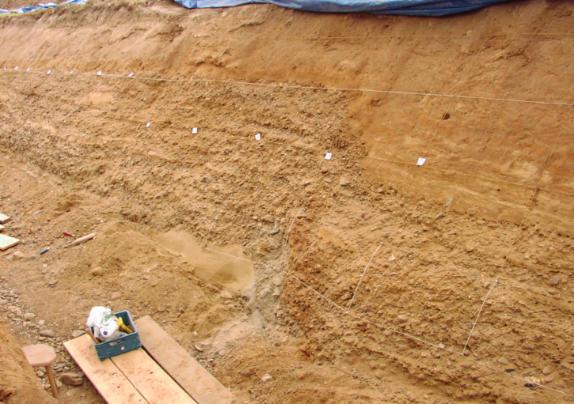
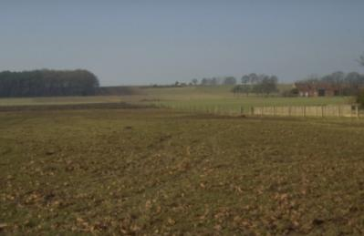
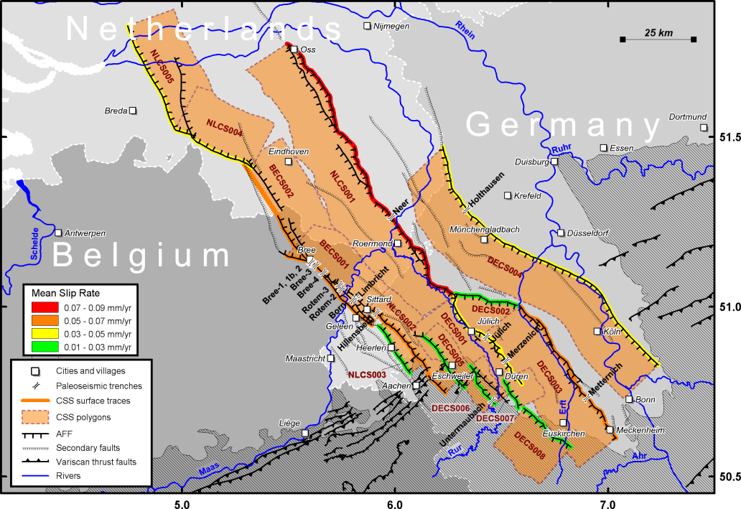
Deformation rate and seismicity
(Lower Rhine Embayment)
Paleoseismology,
Geology,
Seismicity
→ Total Moment~1-2 10¹⁶ N.m/yr
350 km of active faults, max. 0.1 mm/yr during
late Pleistocene (<130 000 year)
Very difficult to measure
(hopeless?)
Coseismic displacement
~ 80 cm ⬄Mw ~ 6.5
30 m
within 300,000 yr
Vanneste et al., BSSA 2013

Slide 11
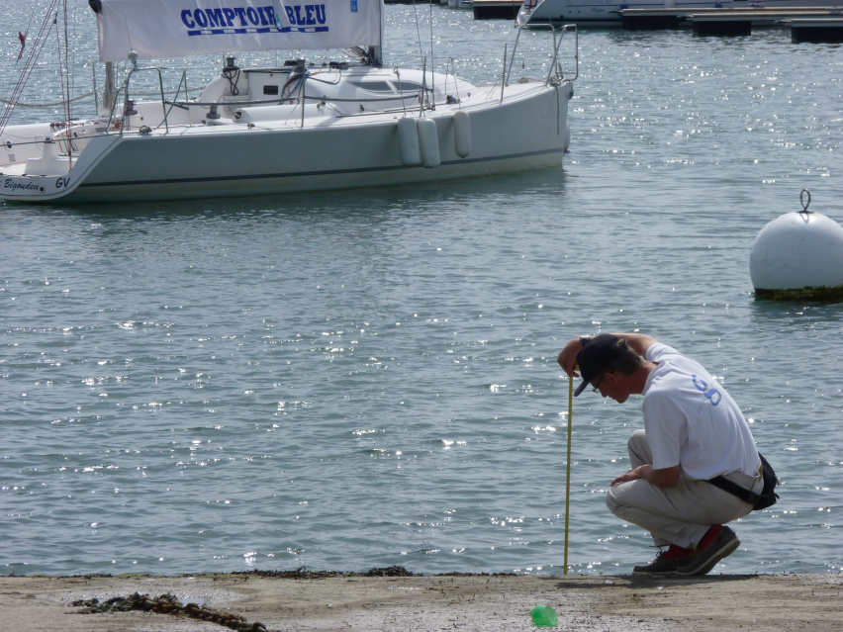
Uplift or subsidence?
Very important for mean sea level assessment at the coast
➔Ostend [BE] or low-lying countries : Saint-Amand-les-Eaux [FR]
??
?
?
Sea rises… or land moves down?

Slide 12
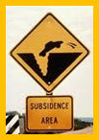
Repeated AG measurements:
6 years
0 to -2 [±1 nm/s² (2 σ)]
⬄ 0 to1 mm/yr (>15 years)
Notes:
Sohier: one in 09/2003 and one in 09/2010?!?!

Slide 13
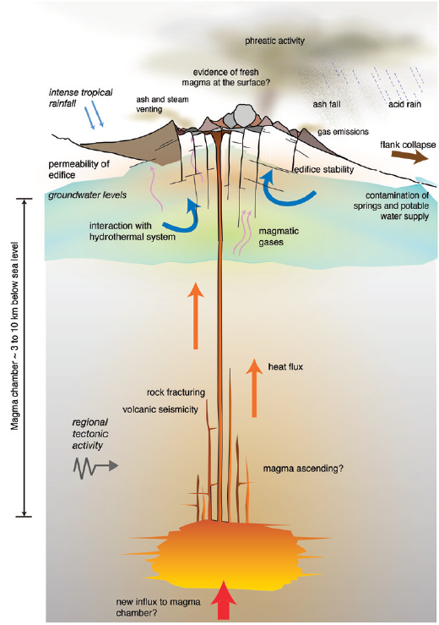
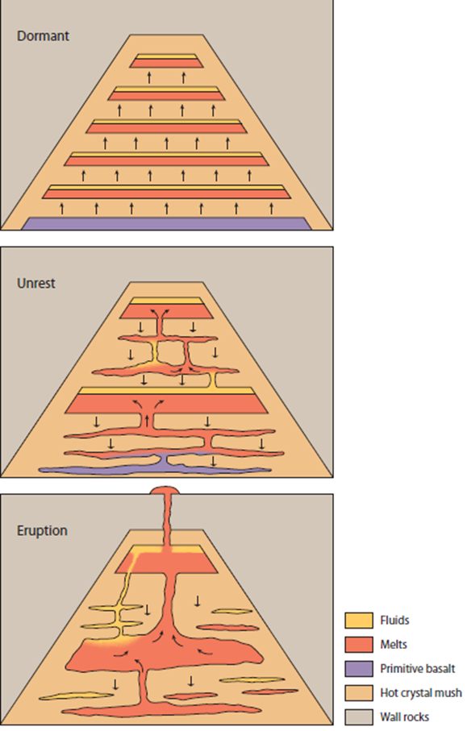
Volcanology
How magma and associated fluids decouple, move through the crust?
Where are the magma bodies?
Storage at shallow depth?
Huge variety of possible eruption types and signature!
Role of water
Gravity monitors shallow and deep processes before other precursors
Sparks & Cashman, Elements, 2017
Notes:
steamdriven=: hydrothermal or phreatic

Slide 14
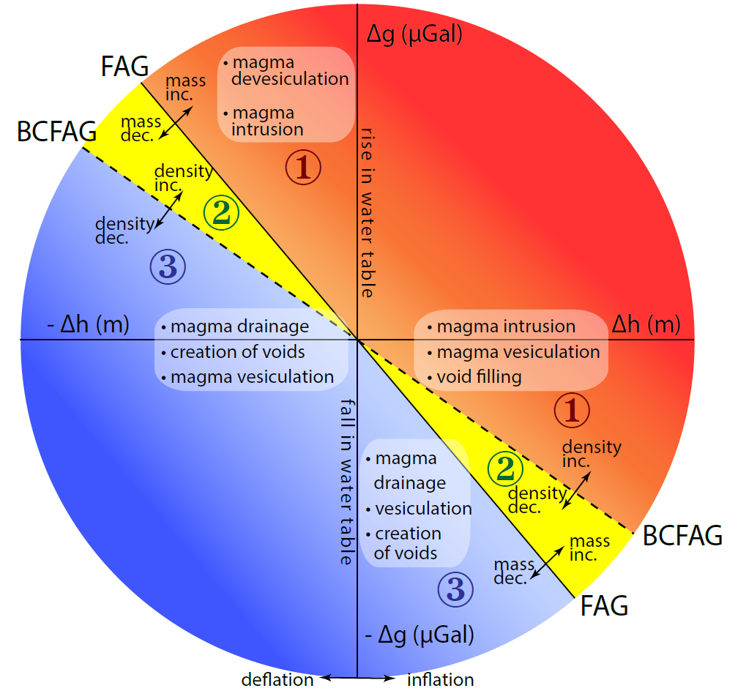
Volcanology: Δh vs. Δg
FAG: Free Air : ~-3 nm/s²/mm
BCFAG: Bouguer: ~-2 nm/s²/mm
Allows interpret change in g with expansion, deflation
Discriminating between movements of magma, water or gas; how they decouple
Intrusion of magma without deformation
Monitoring aquifers ➔ “wet” volcanoes and stream-driven eruptions
Modified from Williams-Jones & Rymer (2002)
Local hydrogeological effects
Notes:
steamdriven=: hydrothermal or phreatic

Slide 15
Volcanology: Δh vs. Δg
Mass decreases, density increases:
Subsidence caused by migration of water out of the aquifers
Subsidence with anomalously large increase in g: gas losses, magma intrusion, rise in water table
Mass and volume increase: density decrease ➔
Buildup of gas pressure ➔ precursor
Notes:
steamdriven=: hydrothermal or phreatic
Gravity decrease, with subsidence: due to formation of void (Miyakejima volc)

