Slide 1
LYRA/EPT Perturbations Project
Thanassis Katsiyannis
Marie Dominique
et al.

Slide 2
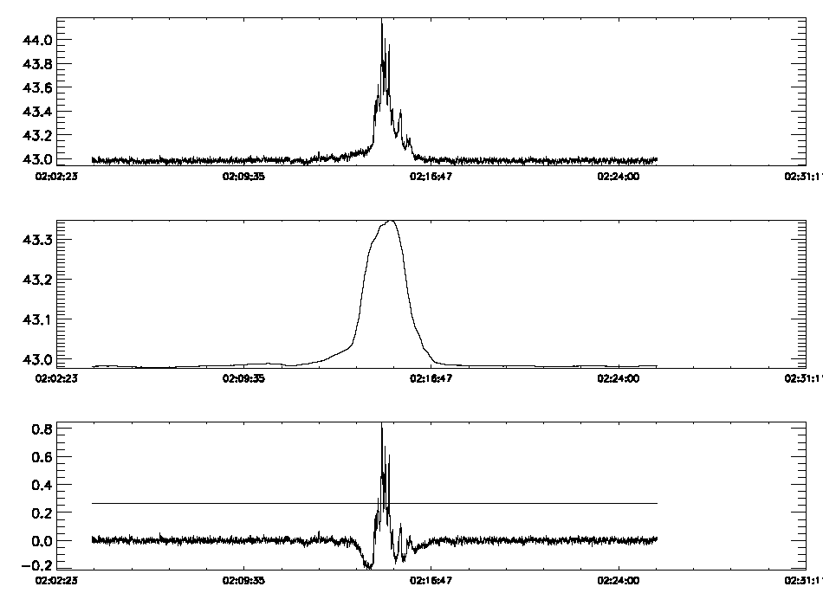
Detection Algorithm

Slide 3
Likelihood of detection VS Geomagnetic disturbance

Slide 4
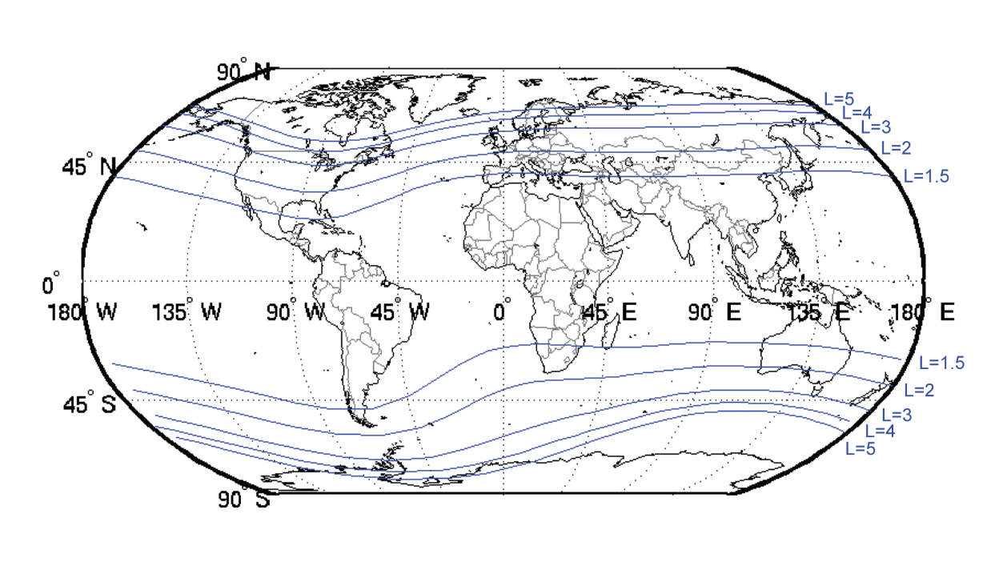
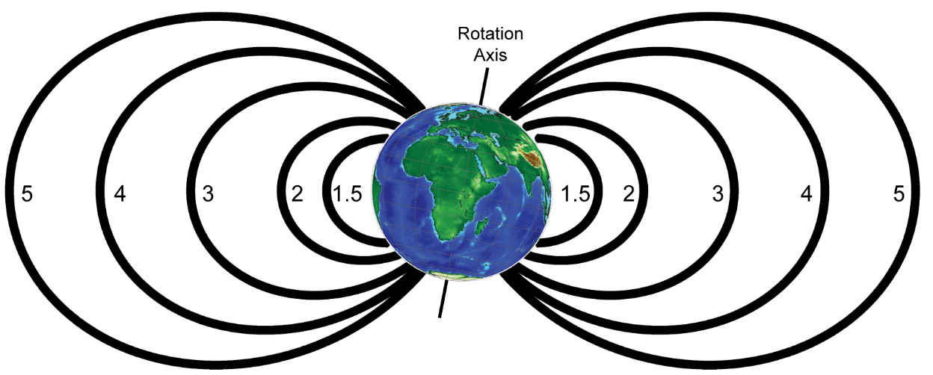
McIlwain L-Shells

Slide 5
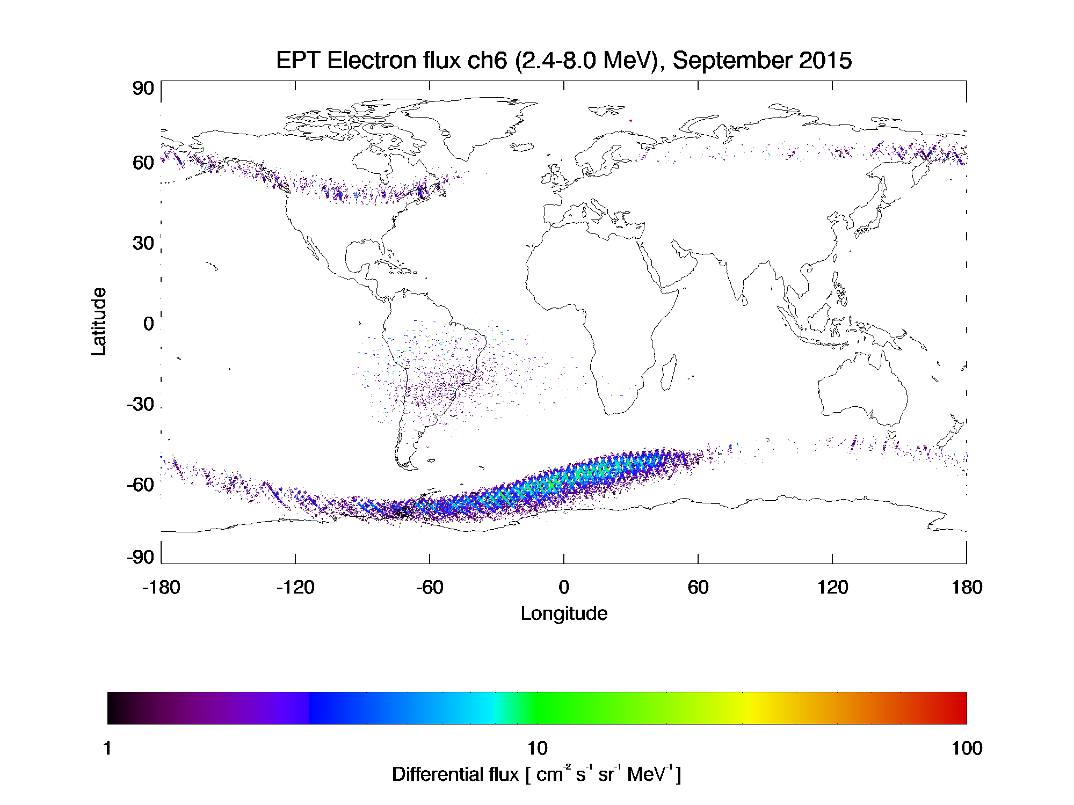
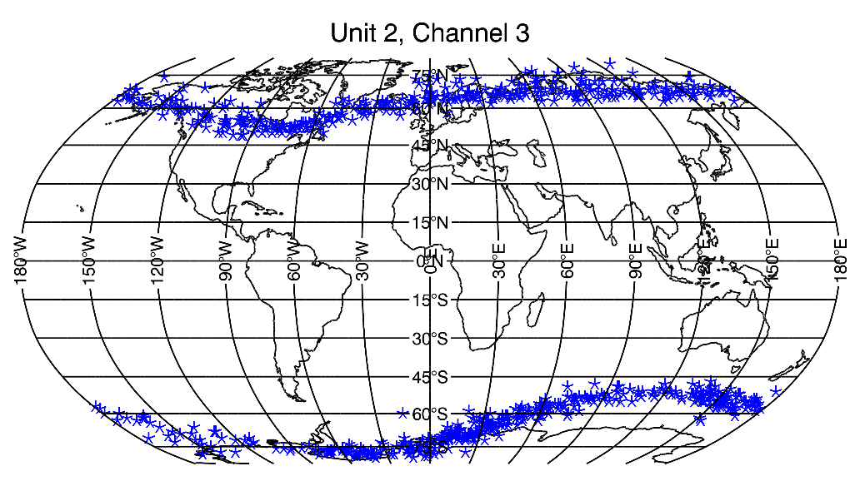
Detection Maps for LYRA and EPT

Slide 6
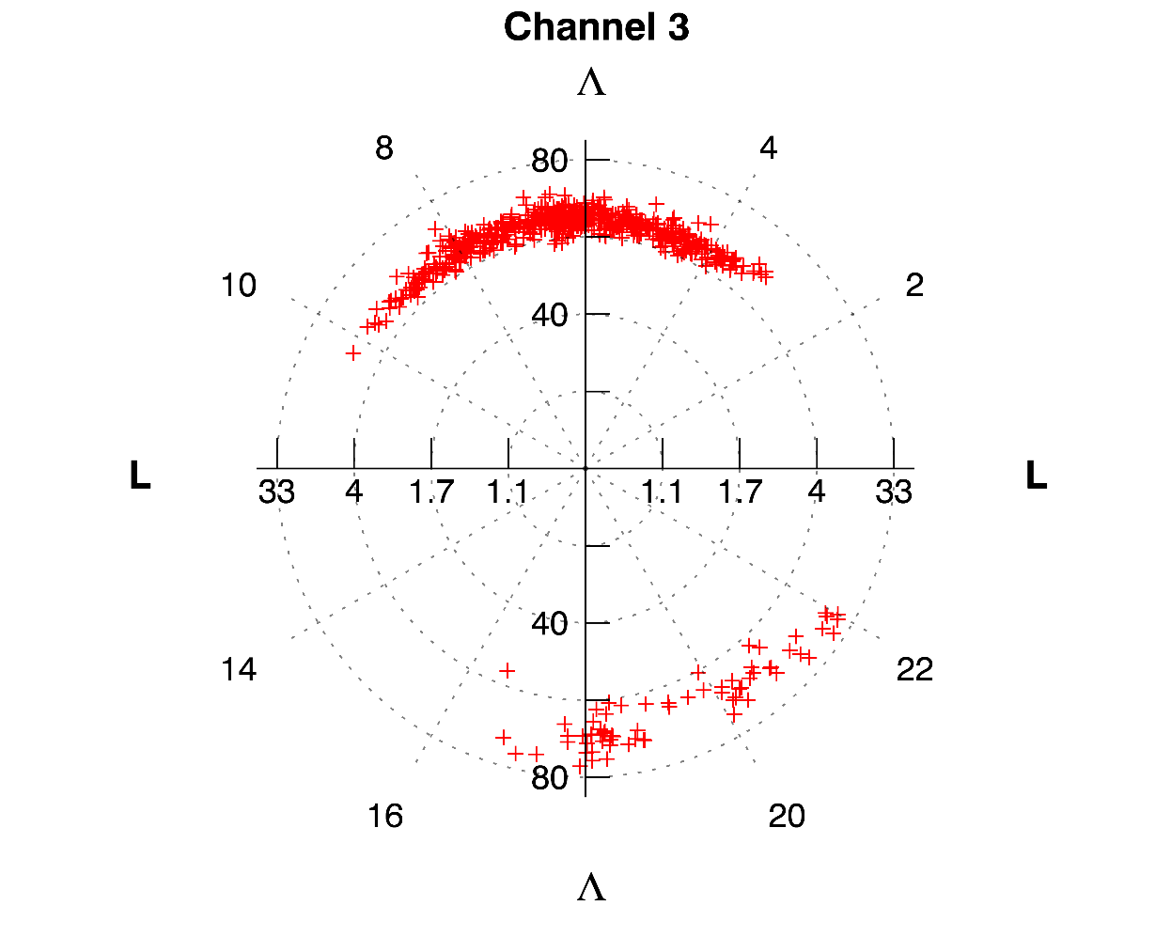
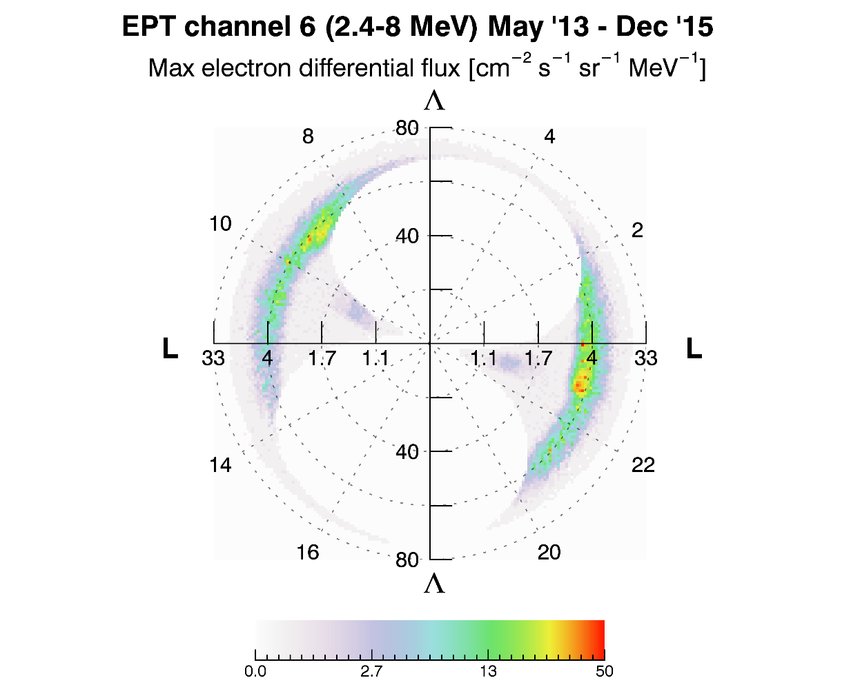
Differences between LYRA and EPT detections

Slide 7
LYRA as in-situ electron detector
Although not designed as such, LYRA is clearly capable of detecting highly relativistic electrons in situ
Whereas the electrons of the same energies can be detected by other instruments, LYRA has the highest cadence
Even if LYRA had no advantage on the observation of electrons, being able to detect in situ particles in an additional orbit is very useful
Radiometers with thin metal filters will never replace dedicated in-situ instruments, but they are a cost effective way to complement them
Notes:
Other instruments: EPT, Van Allen Probes (RBSP), SAMPLEX, POES

Slide 8
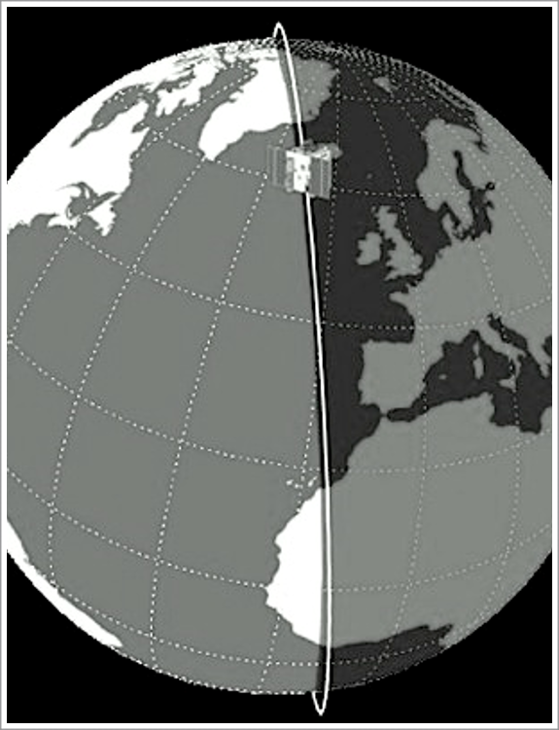
The PROBA-2 orbit
Heliosynchronous
Polar
Dawn-Dusk
750 km altitude
100 min duration

Slide 9
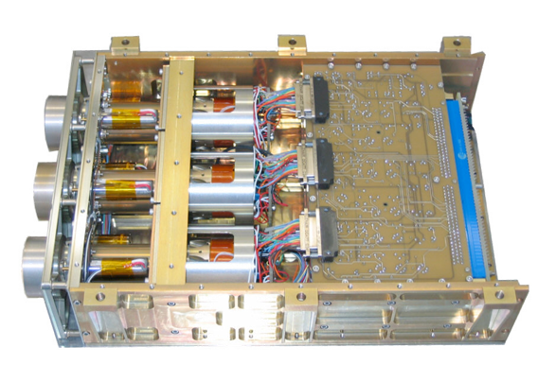
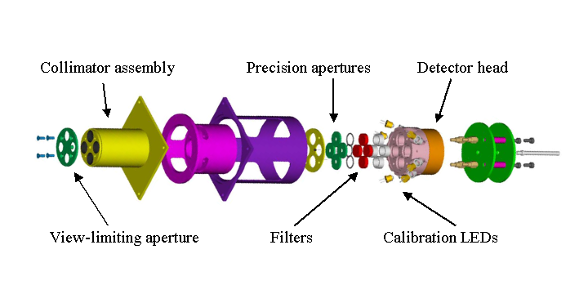
The LYRA instrument
 | Ly | Hz | Al | Zr
 | 120-123 nm | 190-222 nm | 17-80 nm + <5nm | 6-20 nm + <2nm
Unit1 | MSM - diamond | PIN- diamond | MSM- diamond | P-N Silicon
Unit2 | MSM- diamond | PIN- diamond | MSM- diamond | MSM- diamond
Unit3 | P-N Silicon | PIN- diamond | P-N Silicon | P-N Silicon

