Slide 1
How to BEST (BETTER) concatenate Sunspot series ?
L. Lefèvre
F. Clette

Slide 2
The ADF METHOD
Active Day Fraction

Slide 3
ADF method: pros and cons
Not dependent on actual time overlap.
Takes observational parameters into account (limit of size an observer can see).
Does take into account the quality of the input data of observers in a general statistical way (no months nobs<3)
However, there is a bias not in the number of observations but in the window : tendency to observe mainly when the Sun is active. (EXAMPLE Wolf, and others)
Does not take into account group splitting effect (should be quantified at least to justify such a lack).
Method fits observers ADF between 0.1 and 0.8 (Misses ALL the high regime sunspot data between 0.8 and 1 – see figures later).
Sensitivity to calibration interval

Slide 4
ADF method
Observational coverage : serious bias towards active days
If you look at the distribution of ADF versus number of groups or Sunspot Number, you can easily see that more than 50% of the distribution is between 0.8 and 1 and that ALL the maxima of the Sunspot Number are above 0.9
Problems with the range of the reference dataset: obs except Quimby and Wolfer are calibrated with 1900-1976, but if you try and calibrate Wolfer and Quimby with the same… it does not work. The whole CDF range (y axis) varies.
Notes:
Although it might not look like it, I am NOT trying to destroy the ADF method, it is actually a very good idea. I am trying to improve it so that we can use it correctly. So, now, let’s take a closer look at some of the issues I raised.
Problems with the CDF: computed with N(ADF)/N(obs) while N(ADF) does not take into account months with 3 observations or less, N(obs) does take it into account. This changes the level of the CDF. (I’m not sure if CDF is computed with Nmonth(ADF in range)/n obs or nanaluzed (w/o the nobs< 3).

Slide 5
Nobs versus Nactive : Wolf
Notes:
Here we can clearly see that the input data to the method is also imperfect. Clearly here, Wolf observes when the Sun is active at the beginning of the dataset.
In addition to that the upper graph, showing how many days are observed by an observer each month clearly show how biased a human observer can be and it is doubtful that a algorithm choosing randomly 1-f days of not observing will reproduce this bias. Because, in fact, as it is random, it does not affect too much the distribution between active and non active days, while the observer’s bias DOES affect the distribution.

Slide 6
Nobs versus Nactive : Schmidt
Notes:
Here we can clearly see that the input data to the method is also imperfect.

Slide 7
Nobs versus Nactive : Schwabe
Notes:
Here we can clearly see that the input data to the method is also imperfect.

Slide 8
Nobs versus Nactive : Wolfer
Notes:
An example of a good observer.

Slide 9
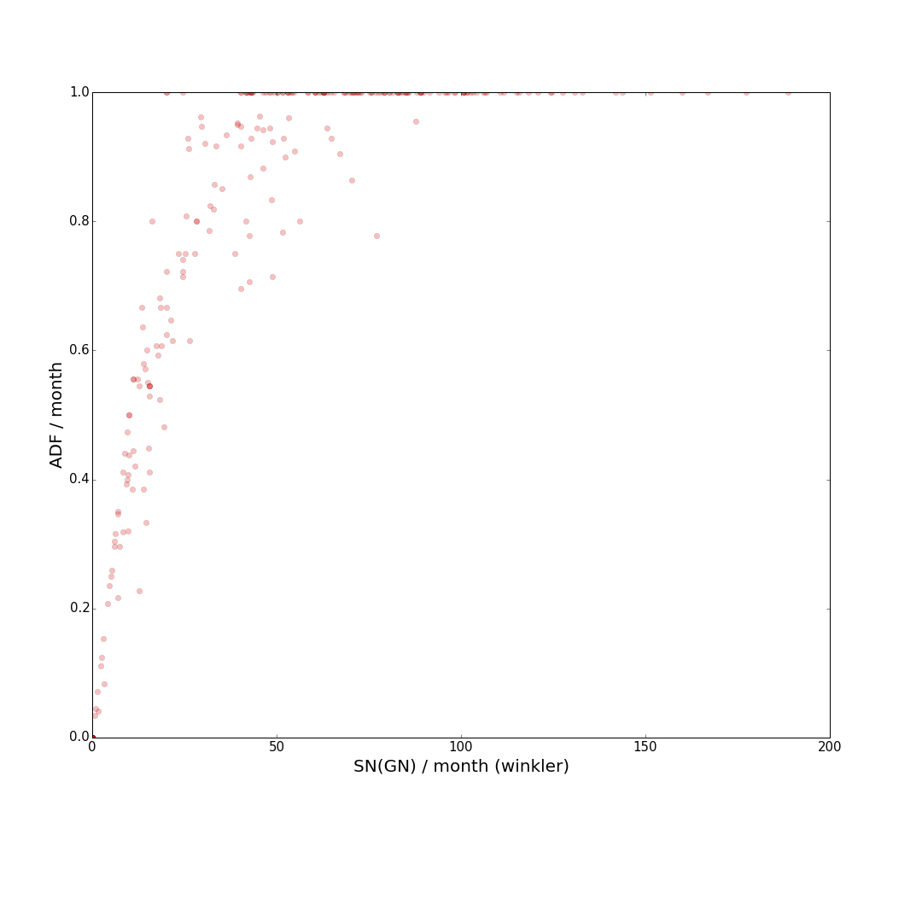
ADF versus activity regime (SN)
How can we determine relations between observers at maxima ?
Wolfer
Winkler

Slide 10
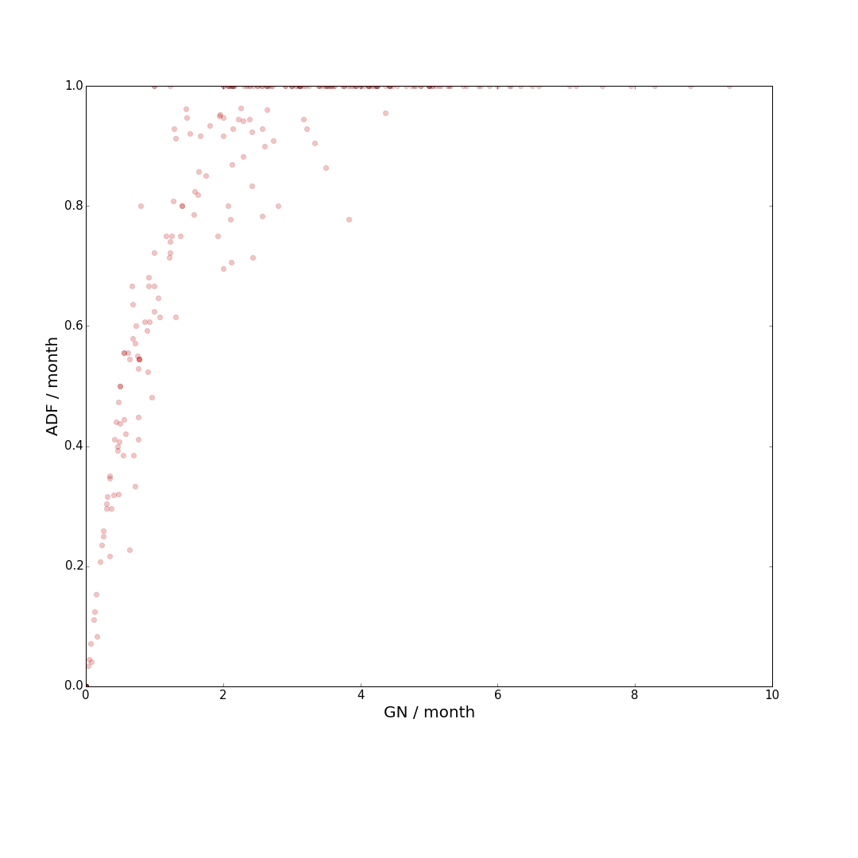
ADF versus activity regime (GN)
How can we determine relations between observers at maxima ?
Wolfer
Winkler

Slide 11
Example

Slide 12
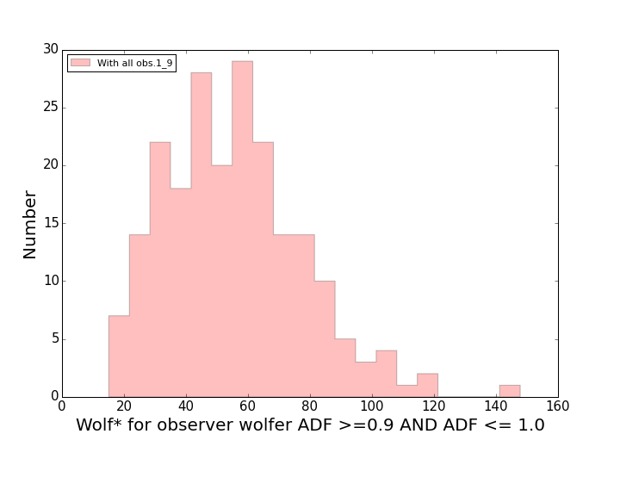
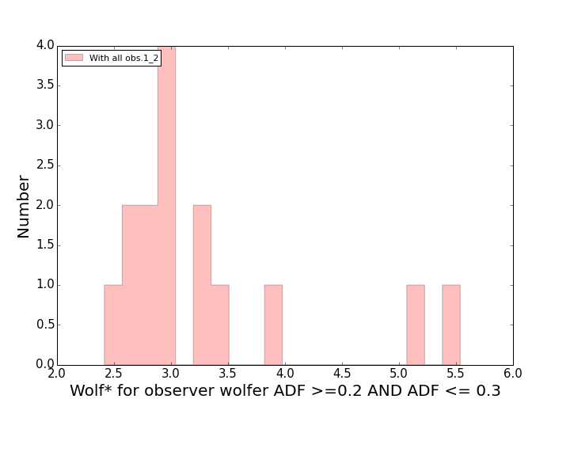
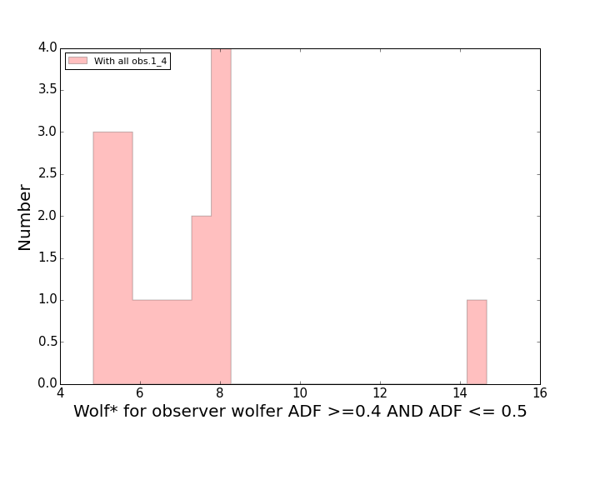
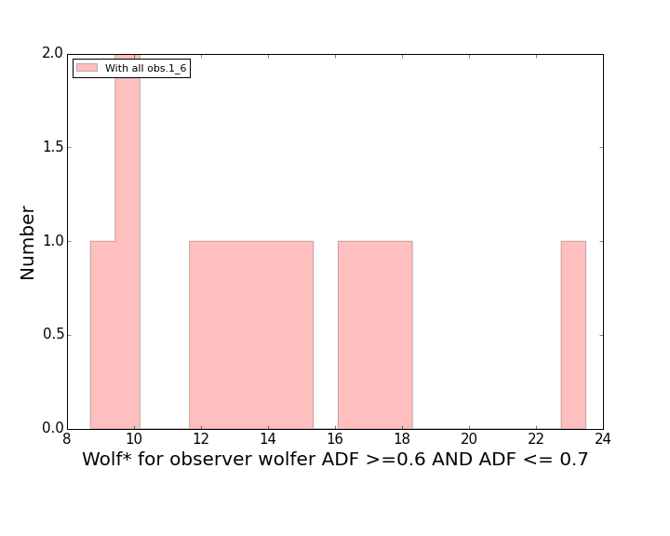
Cut histograms

Slide 13
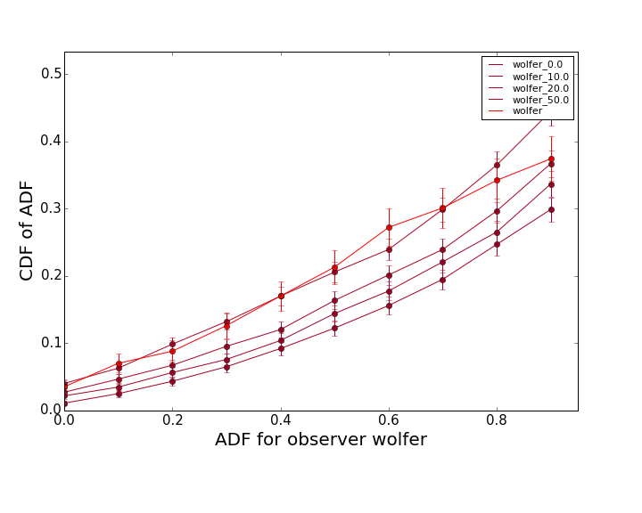
Importance of the calibration period
Wolfer is supposed to have a threshold of 6(0-12).
Calibration period : 1900-1976
Calibration period : 1900-1928

Slide 14
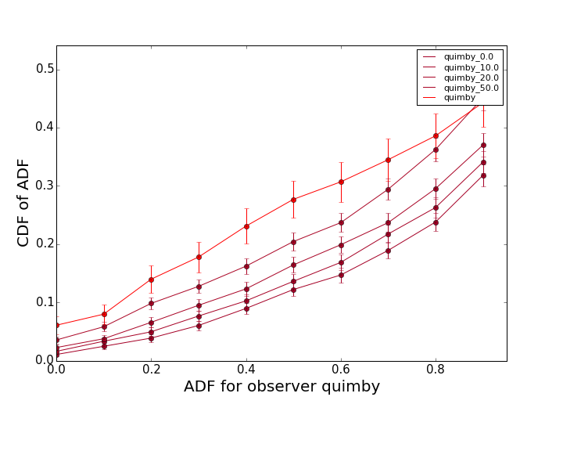
Importance of the calibration period
Quimby is supposed to have a threshold of 22(16-28).
Calibration period : 1900-1976
Calibration period : 1900-1921

Slide 15
Importance of the Calibration period
1900-1976: 45(36-53)
Notes:
For all observers except Quimby and Wolfer, that are calibrated on overlapping periods, the usual method is consistent with the values indicated by Usoskin et al. (2016). For Quimby and Wolfer it works perfectly with the reduced time intervals. However, it is clear that when you take the full period for these observers the results are not reproduced. This is due to the fact that each cycle is different and does not contain the same fraction of “low activity days” (0.1-0.4) and higher activity days (0.6-0.9-1)….Taking full cycles is not enough to avoid the bias introduced.
In the two previous slides you can see that the calibration curves (RGO with Ss=0,10,20, 50, f=1) are displaced in the Y-axis if you do not take the same time period. This is due to this difference in fraction of “different regime days” between the different time periods used for calibration.

Slide 16
THE BACKBONE METHOD

Slide 17
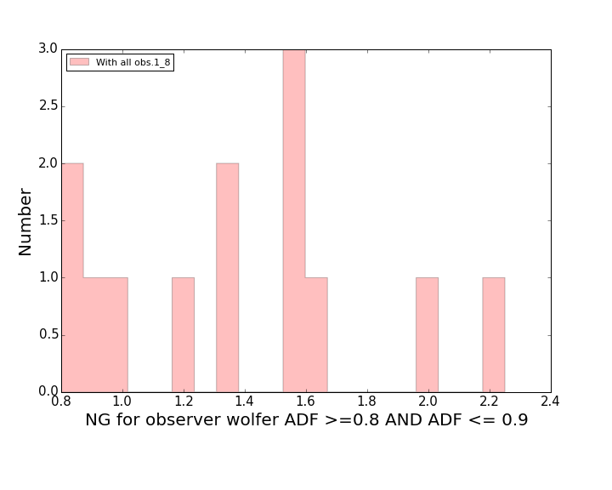
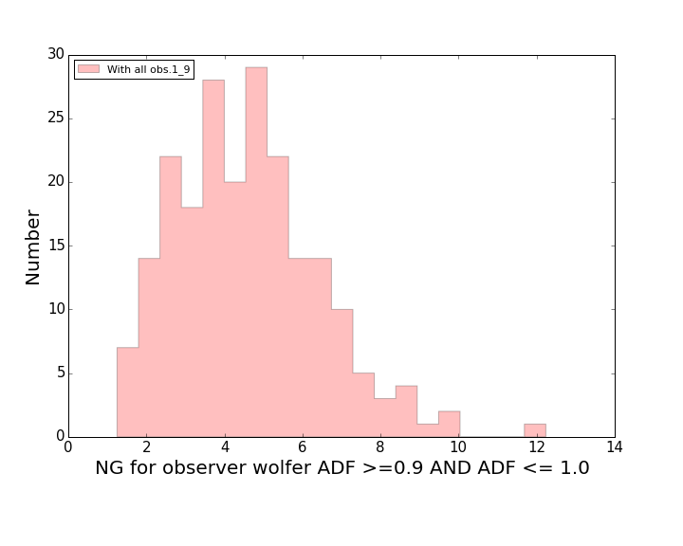
ADF versus activity regime (GN)
Relations at maxima not well defined
Wolfer

Slide 18
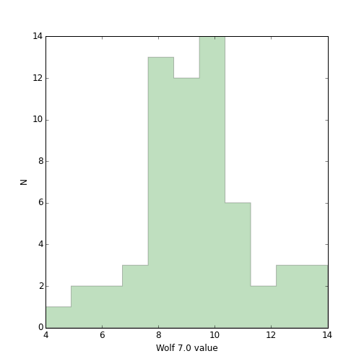
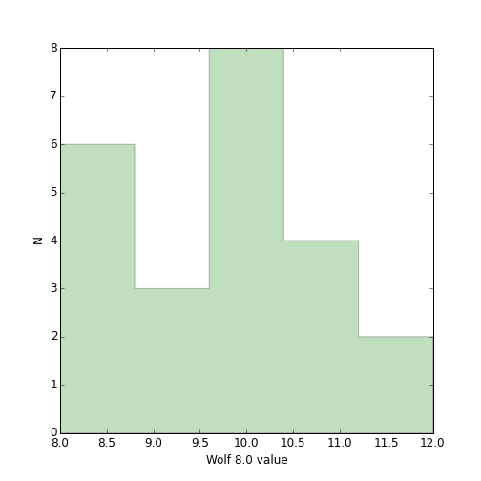
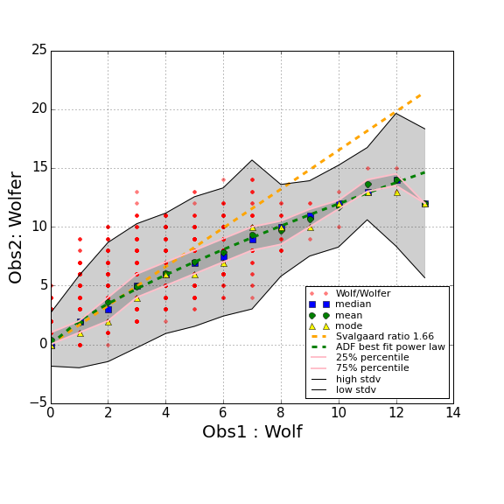
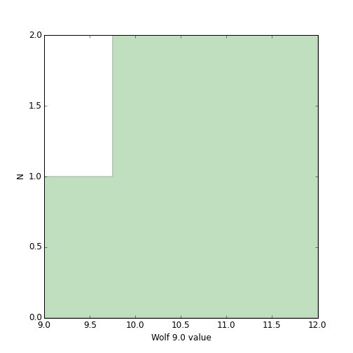
SS Versus ADF
Comparison of ADF versus Svalgaard backbone method. Differences between maxima.

Slide 20
Conclusions?

Slide 21
As already mentioned several times, using yearly averages to compare datasets is not the best idea.
It is probably best to work on daily data and only compute monthly and yearly averages ONCE the studies have been made on daily data.
However, data are never perfect, and techniques must adapt to the quality of the observations.

Slide 22
Is a mixed method possible ?
Adaptative k factor, depending on the regime of activity and also, we need to take care of the evolution of the relation (whatever it is) with time.

