Slide 1

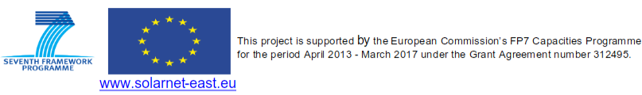
The SOLARNET Solar Virtual Observatory
Presenter: R. Vansintjan
Authors: B. Mampaey, V. Delouille, D. Berghmans
From the Royal Observatory of Belgium
Notes:
My talk will be about the SOLARNET Solar Virtual Observatory prototype developed in the SOLARNET project at ROB

Slide 2
Introduction
Part 1: I’ll give an overview of the SVO and its web interface
  The SVO allows for searches across datasets, searches on solar events, etc…
  The SVO is designed to increase awareness for different datasets.
    We feel there is a need for this because of the campaign like nature of ground based observations.
Part 2: The position of ROB in regards to the SOLARNET SVO
  ROB isn’t involved in PRE-EST and any future meeting with SOLARNET partners.
  We would like to take part in follow-ons of SOLARNET.

Slide 3
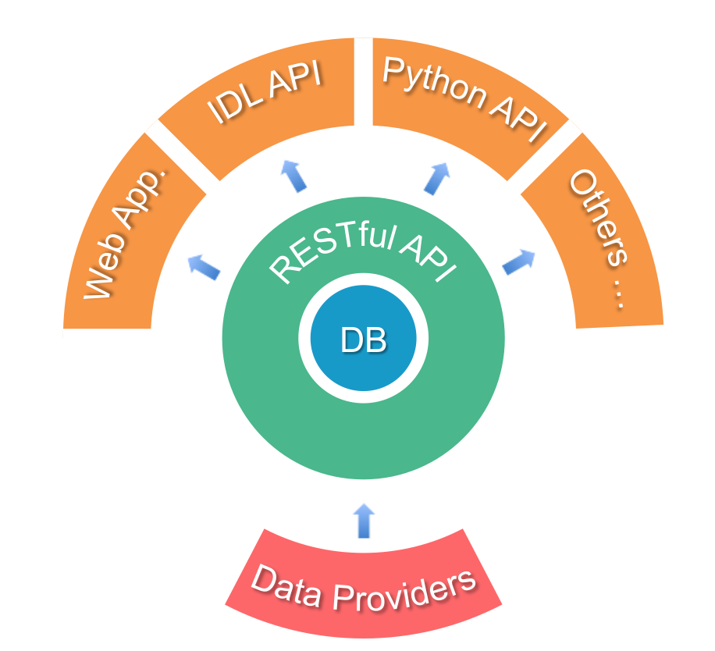
Design of the SVO
Notes:
This is the design of the SVO.
The data will be hosted on the servers of the data providers. We collect the metadata into a central searchable database.
To interface with the database we use the widely used RESTful API so that it’s easy to develop new tools that interface with the API
The SVO is made up out of a web App aimed at user friendliness and an IDL and Python API to make more complex searches and to be used in programs and scripts.

Slide 4
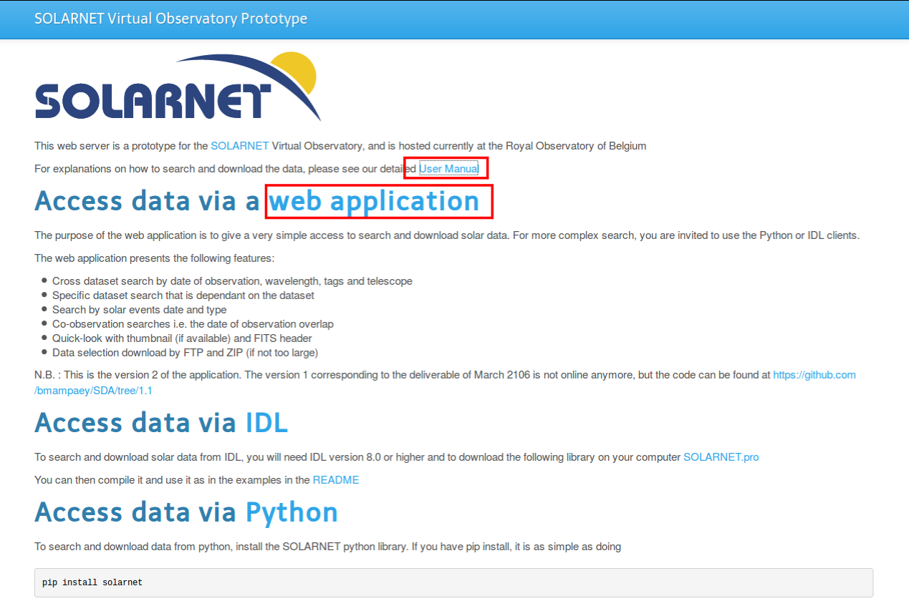
The website: solarnet.oma.be
Notes:
Also show user manual

Slide 5
SVO features overview
Searches across different data sets (date, wavelength, tags)
Dataset specific search interfaces
Quick-look (thumbnail and meta-data)
Search by solar events (event date and type)
Co-observation searches (date of observation overlap)
Data selection download (FTP and ZIP)
US VSO as a data provider (ChroTel, XRT)
We serve data from GRIS, IBIS, ROSA and Themis.
Notes:
By search across data sets the user will become more aware of what is out there.
Tags give the possibility to mark data in a way that is difficult with meta data and by cross referencing event catalogues.
Quick-look is included if the providers provides something
I’ll show the functionality of the SVO with examples from the web app

Slide 6
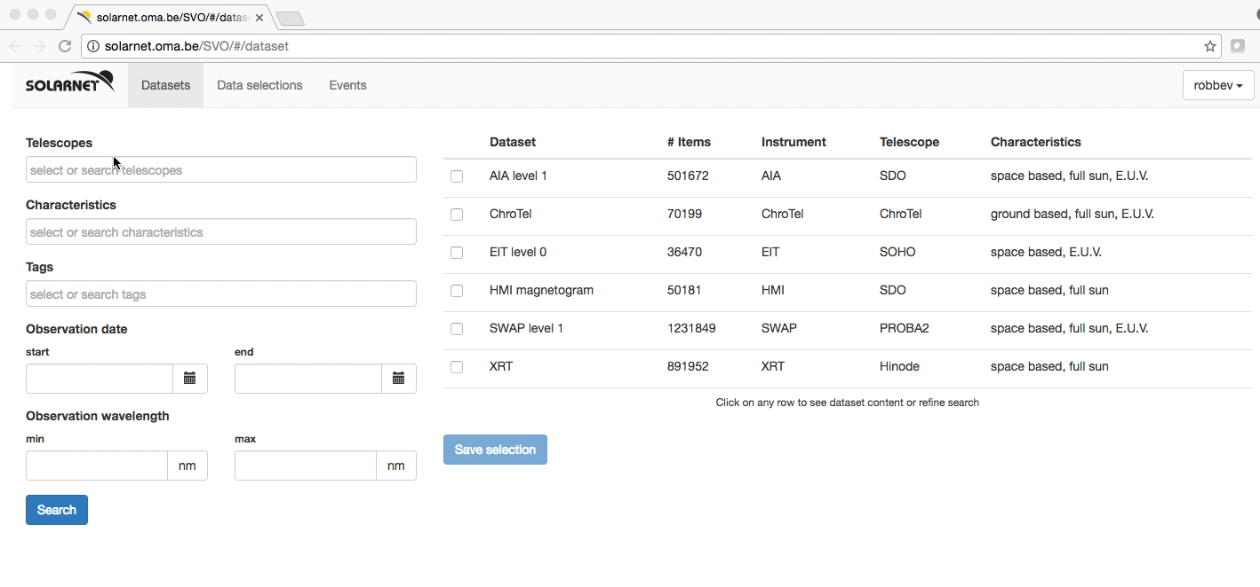
Searching across datasets
Notes:
Here we show the possibilities of searching across datasets.
Selection is possible by telescope (ground based or satellite ) certain characteristics of the data
Tags like a Venus transit or the Halloween event
And date and wavelength

Slide 7
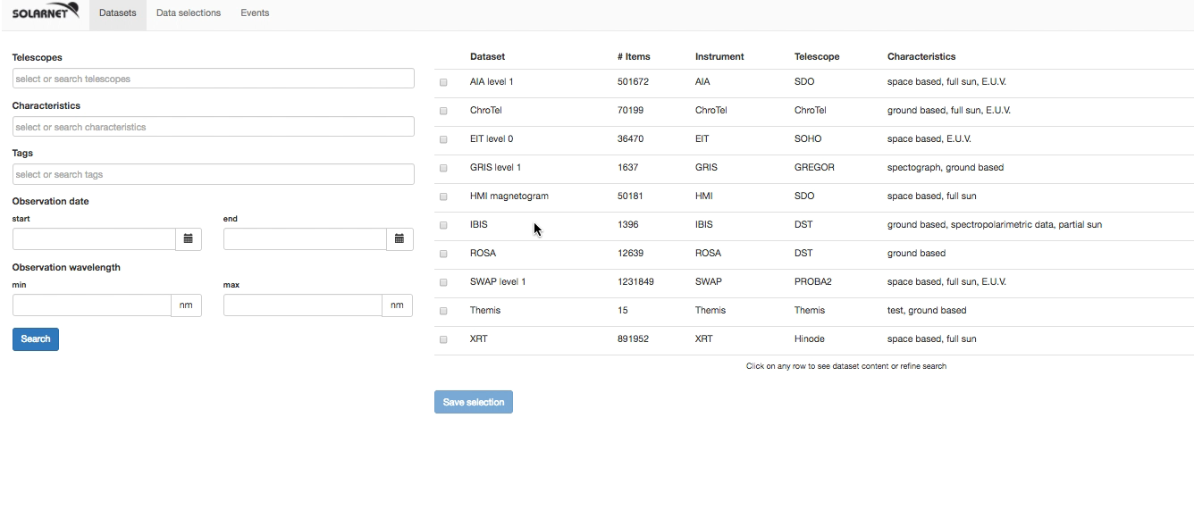
Dataset specific searches and quick-look

Slide 8
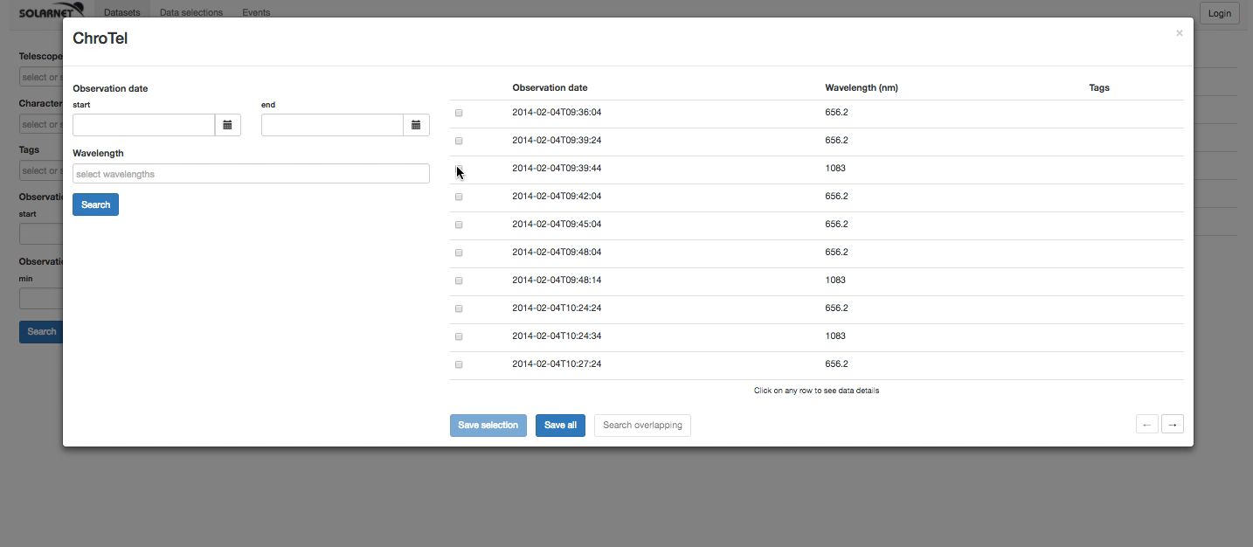
Co-observation searches

Slide 9
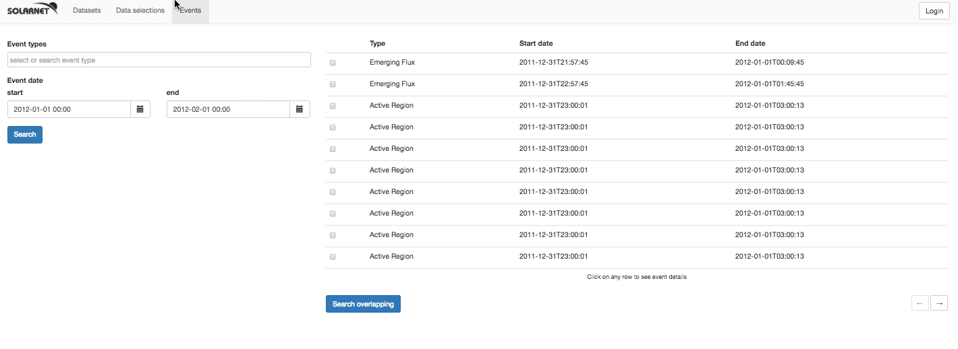
Search by solar events

Slide 10
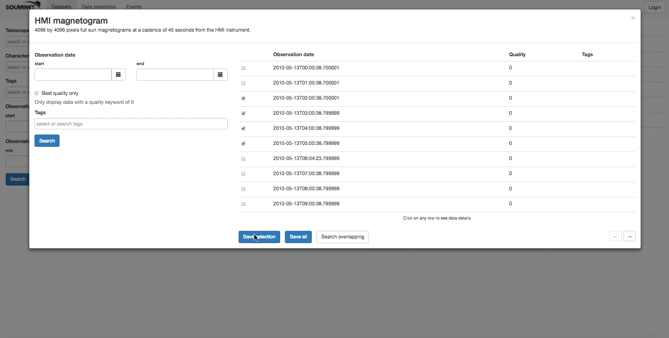
Data selection download

Slide 11
Maintaining the SVO beyond SOLARNET
Certainly: We will maintain the current demo SVO until the end of 2017.
Most probably: We will continue using and expanding the SVO software in line with our internal goals:
  To serve all current ROB/SIDC data from a central point. (USET, SWAP, Humain, etc…)
  To include our new instruments: Solar Orbiter/EUI and PROBA3/ASPIICS
  To focus on space weather applications: coverage more important than resolution, preference for long-term monitoring and full disk.
We would be happy to participate in follow-ons of SOLARNET' (we are not part of PRE-EST consortium).
Notes:
We want to be a data center but focused on full disk.
We can make EST a provider
Make a distinction between meta data archive and data center for small data datasets.
This is useful for PROBA3 and Solar Orbiter

Slide 12
SOLARNET/SVO follow on
We would be happy to provide SVO service in SOLARNET2, but this requires discussion on availability of resources.
Our motivation: High resolution ground based and high resolution from Solar Orbiter should be used together.
Current prototype is not a production tool for massive amounts of data and large user communities. Significant developments is still needed
There is a difference in infrastructure cost between hosting a meta-data archive only and being a data provider.
  Future development of the SVOs back-end is needed to do either.
  We need to look at similar projects to make a clear cost estimate.
Notes:
Sure: Run until the end of the year
Probable: Continue on our own for our own priorities for Solar orbiter and space weather applications (full disk, long term)
Optional: if they wont a service like a data center they should fund it.
- Medium VMWare instance (2 vCPU / 4 GB RAM / 25 Gb HD, mainly for a dedicated operational service): 600€/VM Instance/year
- Large VMWare instance (8 vCPU / 32 GB RAM / 50 Gb HD, mainly for data reduction, visualisation, GUI scientific software, etc...): 1400€/VM Instance/year

Slide 13
Thank you!
Any questions?

